Slide 1
LAMOST DR2中的河外源
沈世银
上海天文台

Slide 2
提纲
LAMOST巡天计划中的星系源
河外源的观测情况（DR2，2013-2014）
河外源的部分科学产出
新的星系对样本
E+A星系
星系团的子结构
类星体

Slide 3
LAMOST河外巡天
LEGAS (LAMOST extragalactic survey)
Test field （2010-2011）
Pilot survey （2011.9-2012.6）
正式巡天
2012 – 2013
2013 – 2014

Slide 4
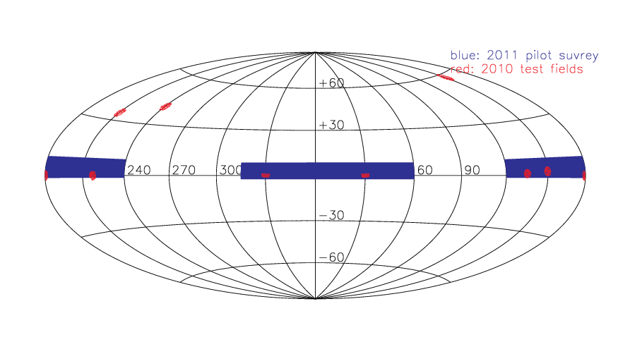
Pilot survey(2011)

Slide 5
正式巡天（2012-2013）
北银冠天区（NGP）的补充星系星表
南银冠天区（SGP）的河外星系表
类星体候选体（吴学兵）
完备小天区 （吴宏）
河外源数目较少，优先级高于恒星

Slide 6
北银冠天区的补充星系
SDSS 中主星系样本表(r<17.77)中没有红移测量的星系
SDSS主星系样本：完备性>90%
光纤碰撞效应：55arcsec
N=82,306, Objtype='GAL’
WISE选的AGN源
点源 (N=11,229) Objtype=‘AGN_POINT’
展源 (N=8861) Objtype=‘AGN_EXT’
重复观测的类星体
r<17.5 (N=5345) Objtype=‘QSO_rev’
观测1
观测2
>55”

Slide 7
南银冠天区的完备星系样本
天区: (Dec>-10 & b<-30)
3700 sq degree
主星系样本 （13<r<18)
N=659,598
Objtype=‘GAL’
蓝星系样本(g-i<1.0,18<r<18.8)
发射线星系，更容易谱线测量
Objtype=‘EMG’, N=198,922
N=85,8520

Slide 8
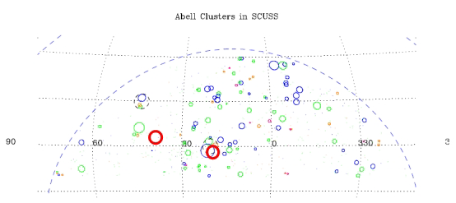
SGP的完备小天区
选择星系密度低、高两个区域。
RA=37.8815 Dec=3.4393
RA=21.5260 Dec=-2.2009
测量所有14<r<18.1 mag的源
可以对类星体选源方法（如光变法）进行验证。
TSOURCE：LEGAS_WH

Slide 9
亮星系样本（2013.12）
‘BGnoz’: 14<r<16.5, no redshift
93,338
Duplicate with complementary sample
Contamination from bright stars
‘BGz’: 14<r<16.5, galaxies with z measured
181,872 (bug)
Supplement to high galactic region
Few broad absorption line QSO (顾敏峰）
53

Slide 10
Footprint and Plate type
Footprints
EG (south Galactic, Dec>-10, b<-30)
HD (Halo and Disk)
GAC (150<l<210, |b|<30)
Few M plates: 8 EG
B plates (r<16.5)
M plates(r<17.8)
Survey Strategy
PRI: EG source < star

Slide 11
DR2 释放数据中的河外源
光谱class=‘GALAXY’
23,830
光谱class=‘QSO’
8630
TSOURCE = ‘LEGAS_SSY’
23,016
9,113 class=‘GALAXY’
8,799 class=‘STAR’

Slide 12
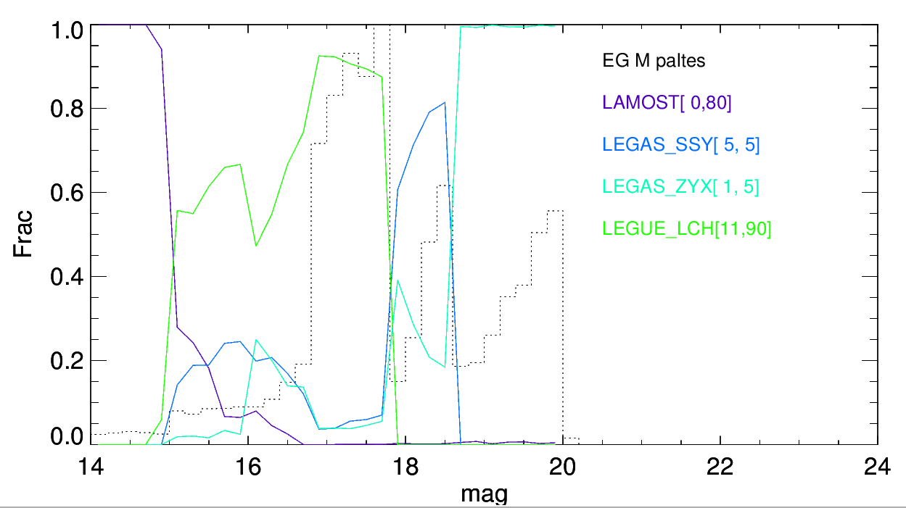
8 EG M plates in SGP
LEGAS_SSY
galaxies in input catalog: 33,827
Tiled 4,458 galaxies
Released 3845 spectra
2489 with z>0

Slide 13
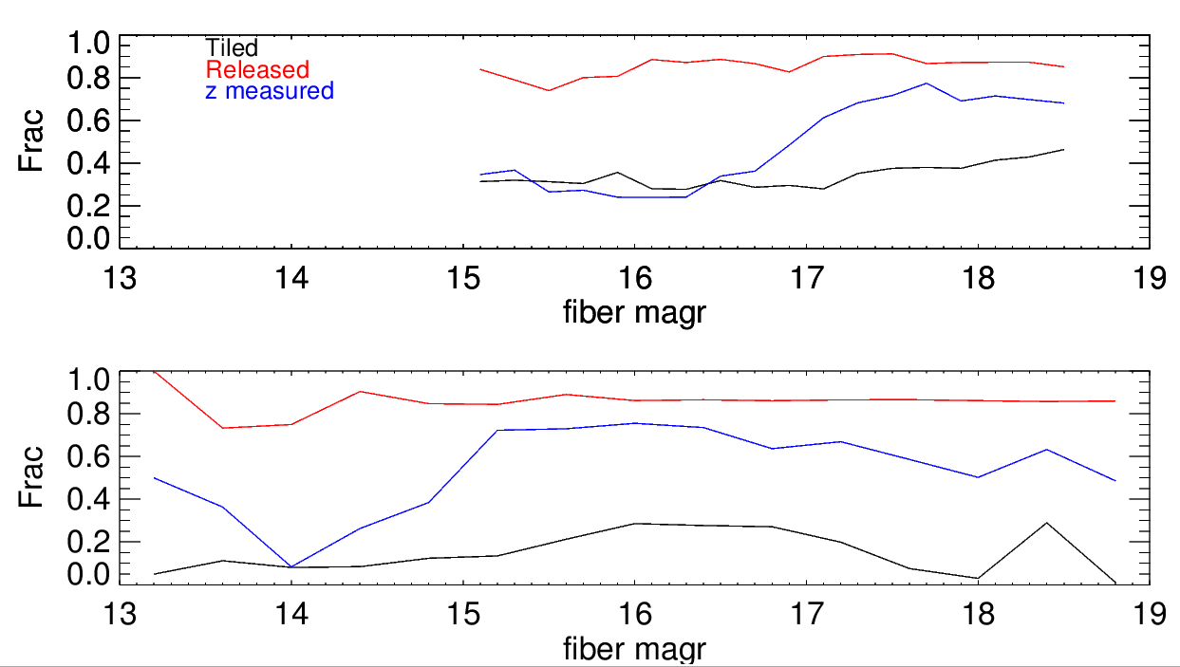
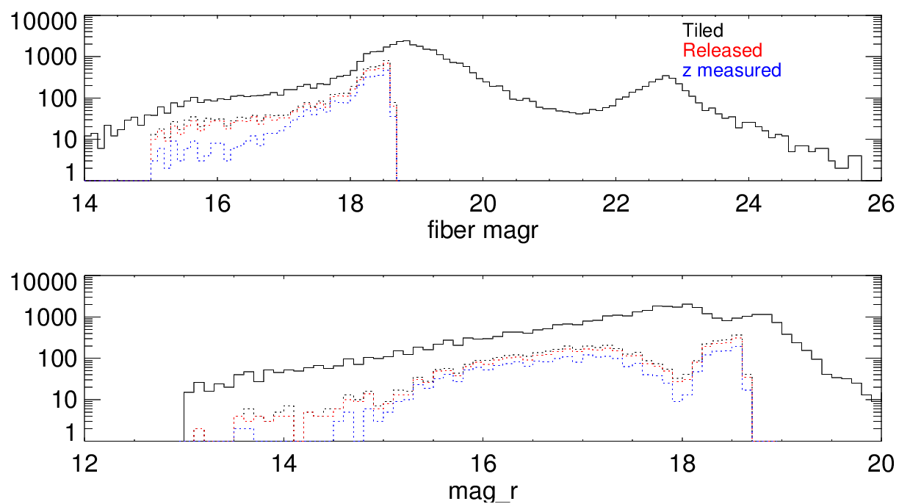
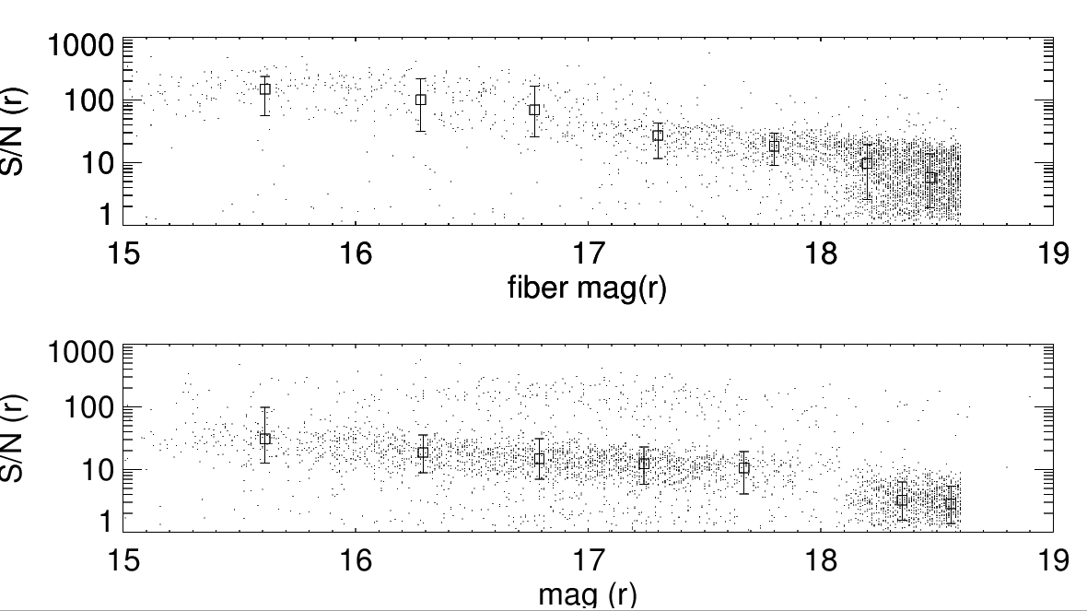

Slide 14
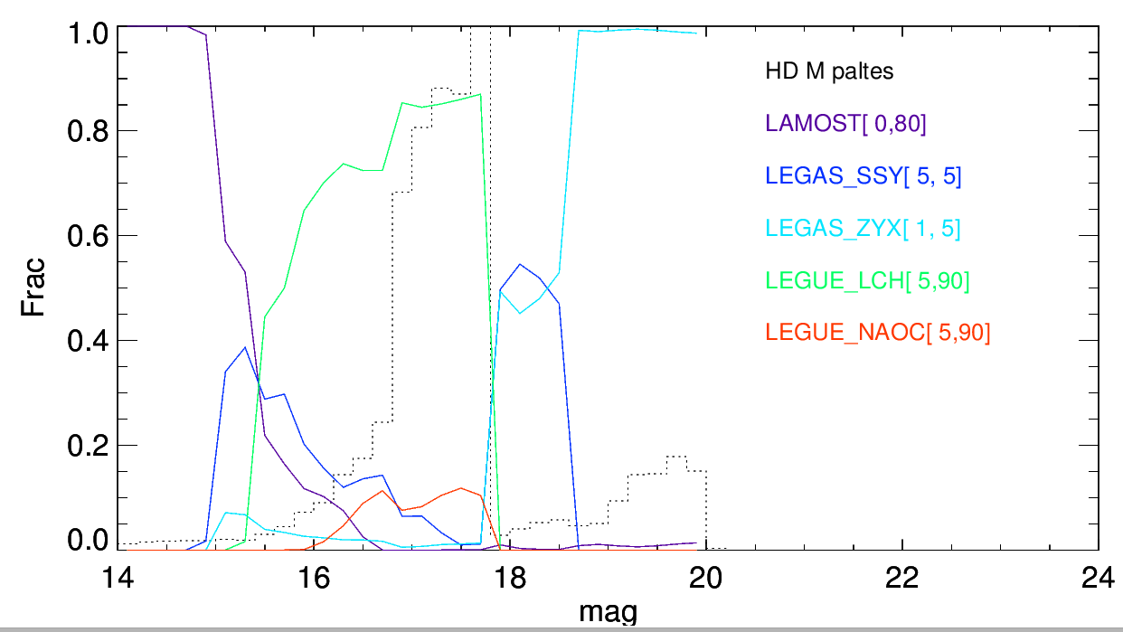
HD M plates

Slide 15
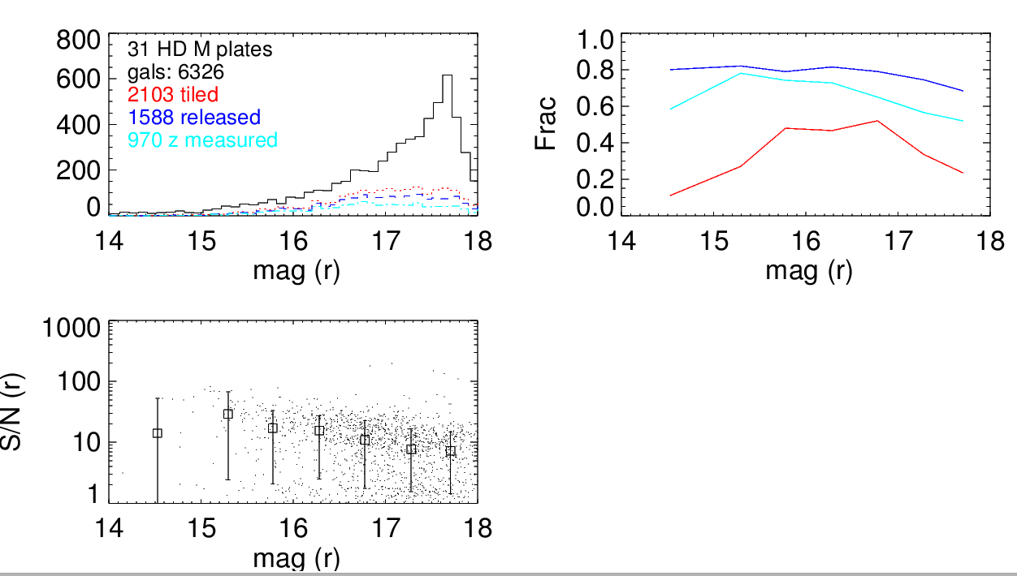
Complementary galaxies in HD M plates
Low efficiency at r>17
Identify new galaxy pairs

Slide 16
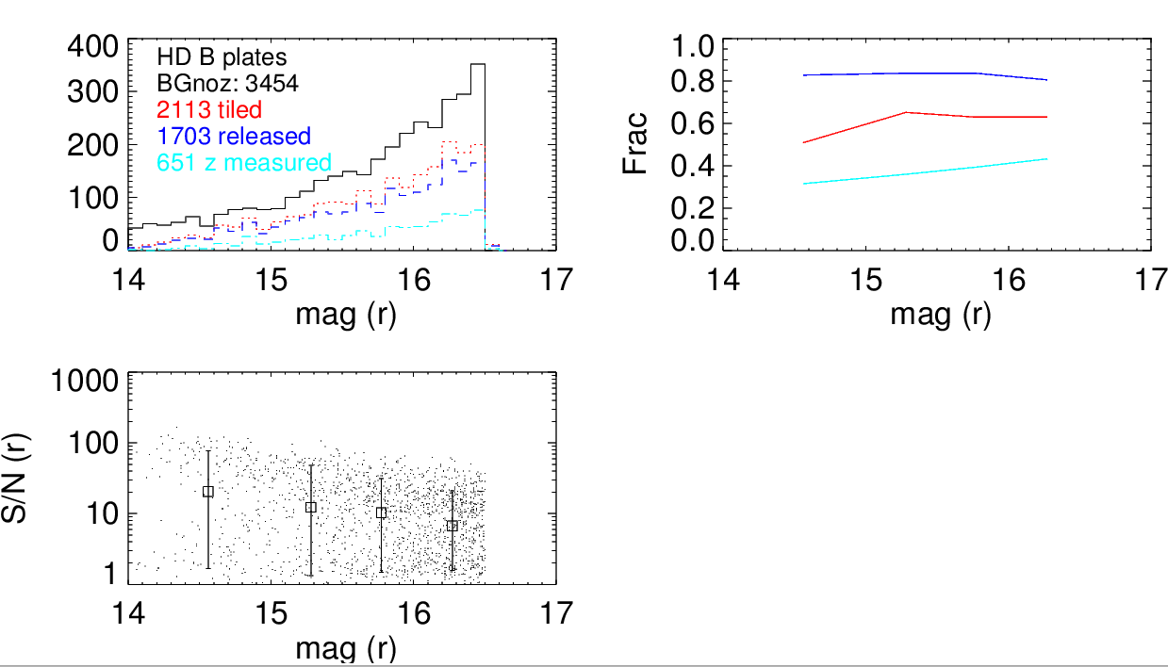
Bright galaxies(no z) in HD B plates
Contamination from bright stars

Slide 17
Summary on observation of galaxies in LAMOST DR2
EG M plates
can reach S/N ~10 to r<18
can get redshifts for 18<r<18.8 blue galaxies
Too few~
HD B/M plates
Redshift successful rate ~50% at r~17
Complementary galaxies in B plate? (From 2015)

Slide 18
EG science from LAMOST DR2
new galaxy pair (Shen Shiyin)
New QSOs
M31-M33 vicinity (Huo Zhiying)
DR1 (Ai Yanli)
Substructure of galaxy cluster Zwicky 721
Complete fields (Yang Ming)
E+A galaxies (Yang Haifeng)

Slide 19
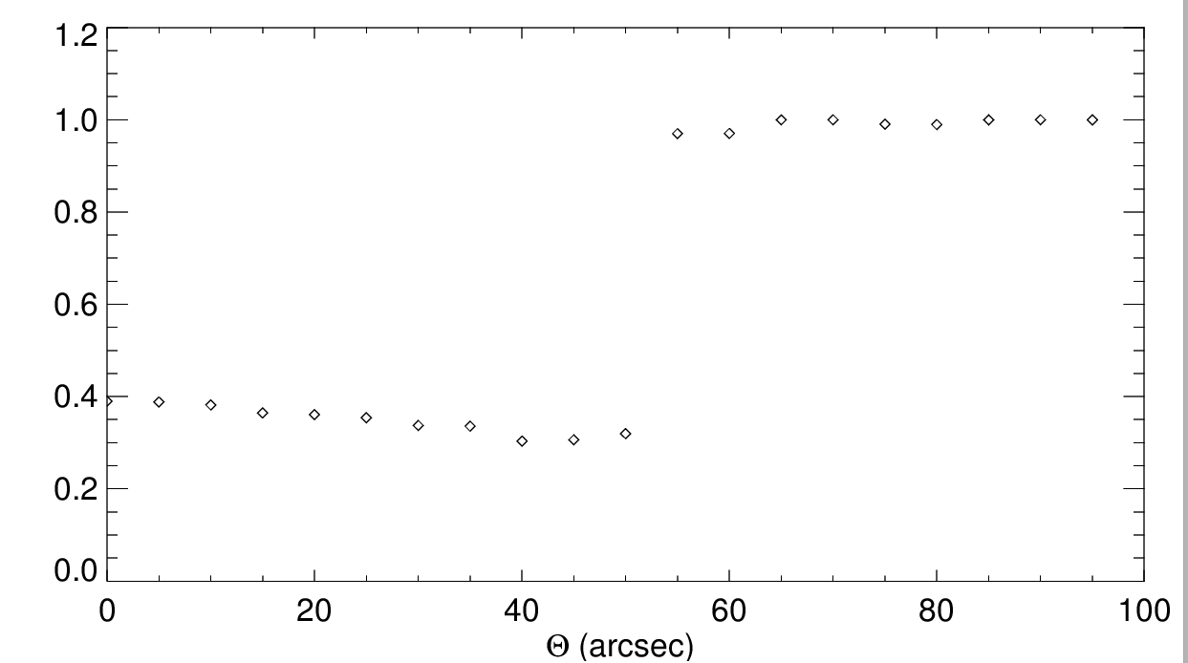
Completeness of galaxy pairs in SDSS

Slide 20
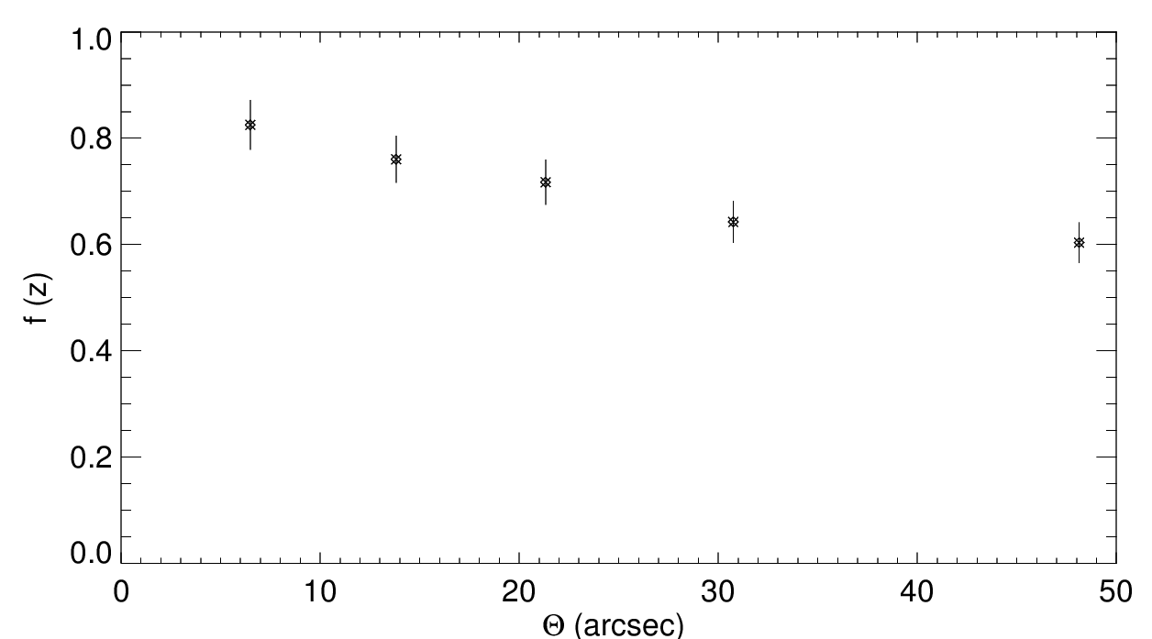
Probability of a nearby galaxy being a pair

Slide 21
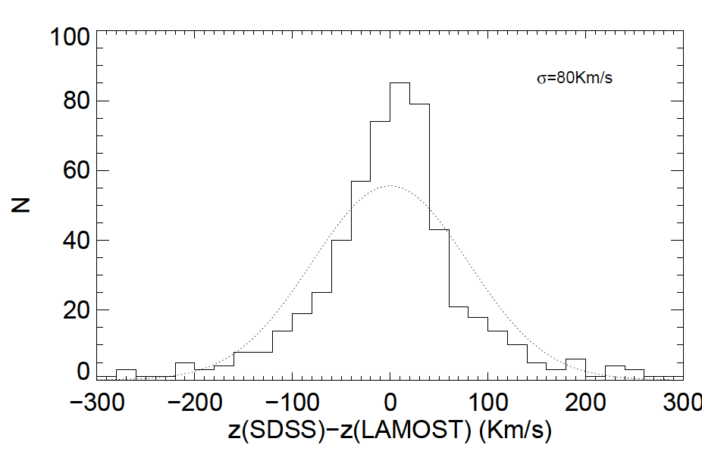
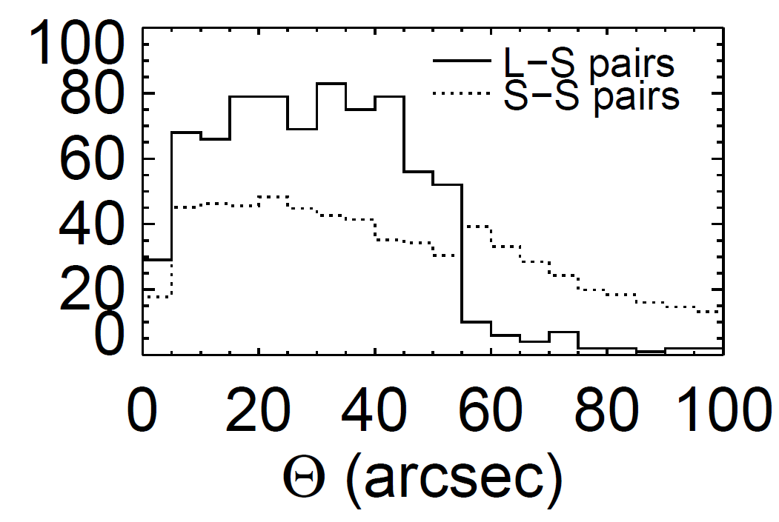
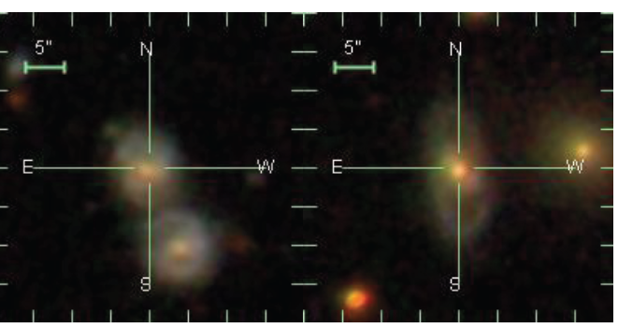
New L-S galaxy pair sample
1807 complementary galaxy with z
572 with z in DR12
784 L-S galaxy pairs
P<100Kpc dV<500Km/s

Slide 22
Complementary galaxy sample in LAMOST
A complete galaxy pair sample?
If so,
Benchmark of galaxy pair studies
Small-scale environmental effects
Sciences on galaxy pairs

Slide 23
Bivariate luminosity function of galaxy pairs (Feng Shuai)
Ψ(L1,L2)
Is L1 independent of L2?
Does Ψ (L1,L2) vary with P and dV?
New photometry of galaxy pairs

Slide 24
Projects on galaxy pairs
Refinement of the galaxy pair definition
Pair-wise velocity distribution in non-linear region (dV)
Gaussian VS Exponential ?

Slide 25
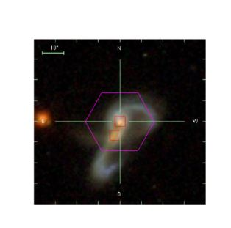
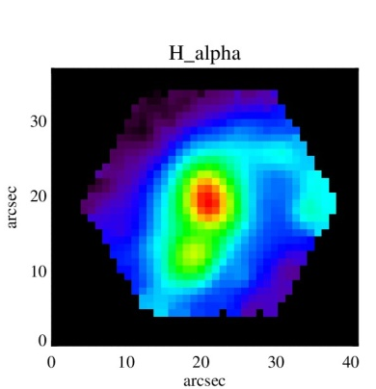
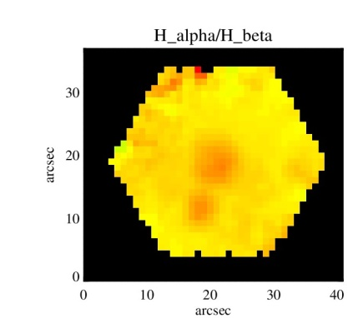
Project: IFS studies on galaxy pairs
SDSS IV (MaNGA)
We have been awarded an ancillary program on targeting a sample of >100 galaxy pairs (PI: Yuan Fangting)

Slide 26
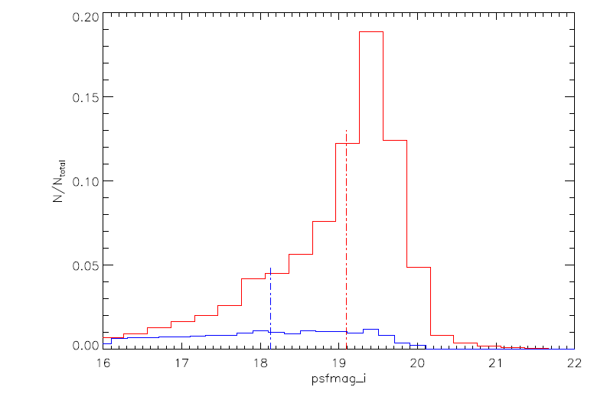
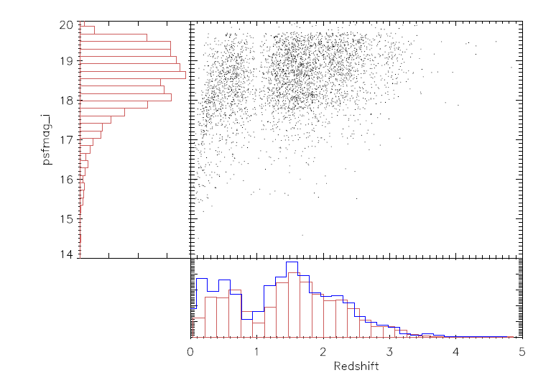
QSO studies
DR1
70,290 QSO candidates observed (82,625 spectra)
~10000 with classification ‘QSO’ or ‘STAR’
4000 eye-ball confirmed quasars
2737 also in DR10

Slide 27
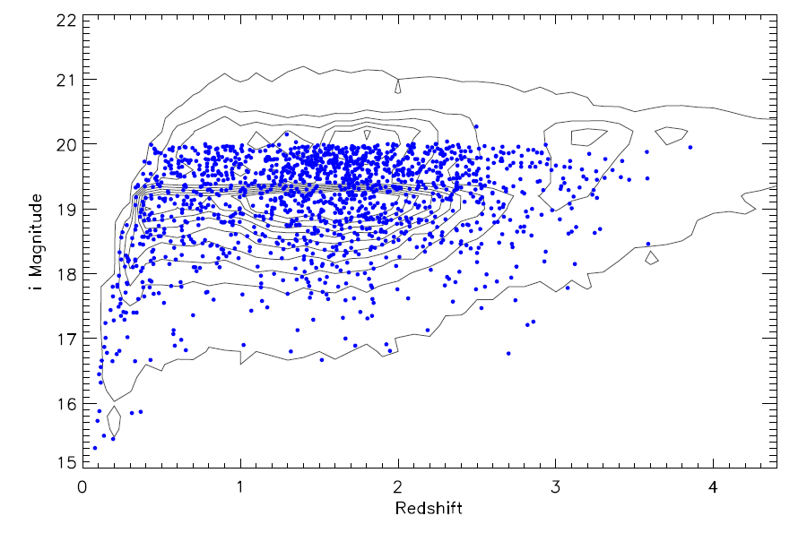
QSO in M31 and M33 vicinity
DR2: 1870 new QSOs (133 deg^2)

Slide 28
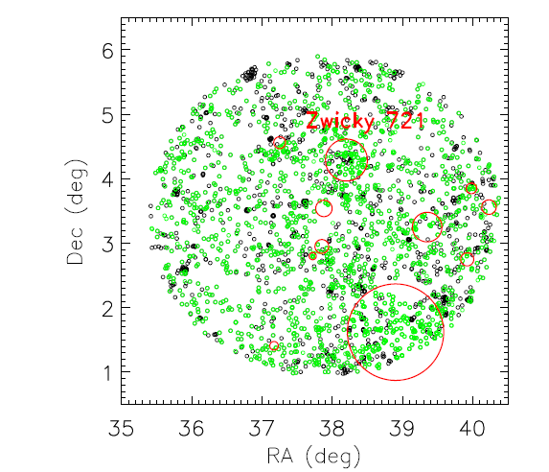
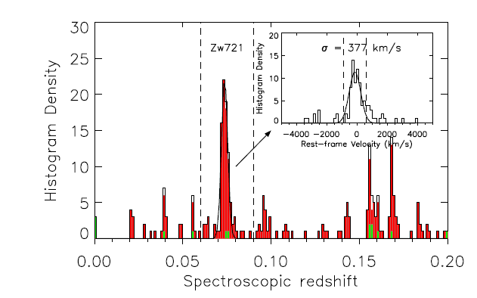
Substructure of Zwicky 721
Field A
2519 galaxies 14<r<18.1
1528 redshifts by visual inspection

Slide 29
E+A galaxies
Strong Balmer absorption lines and little/no nebular emission lines.
Post-starburst phase (Hdelta absorption: A stars)
71 E+A galaxies in DR2
Searched from 37026 galaxies in LAMOST DR2

Slide 30
Summary
LAMOST河外部分：不抛弃，不放弃

