Slide 1
Chi-square Fitting
Zeng Qi & Qin Songmei

Slide 2
Chi2

Slide 3
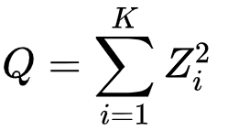
Chi2 fitting & Chi2 distribution
Definition: The Chi-Square Distribution, denoted as χ² is related to the standard normal distribution such as, if the independent normal variable, let’s say Z assumes the standard normal distribution, then the square of this normal variable Z² has the chi-square distribution with ‘K’ degrees of freedom.

Slide 4
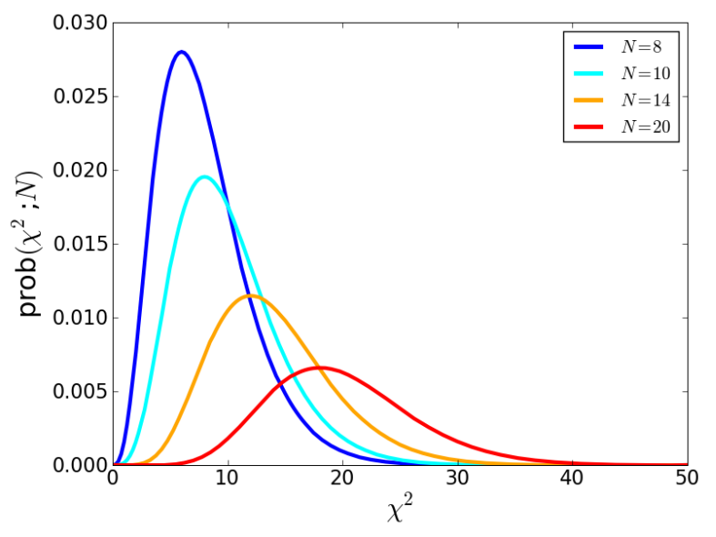
Freedom
K=N-M
Definition: The Degrees of Freedom refers to the number of values involved in the calculations that have the freedom to vary. In other words, the degrees of freedom, in general, can be defined as the total number of observations minus the number of independent constraints imposed on the observations.
χ2 -distributions for different values of K = N degrees of freedom
Reference：arXiv:1012.3754

Slide 5
Freedom
A rule of thumb is that a “typical” value of χ² for a “moderately” good fit is χ² ≈ k
χ² << k
Data errors are overestimated.
Errors are too large.
χ² >> k
Data errors are underestimated.
Intrinsic dispersion

Slide 6
Freedom

Slide 7
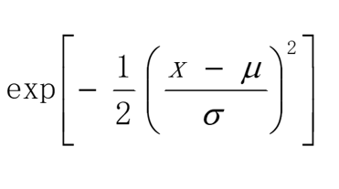
Chi2 & Maximum likelihood estimation
Maximum likelihood estimation distribution of data for a given model.
P(μ,σ)=
L $∝$

Slide 8
Chi2 & Maximum likelihood estimation
We assume that the uncertainty σi associated with each measurement yi is known, and that the xi’s (values of the dependent variable) are known exactly.
If the measurement errors are normally distributed, then this merit function will give maximum likelihood parameter estimations of a and b.

Slide 9
Errors in both x and y

Slide 10
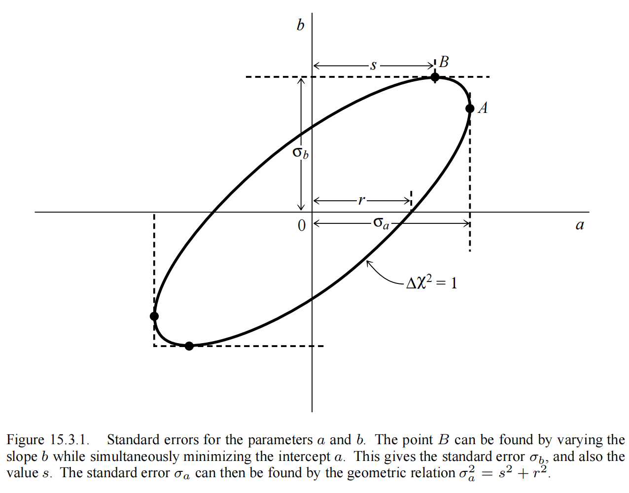

Slide 11
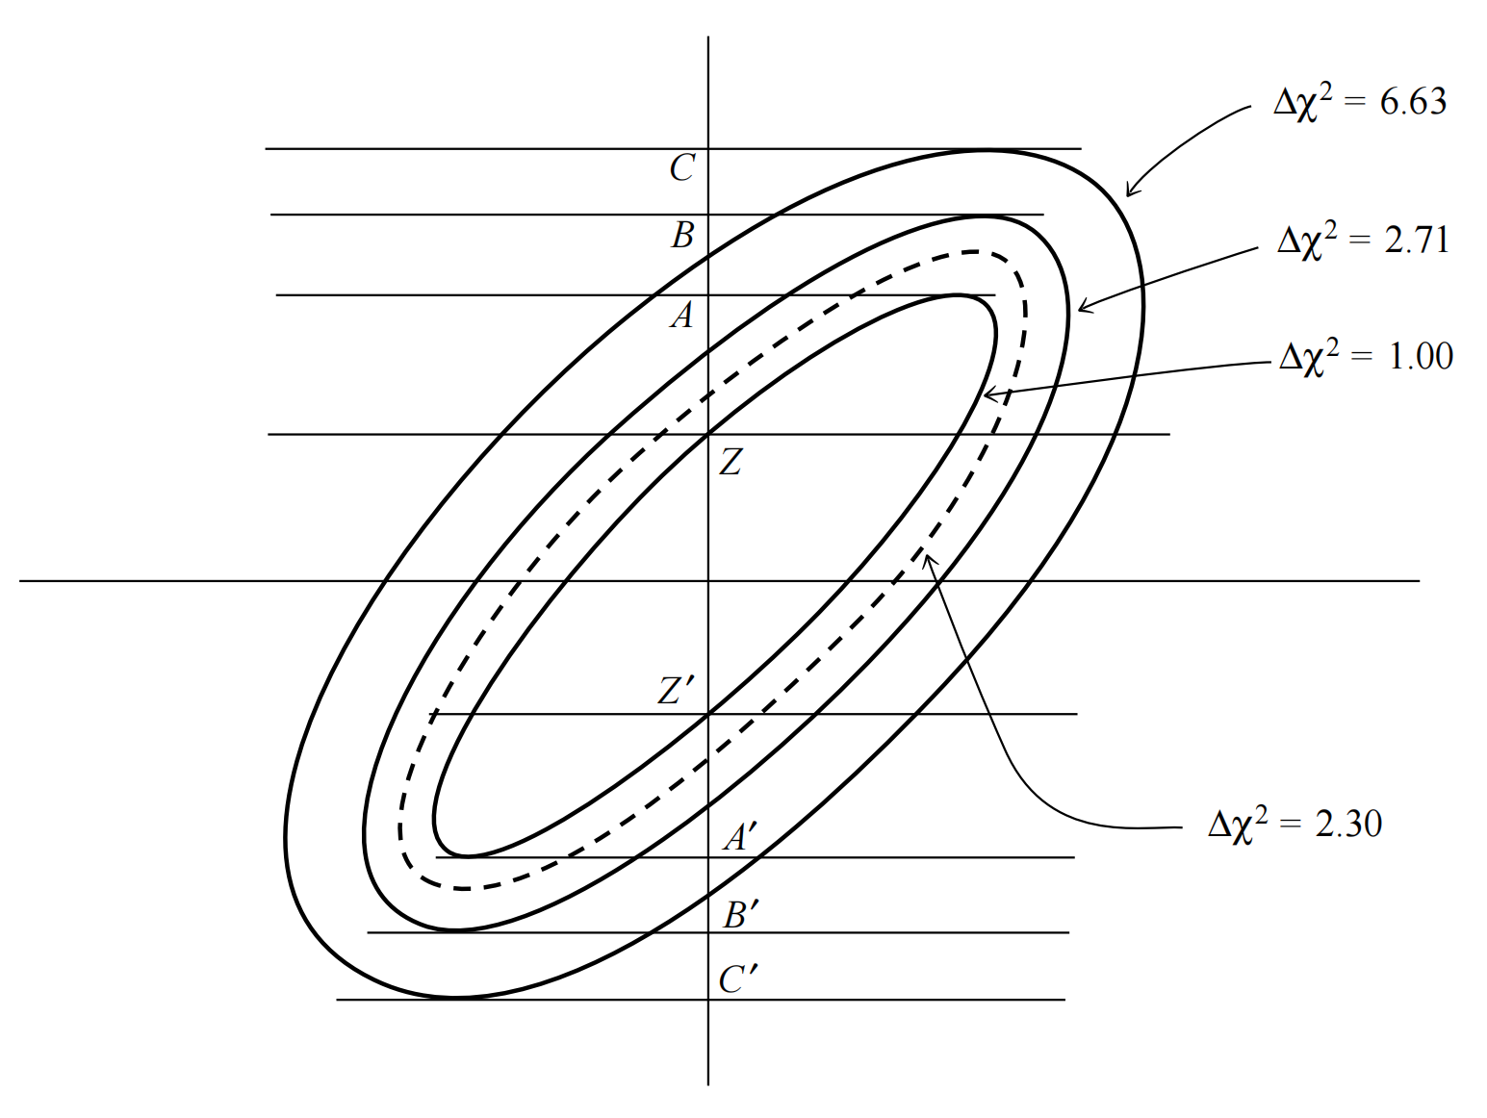
Confidence region and confidence level
a
b

Slide 12
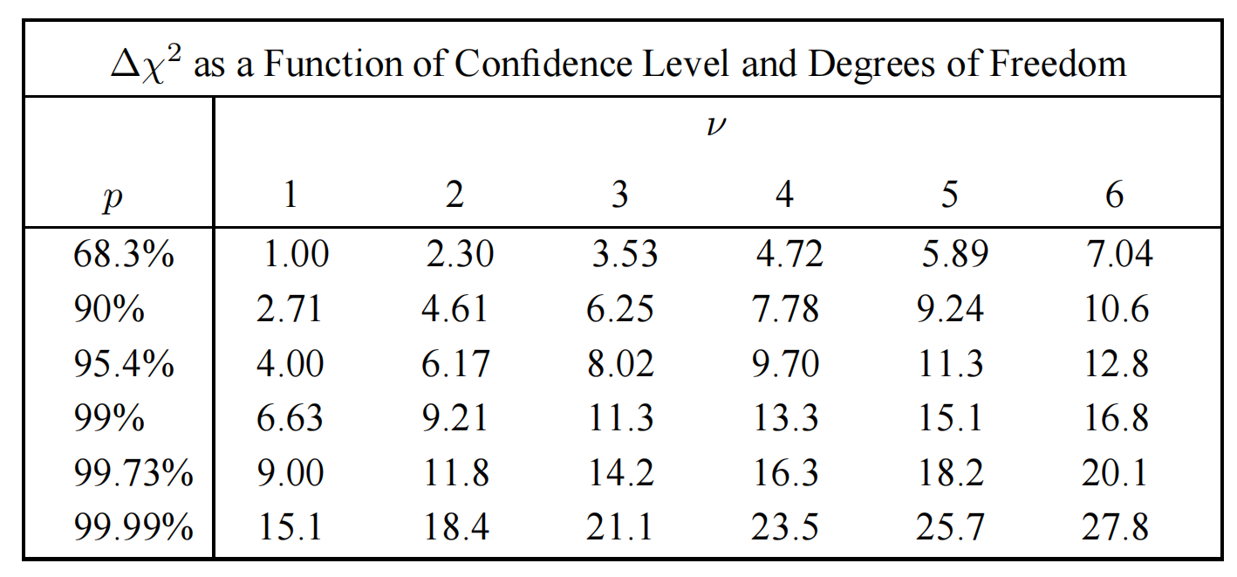
Confidence region and confidence level

Slide 13
Nonnormal errors

Slide 14
Useful webpages
https://github.com/statsmodels/statsmodels/blob/main/examples/python/chi2_fitting.py
https://probfit.readthedocs.io/en/latest/api.html#probfit.costfunc.Chi2R

