Slide 1
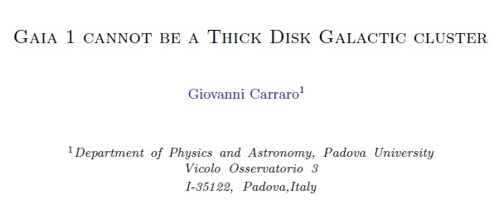
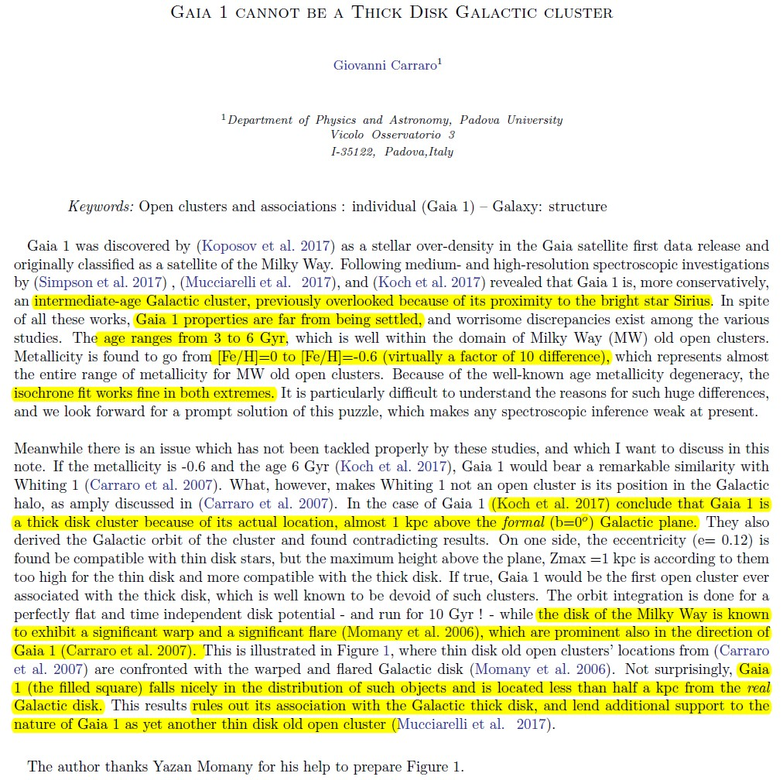
Astro-ph.1801.03997

Slide 2
Gaia_1 == newly identified STAR CLUSTER from Gaia DR1 sources
property == large discrepancy: age 3 -- 6 Gyr; [Fe/H] ~ -0.6 – 0
nature == thick disk cluster ? – rare! → accretion origion?
** Galactic disk warp & flare ** ➔ “thin disk” population

Slide 3
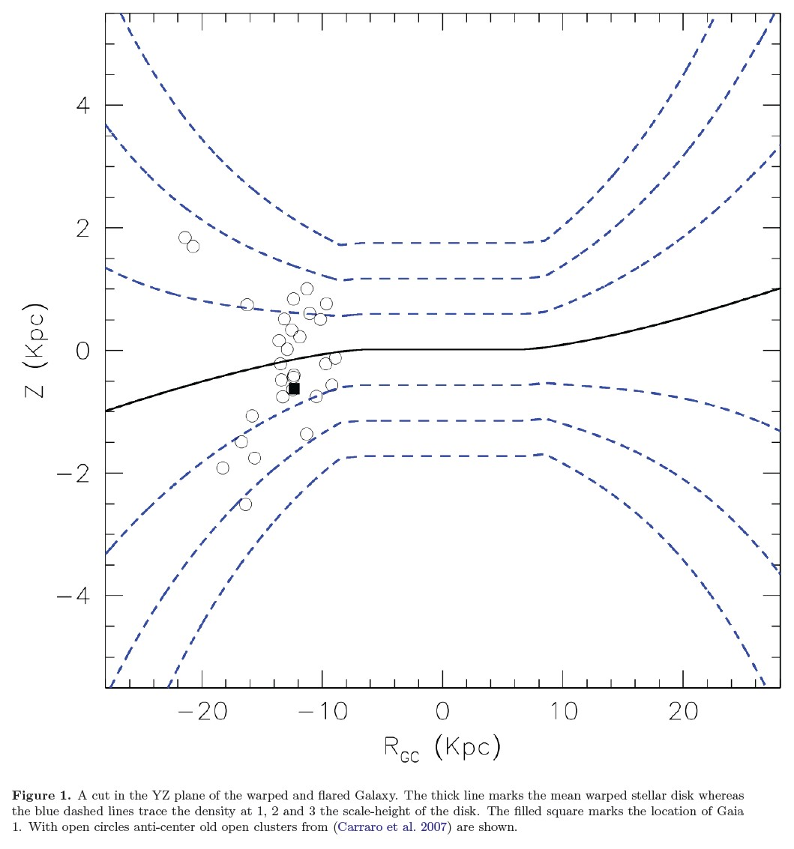

Slide 4
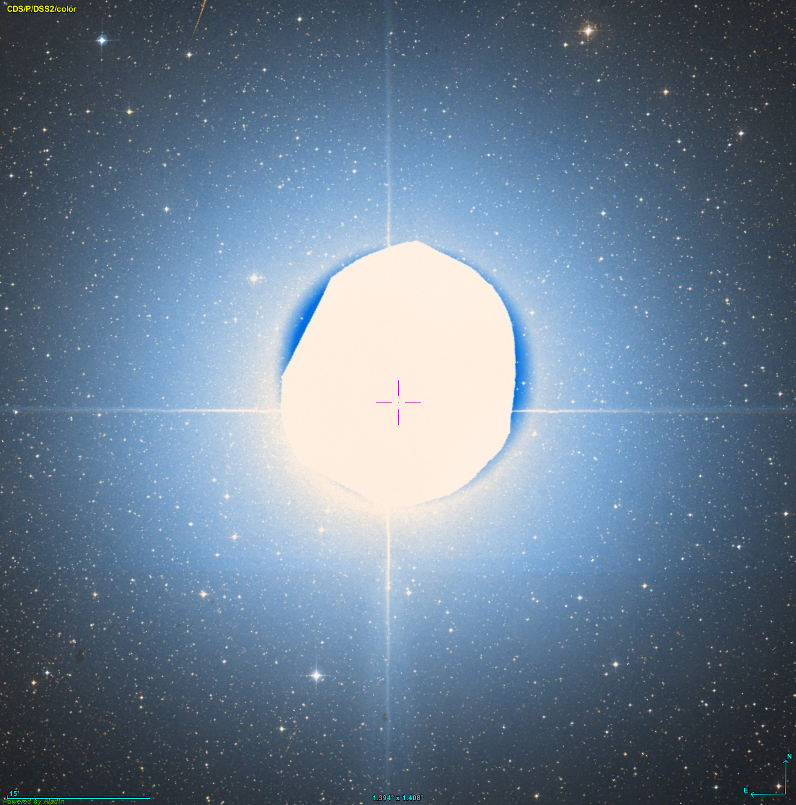
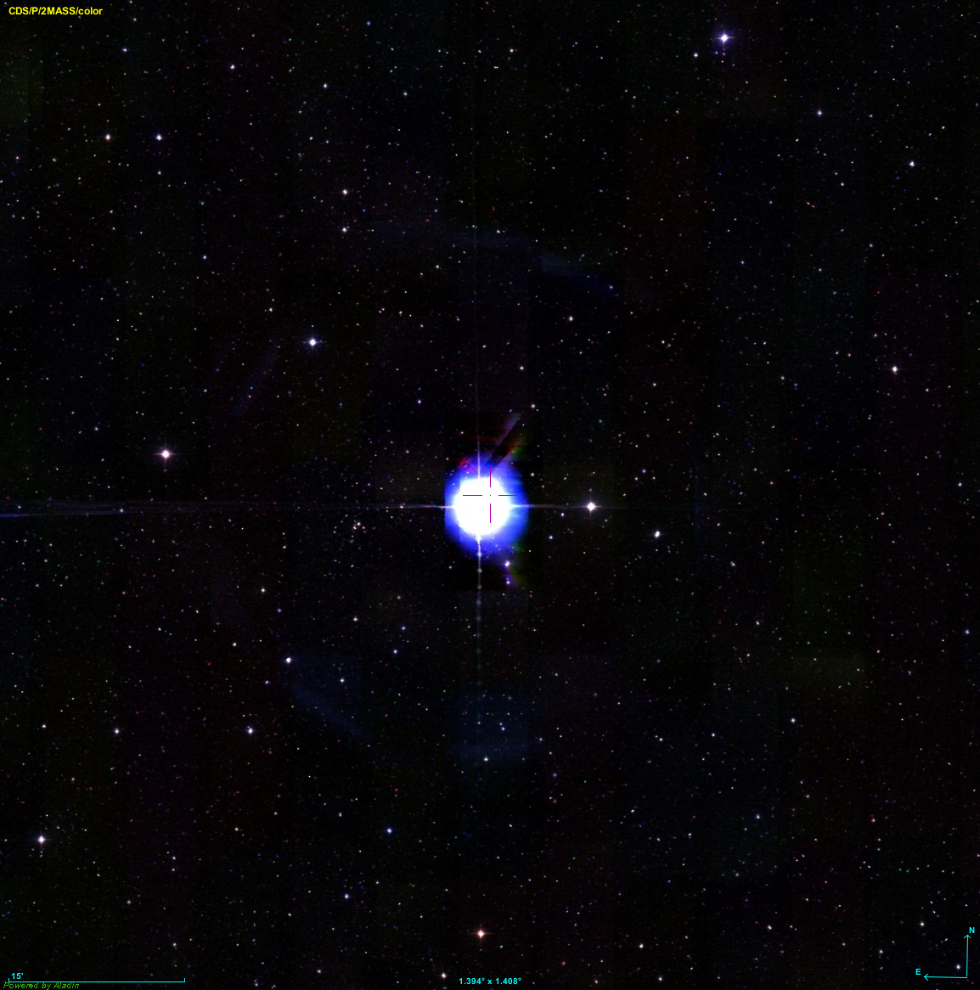
双星
A：大犬座α，A0型，-1.45mag；
B：白矮星，~7mag
Sirius 天狼星

Slide 5
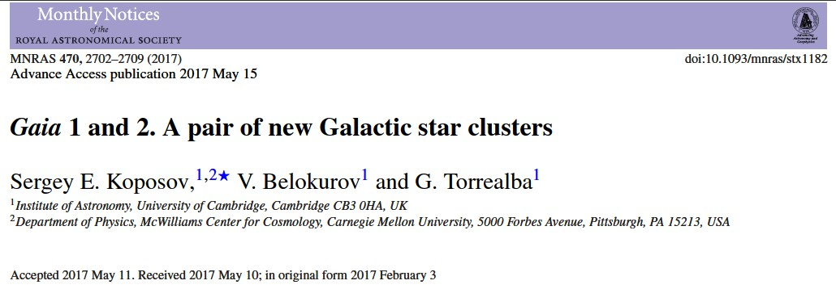
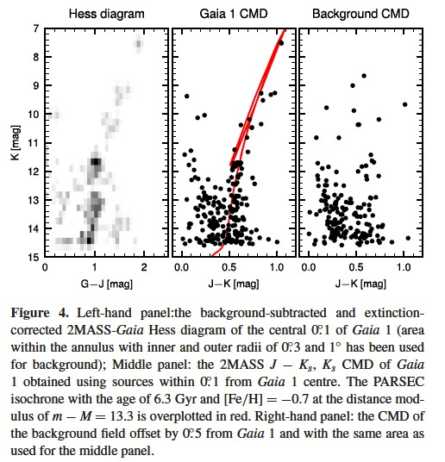
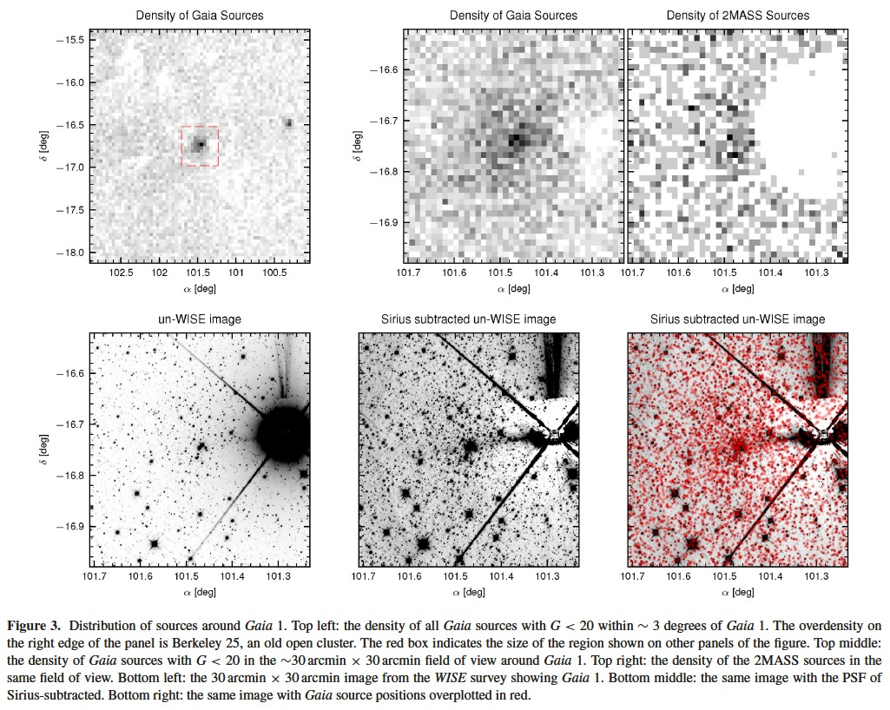

Slide 6
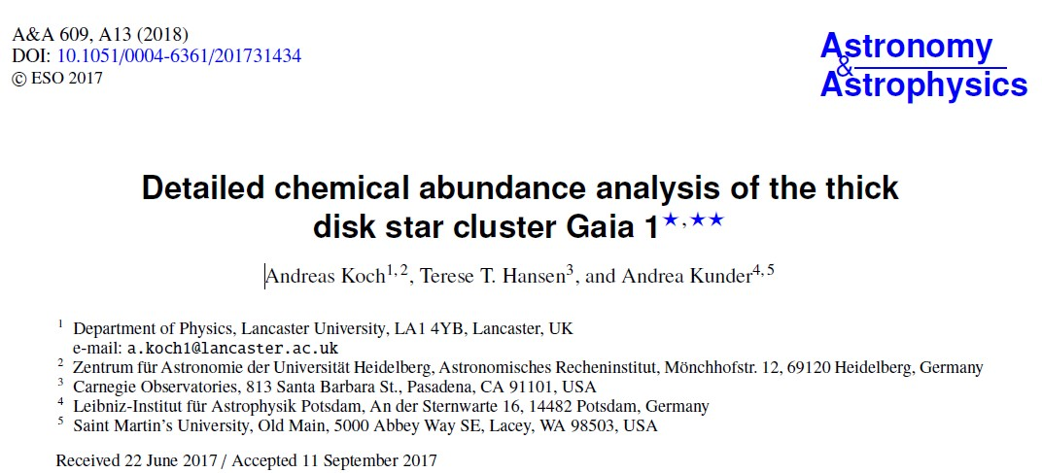
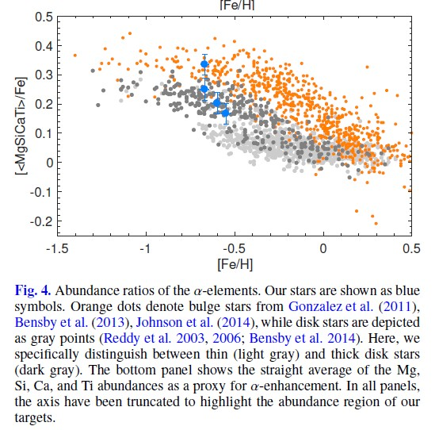
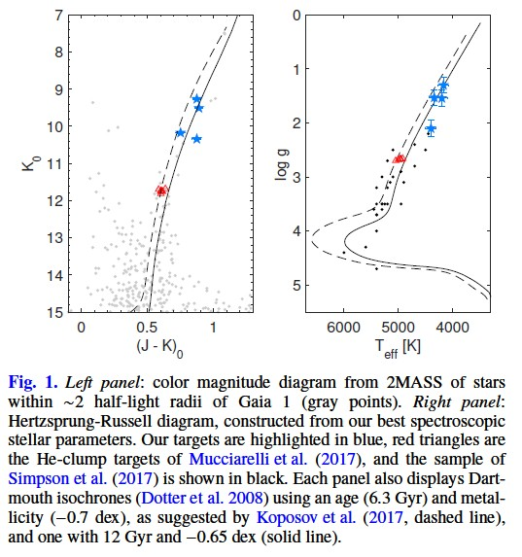

Slide 7
