Slide 1
The environmental effects to the internal structures of early-type galaxies
Jin Yunpeng, LingZhu, Shude Mao,
Lan Wang, Cheng Li…

Slide 2
What determines the internal structure of galaxies
  Merger history + SFH (mass dominating)
  Local density environment (tidal force, ram pressure)
How to describe the internal structure
  Morphology
  Kinematics: Lambda_Re
  Internal orbit distribution

Slide 3
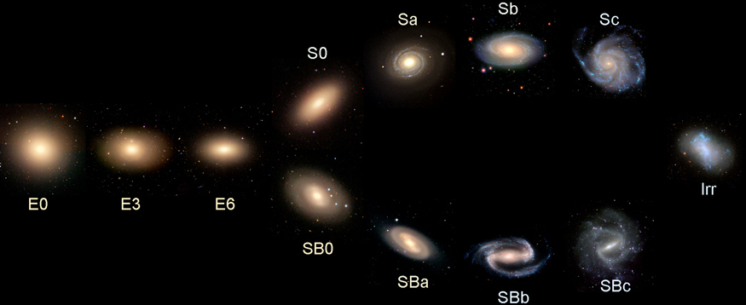
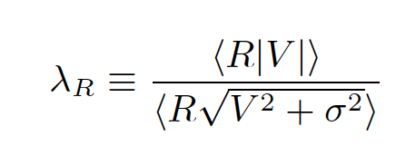
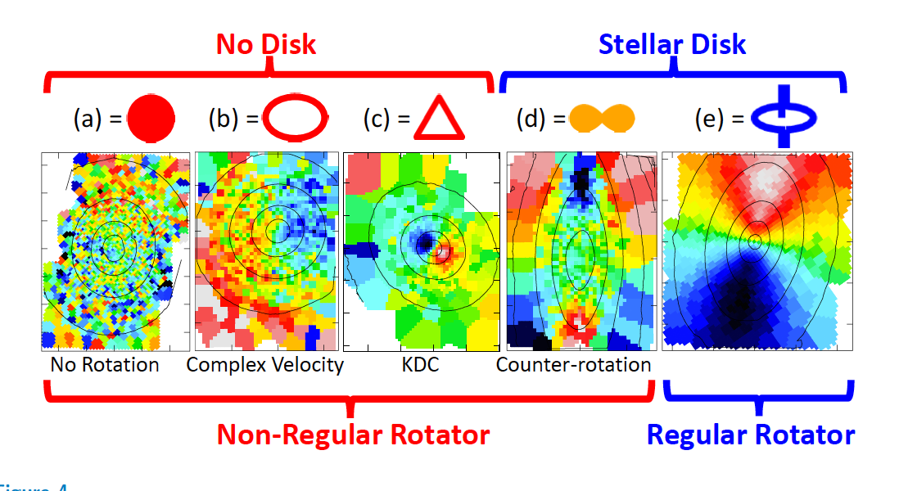
Morphology: bulge/disk fraction
kinematics:
See a review Cappellari 2016

Slide 4
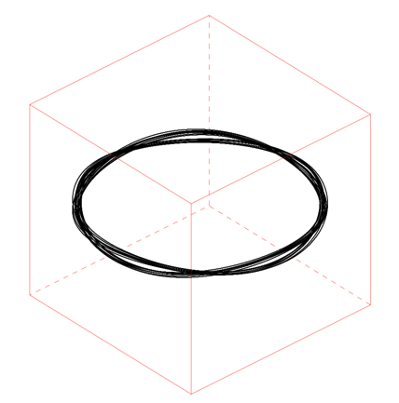
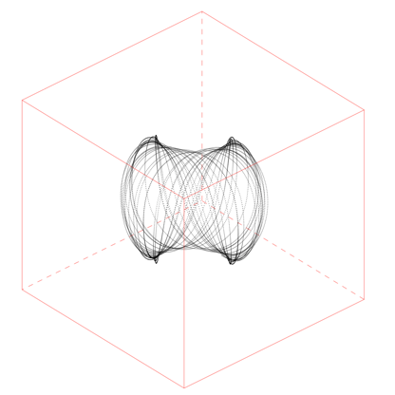
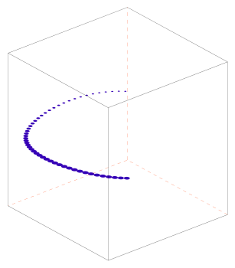
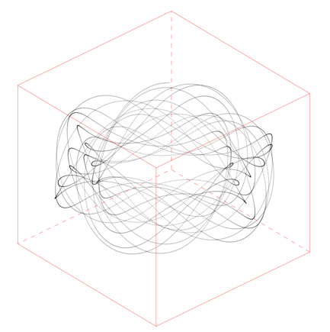
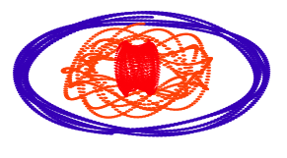
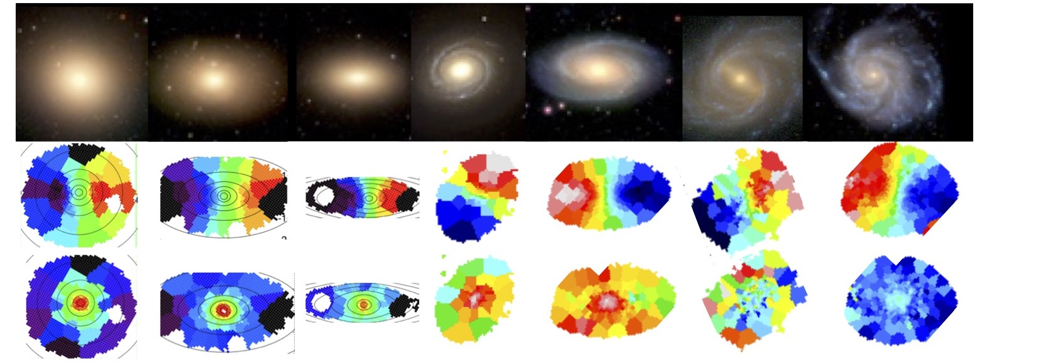
Galaxy built by stars on different orbits
Stellar orbit distribution determines the morphology and kinematics
Hot orbits: dispersion-dominated bulge
Cold orbits: fast rotating disk
+ + +… =
λ_{z} ~ 1
λ_{z} ~ 0.5
λ_{z} ~ 0
Cold
Warm
Hot
Project to the sky-plane
Notes:
In the dynamical point of view, the major visual part of a galaxy is built by stars on different orbits in a gravitational potential.
Here I am showing you three typical orbits:
The combination of many different orbits construct a galaxy, the stellar orbit distribution in the galaxy determines its morphology and kinematic maps. The highly rotating orbits
May build a flat disk, and the dynamical hot orbits build a dispersion dominating bulge. So disk and bulge is a qualitative proxy of the galaxy’s underlying orbital structure.
Stars form a collisionless system, they could conserve the information of orbit for a long period until violent disturbance, thus they are fossil record of the galaxy formation history.

Slide 5
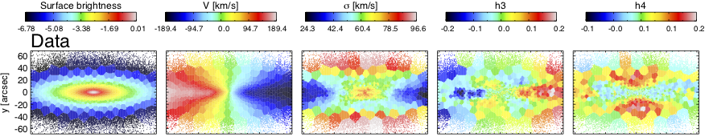
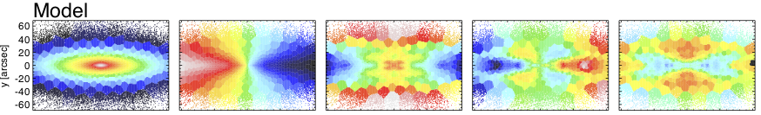
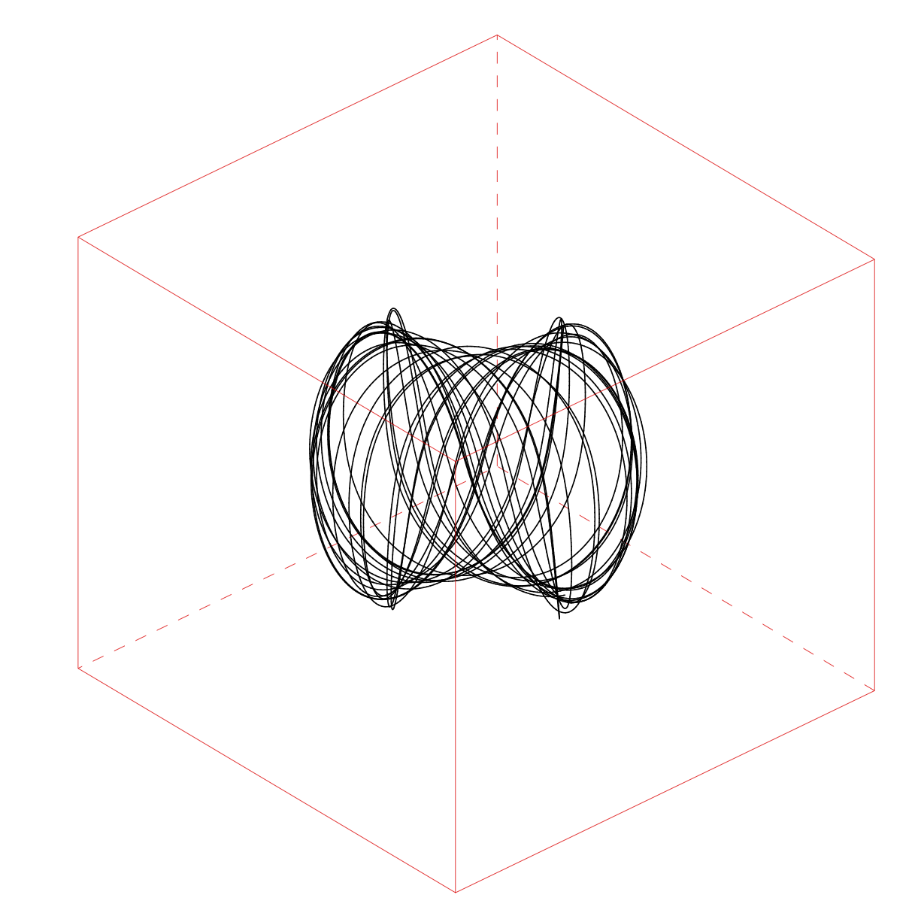
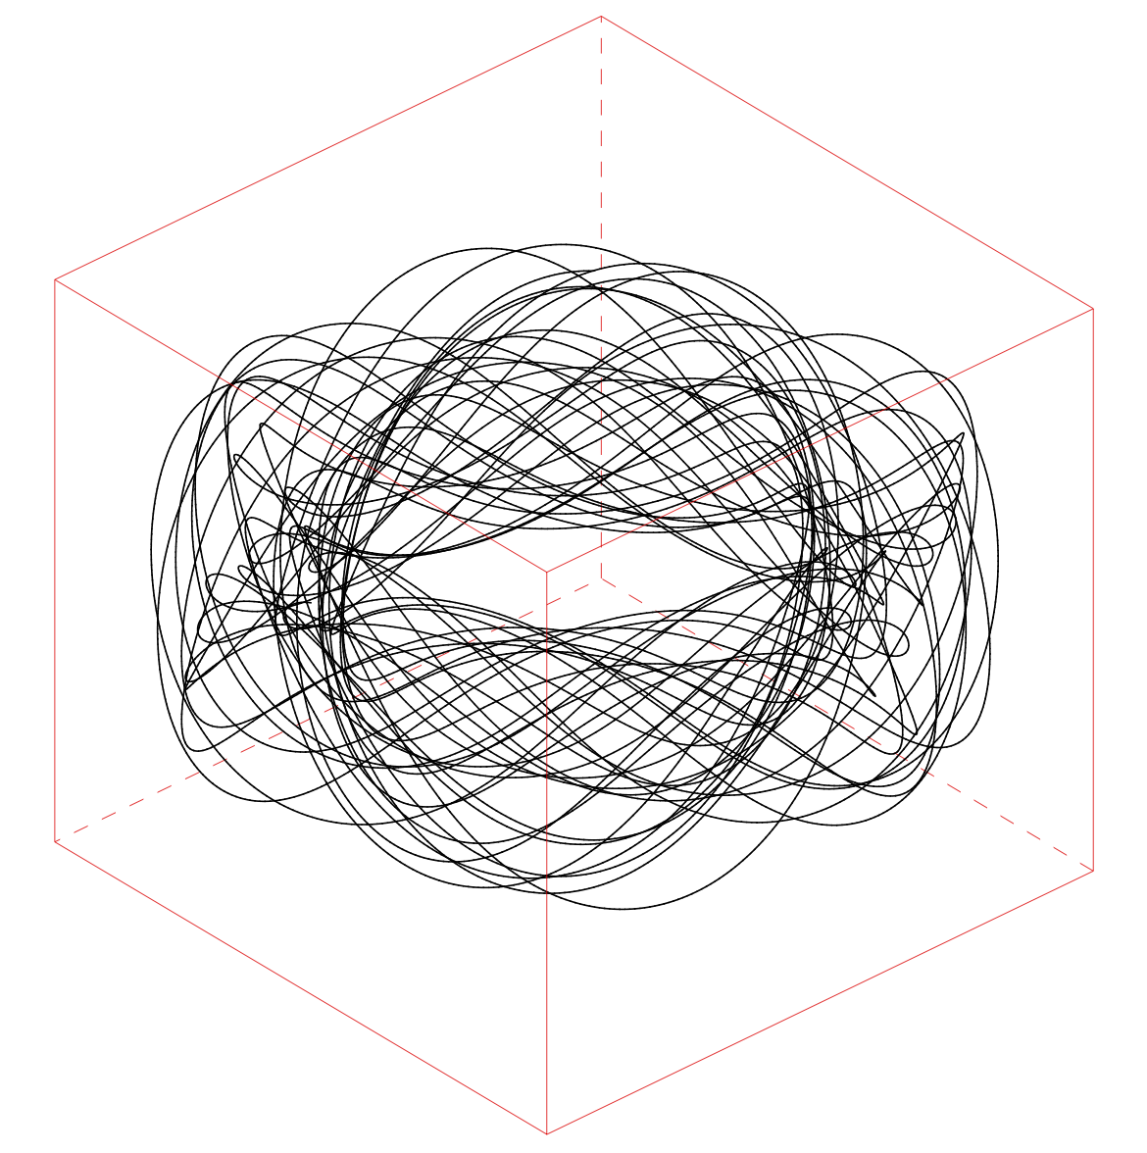
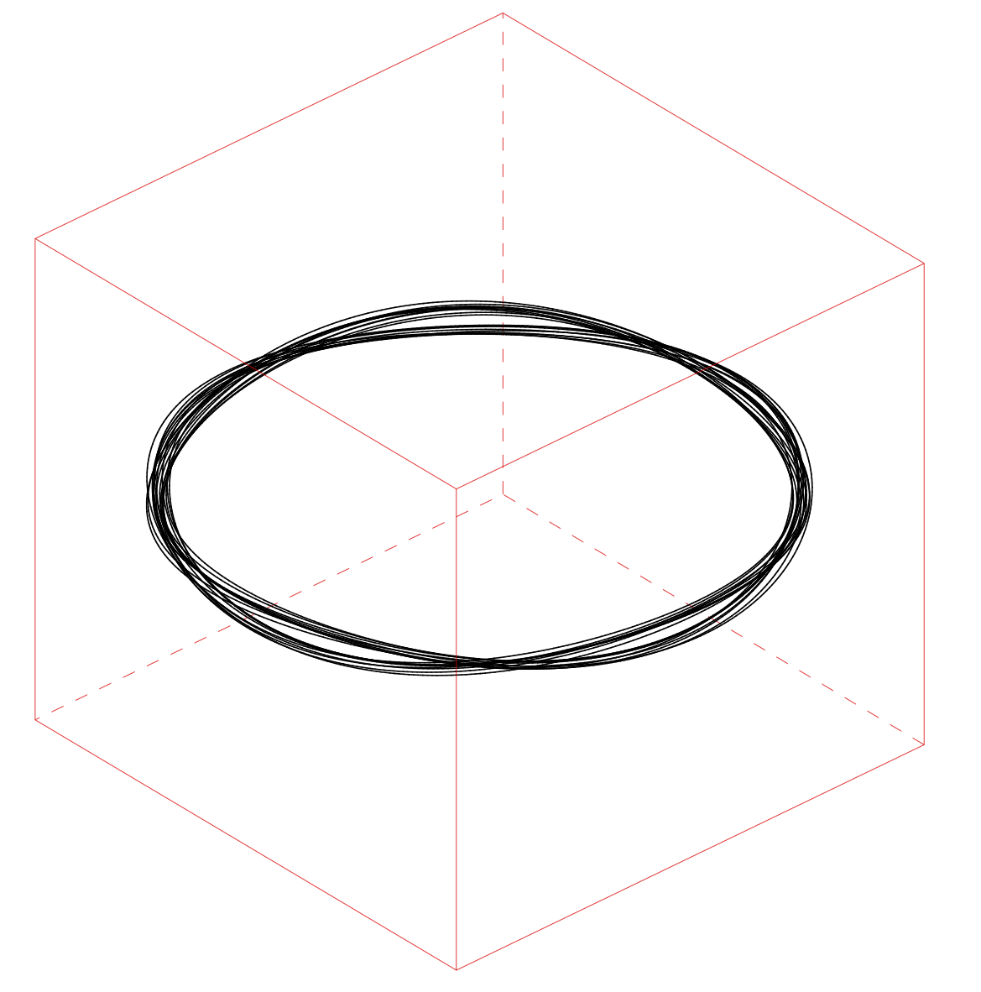
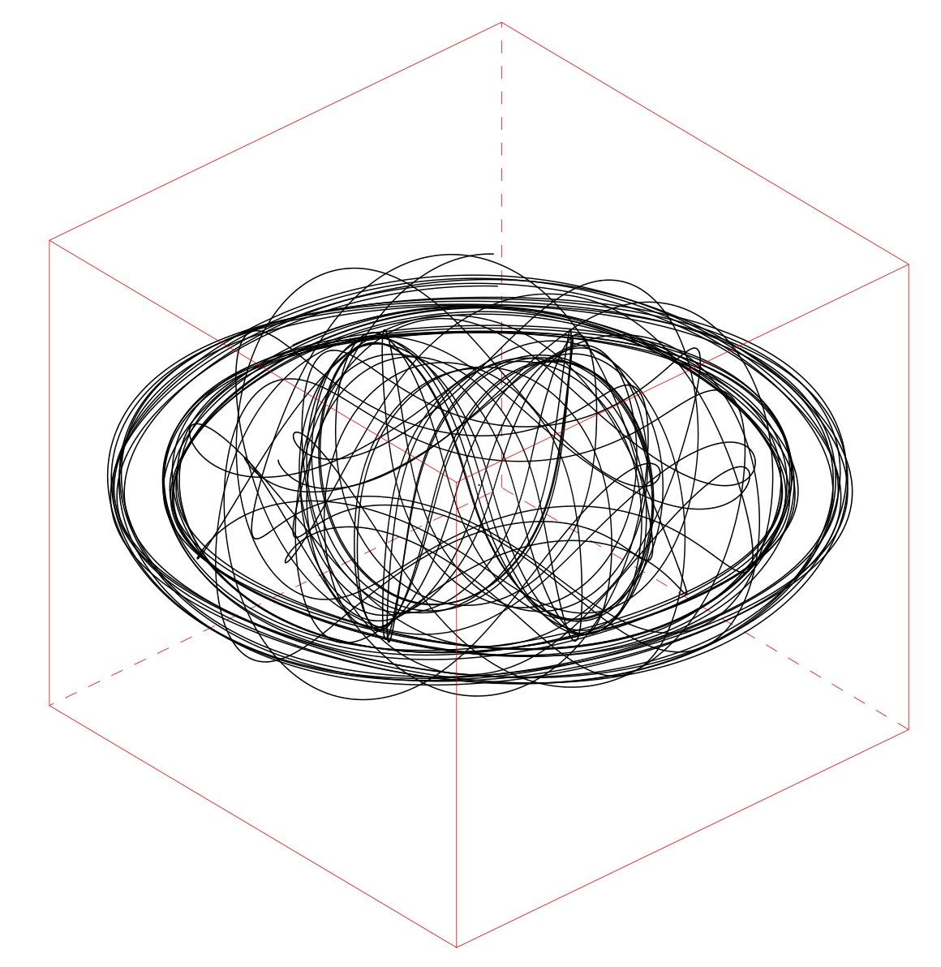
SB V[km/s] σ[km/s]
Mass distribution
Intrinsic shape
Internal orbit distribution
Stellar mass + DM mass + BH…
= gravitational potential
Stellar M/L, DM M₂₀₀, C, viewing angles: θ,ϕ,φ.
λ_{z} ~ 0
Hot
λ_{z} ~ 0.5
Warm
λ_{z} ~ 1
Cold
A 6D model
w₁ + w₂ + w₃ +… =
Orbit library
Schwarzschild 1979, Richstone & Tremaine 1988, Rix+ 1997, Gebhardt+ 2003, Remco van den Bosch+ 2008, Zhu+ 2018a …

Slide 6
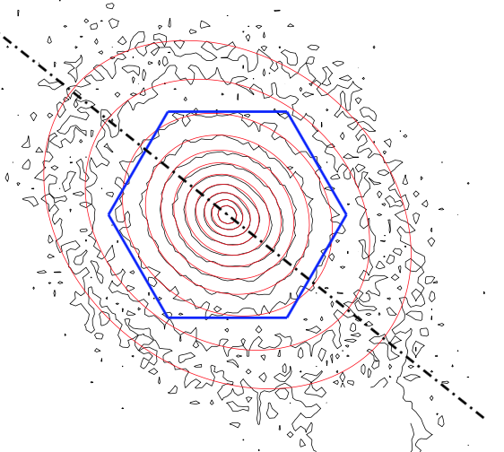
A MaNGA galaxy

Slide 7
A MaNGA galaxy
Stellar orbit distribution

Slide 8
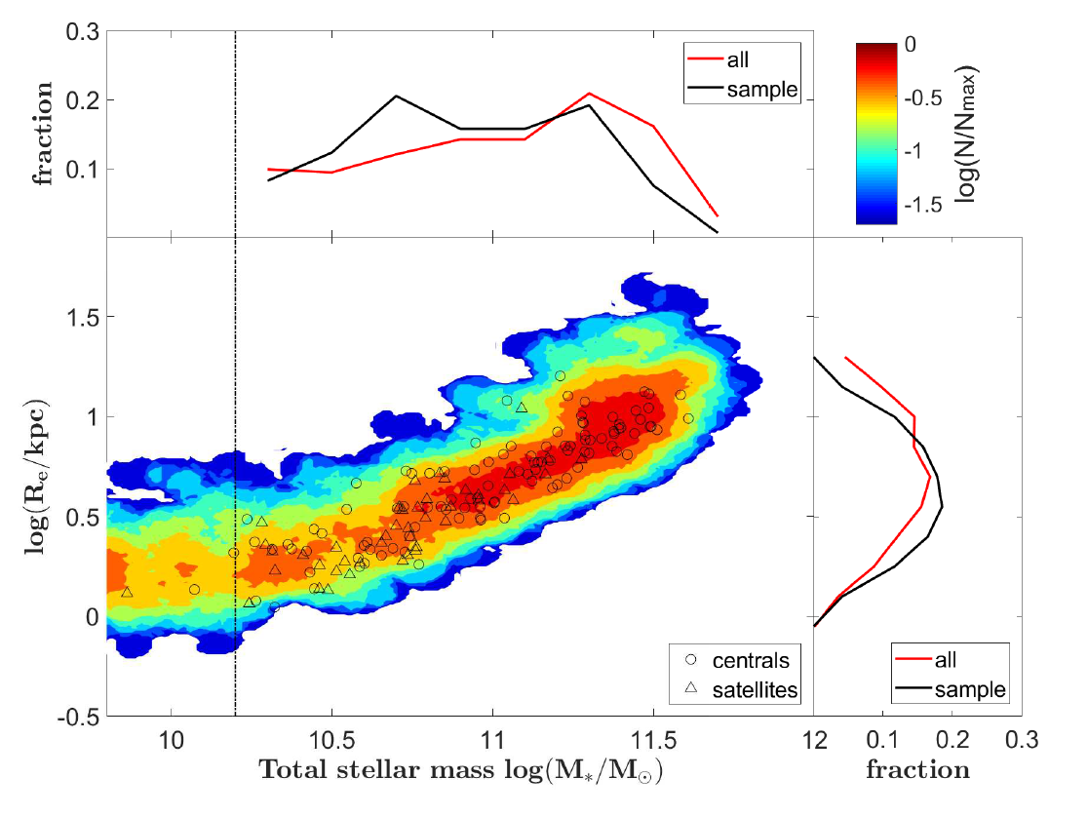
Massive Early-type galaxies in MaNGA
141 centrals + 58 satellites from MaNGA

Slide 9
Dark matter fraction

Slide 10
M_{star} is the major driver of change of intrinsic shape
With control of stellar mass, no different between centrals and satellites
Galaxies tends to be prolate (higher T) have more nearby neighbours (rp < 30 kpc)
r_p [Mpc /h]

Slide 11
Internal orbit distribution
M_{star} is the major driver of change of orbit distribution
With control of stellar mass, no different between centrals and satellites

Slide 12
Galaxies with more hot orbits have more nearby neighbours (rp < 30 kpc)
Note here the orbit distribution is within 1 Re of the galaxy
Jin + 2019 to be submitted

Slide 13
In the future
Tag orbits with age and metallicity

Slide 14
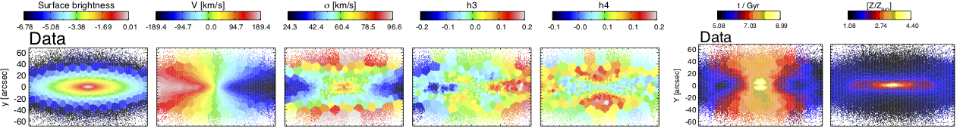
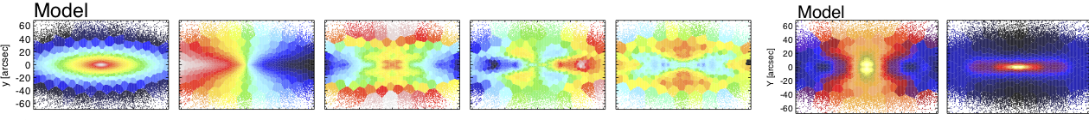
Tag orbits with age and metallicity
Data
Model
λ_{z} ~ 0
Hot
λ_{z} ~ 0.5
Warm
λ_{z} ~ 1
Cold
A 6D model
w₁ + w₂ + w₃ +… =
t₁, Z₁ t₂, Z₂ t₃, Z₃
With t and Z

Slide 15
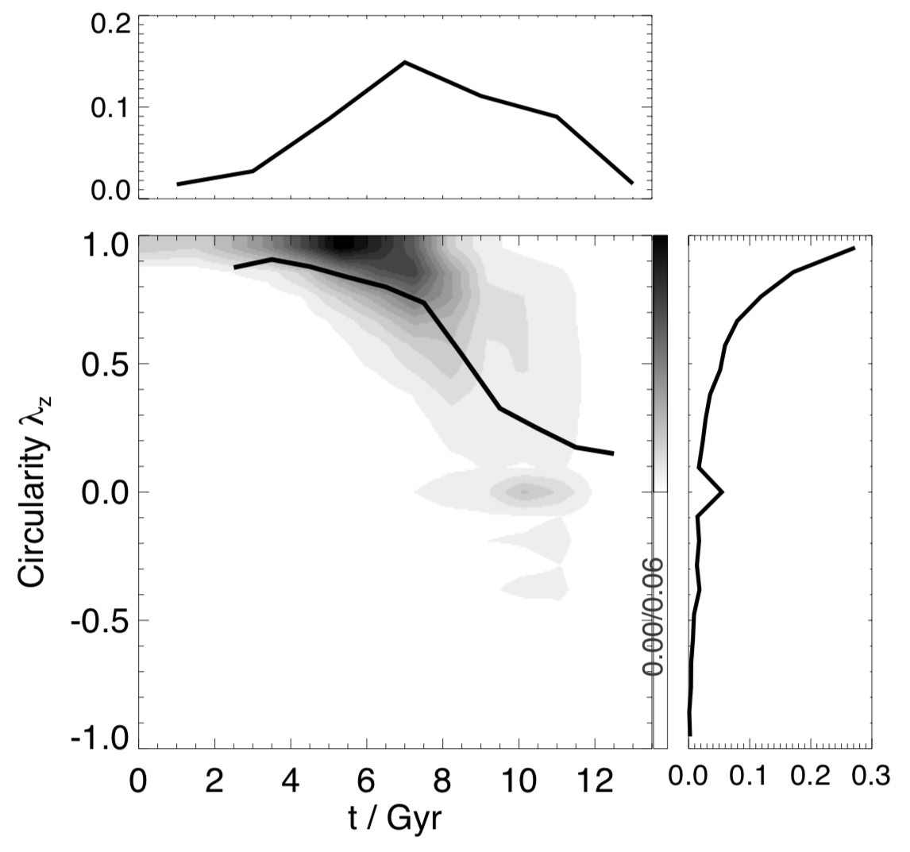
Tests with mock MUSE data - Auriga halo 6
Age vs. Circularity
Simulation:
Particles with known
(x, y, z, v_{x}, v_{y}, v_{z}, t, Z)
True
Stellar age t / Gyr

Slide 16
Tests with mock MUSE data - Auriga halo 6
Age vs. Circularity
Simulation:
Particles with known
(x, y, z, v_{x}, v_{y}, v_{z}, t, Z)
Mock data
Mock data
Best-fitting model
True
A orbit-superposed model tagged with t and Z
Stellar age t / Gyr

Slide 17
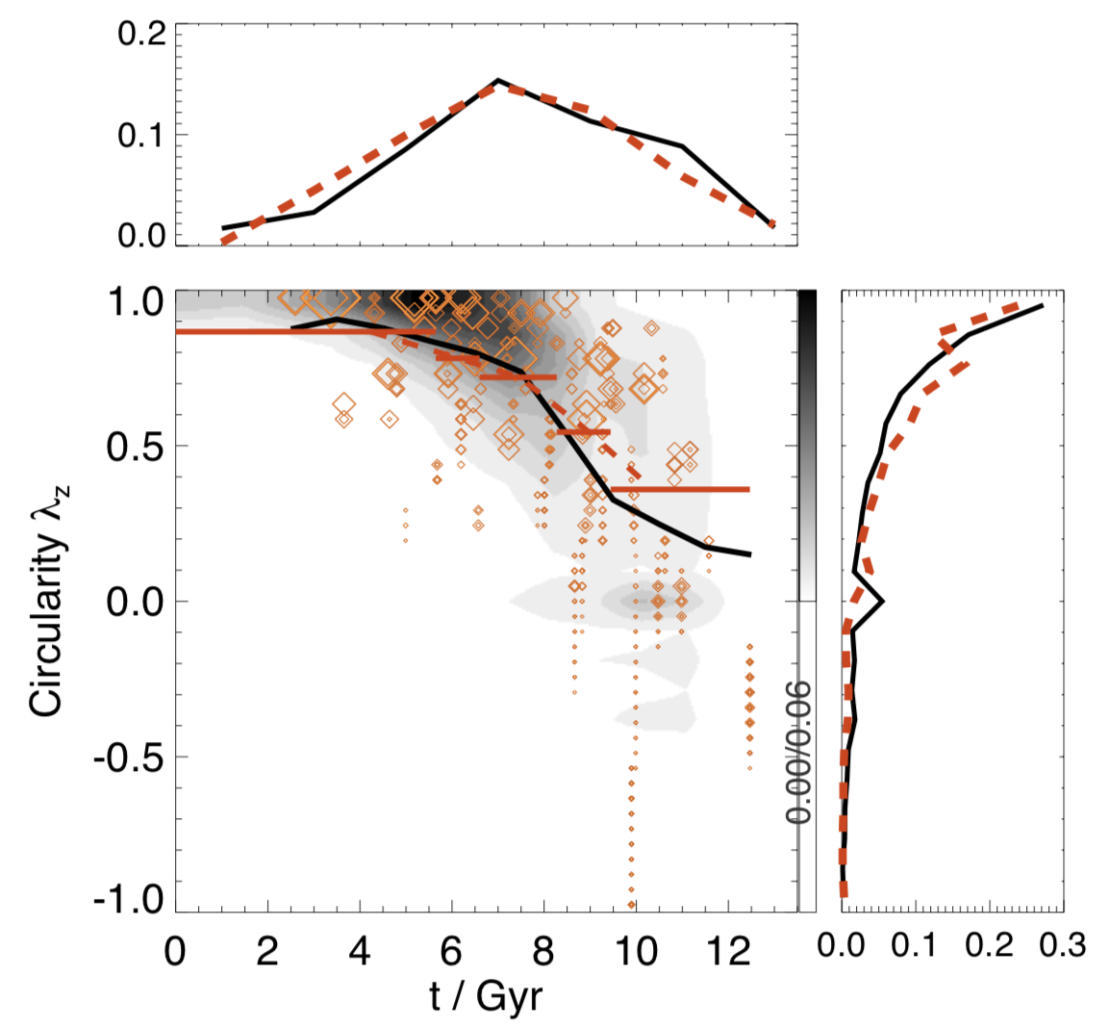
Tests with mock MUSE data - Auriga halo 6
Age vs. Circularity
Simulation:
Particles with known
(x, y, z, v_{x}, v_{y}, v_{z}, t, Z)
Mock data
Mock data
Best-fitting model
Young medium old
True
Model
A orbit-superposed model tagged with t and Z
Stellar age t / Gyr

Slide 18
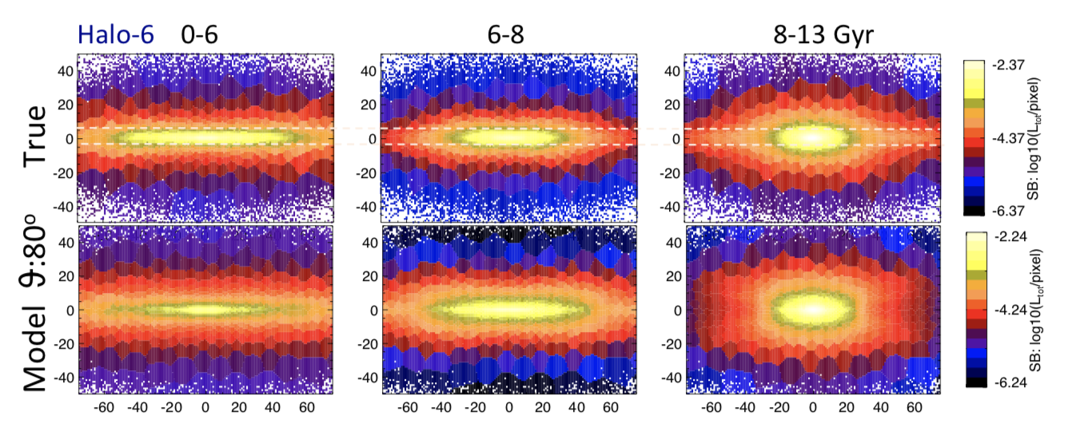
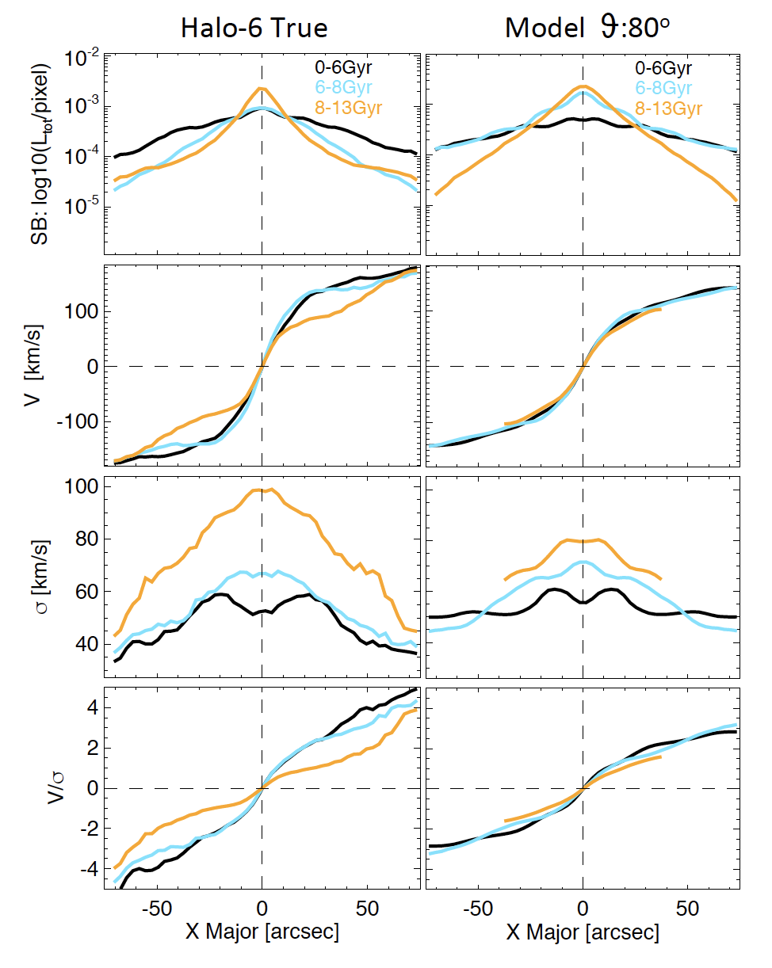
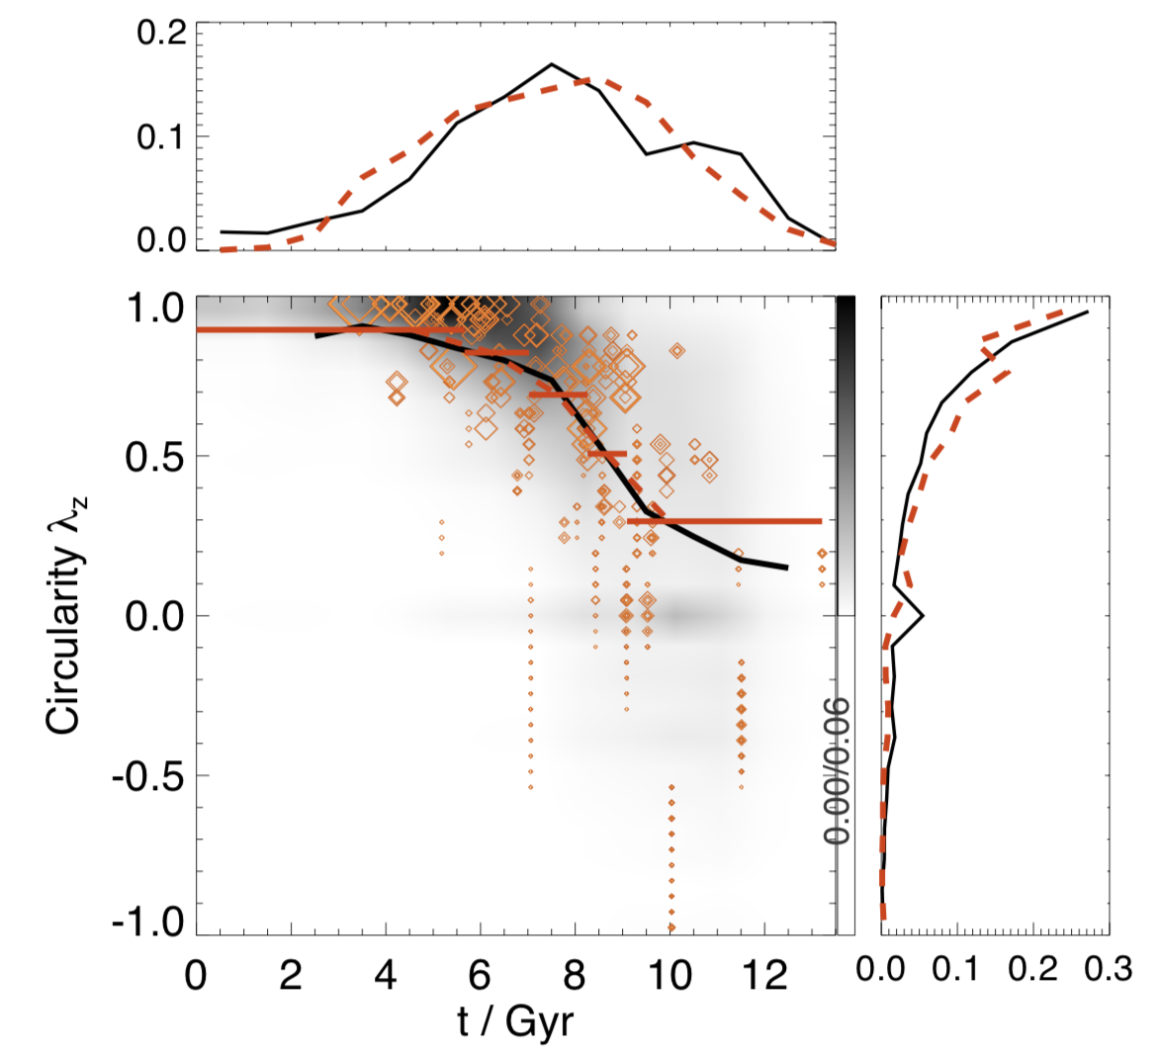
Orbital decomposition based on stellar age
Young medium old
True Model
V/σ σ[km/s] V[km/s] SB
Age vs. Circularity
Young medium old
X[arcsec] X[arcsec]
Surface brightness and Kinematics
of old, medium age and young stars

Slide 19
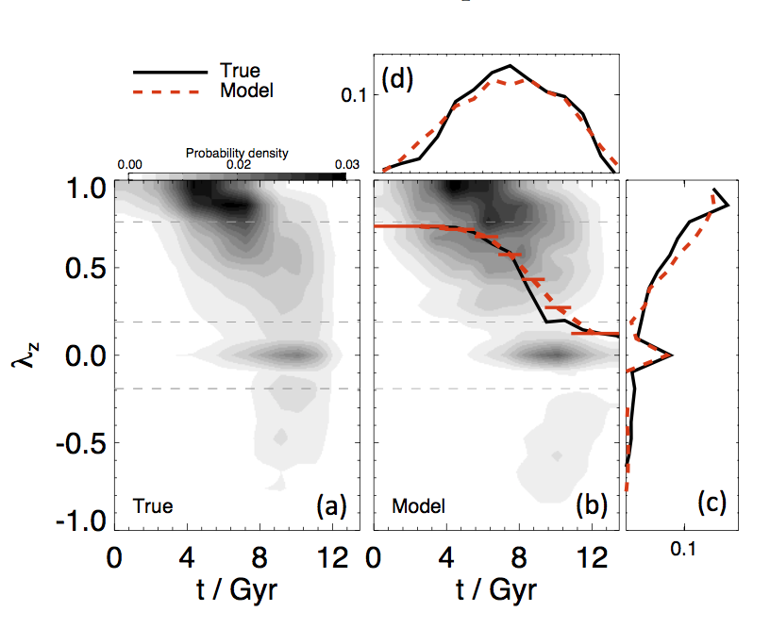
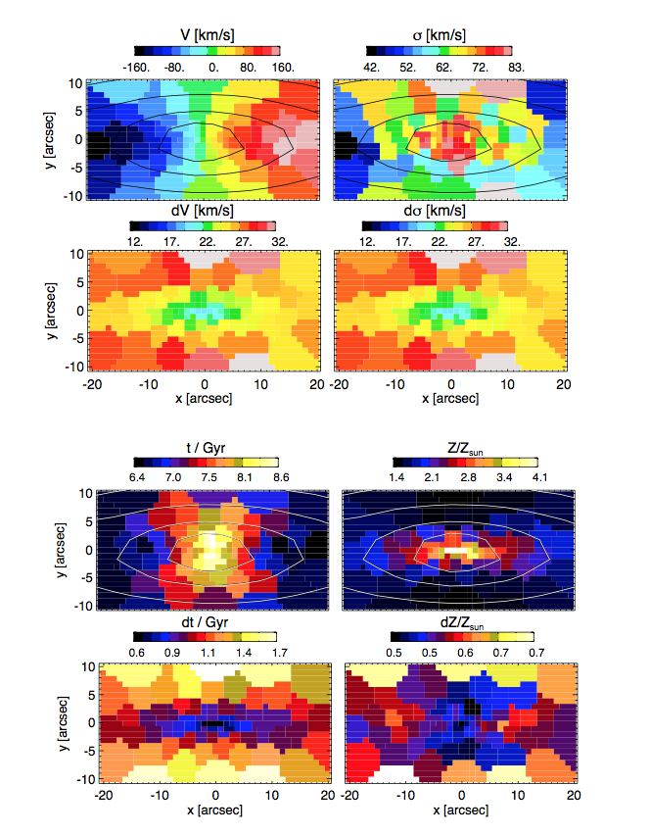
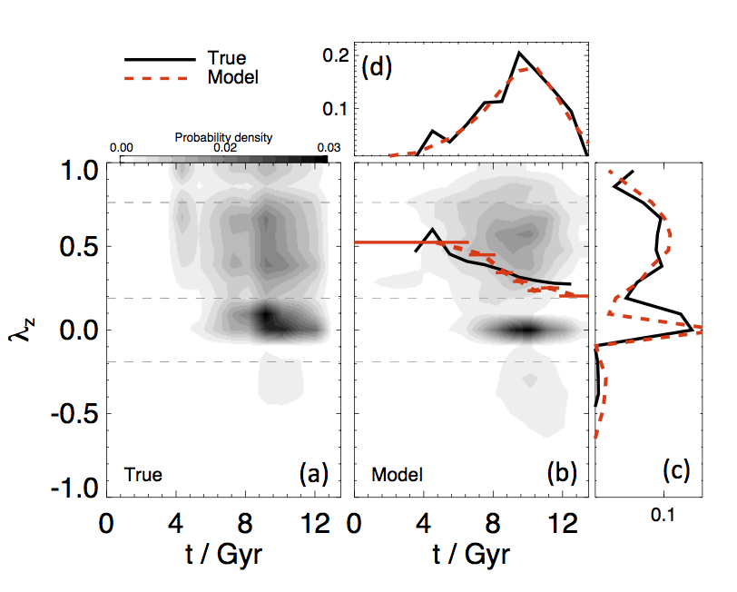
CALIFA/
MaNGA-like mock data
15 spirals
9 ellipticals
Zhu+ 2019 to be submitted

