Slide 1
Attenuation & Effective optical depth
Jiafeng lu
5/26/2021

Slide 2
Extinction and Attenuation
Extinction
The amount of light lost along a single sightline due to absorption or scattering away from the line of sight.
Dust property, dust column density
Attenuation
The effective amount of light lost in aggregate for a number of sightlines.
Dust property, dust mass
Distribution

Slide 3
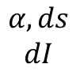
Optical depth
The relative reduction of radiation intensity
Attenuation coefficient
$$−dI=Iαds→I=I_{0}e^{−τ}$$
$$dτ=αds$$
$$A=m_{0}−m=2.5\lg{\frac{I_{0}}{I}}$$
$$A=2.5\lg{e}τ$$
$$I_{0}$$
$$I$$
$$α,ds$$
$$dI$$
$$τ$$

Slide 4
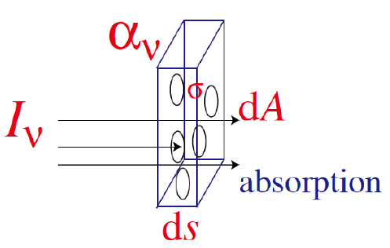
Optical depth Understanding from cross section
Medium particles
Cross section : σ
Given number density n, the covering area of particles in dV
n: dust column density, σ: dust property
Optical depth: indicator of dust column density
$$dA_{abs}=σdN=σndV=σndAds$$
$$−\frac{dI}{I}=\frac{dA_{abs}}{dA}=σnds$$
$$dτ$$

Slide 5
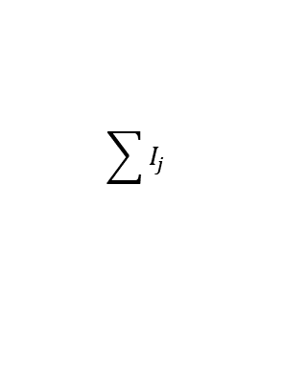
Effective optical depth
$$\sum{I_{j}}$$
$$I_{0,2}$$
$$τ_{2}$$
$\sum{I_{j}}=\sum{I_{0,j}e^{−τ_{j}}}$
Effective optical depth
$\hat{τ}=−\ln{\frac{\sum{I_{j}}}{\sum{I_{0,j}}}}$
Dust attenuation
Mean optical depth
$\overline{τ}=\frac{1}{n}\sum{τ_{j}}$
Mean dust column density
$$τ_{1}$$
$$I_{0,1}$$
$$I_{0,3}$$
Attenuation V.S. Amount of dust
?

Slide 6

Attenuation-distribution based
$$\hat{τ}=−\ln{\frac{\sum{I_{j}}}{\sum{I_{0,j}}}}$$
Example
Effective optical depth
$$τ$$
$$τ$$
$$τ$$
$$0< < < \frac{τ}{2} < <τ$$
$$τ$$
or Uniform mixed

Slide 7
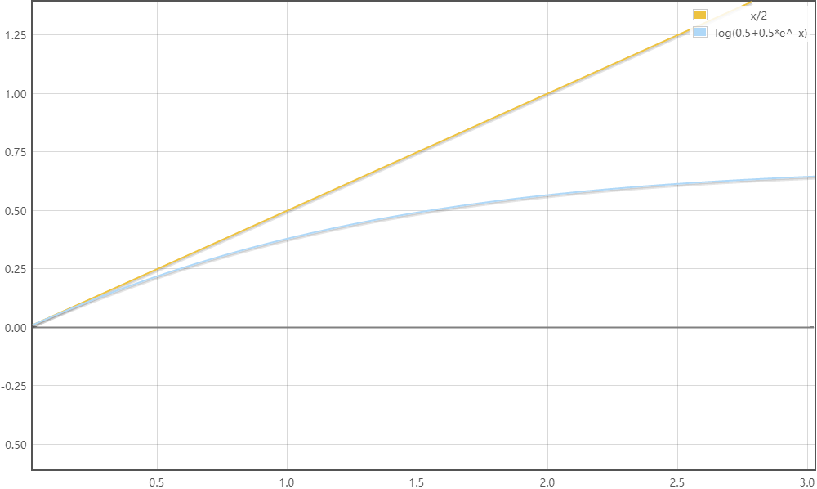

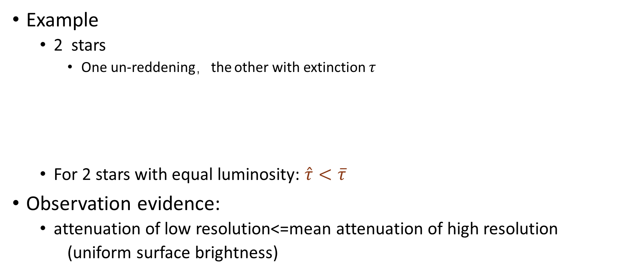
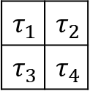
Attenuation-luminosity weighted
$$τ$$
$$\hat{τ}=−\ln{\frac{\sum{I_{j}}}{\sum{I_{0,j}}}}$$
Example
2 stars
One un-reddening，the other with extinction $τ$
For 2 stars with equal luminosity: $\hat{τ}<\overline{τ}$
Observation evidence:
attenuation of low resolution<=mean attenuation of high resolution
(uniform surface brightness)
Mean optical depth: 0.5$τ$
Effective optical depth:$−\ln{(\frac{I_{1}+I_{2}e^{−τ}}{2})}$
$$\hat{τ}\&\overline{τ}$$
$$τ$$
$$τ_{1}$$ | $$τ_{2}$$
$$τ_{3}$$ | $$τ_{4}$$

Slide 8
Attenuation
Attenuation-distribution based
Effective optical depth is not deeper than the overall light depth
Attenuation-luminosity weighted
attenuation of low resolution<mean attenuation of high resolution
Inference
Dust mixture & radiative transfer
Attenuation curve
Clumpy dust approximation

Slide 9
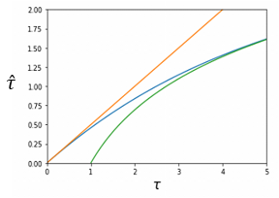


Dust mixture & radiative transfer
When radiation considered
$$jds−dI=Iαds$$
As light passes through medium, increment = radiation from the medium itself - the absorbed part
Uniform mixed
$$I_{\text{ν}}\left(τ_{\text{ν}}\right)=I_{\text{ν},0}\frac{1−e^{−τ_{\text{ν}}}}{τ_{\text{ν}}}$$
$$\hat{τ_{\text{ν}}}=−\ln{\frac{1−e^{−τ_{\text{ν}}}}{τ_{\text{ν}}}}\sim \left\{\begin{aligned}\frac{τ_{\text{ν}}}{2} ,τ_{\text{ν}}≪1 \\ lnτ_{\text{ν}} ,τ_{\text{ν}}≫1\end{aligned}\right.$$
$S_{\text{ν}}=\frac{j_{\text{ν}}}{α_{\text{ν}}}$, $dτ_{\text{ν}}=α_{\text{ν}}ds$
$\frac{dI_{\text{ν}}}{dτ_{\text{ν}}}=S_{\text{ν}}−I_{\text{ν}}$

Slide 10
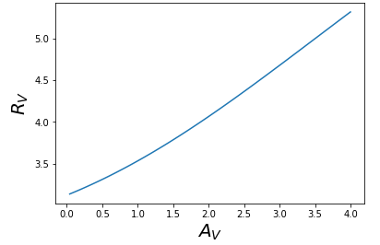

Attenuation curve-distribution
$$\hat{τ_{\text{ν}}}=−\ln{\frac{1−e^{−τ_{\text{ν}}}}{τ_{\text{ν}}}}\sim \left\{\begin{aligned}\frac{τ_{\text{ν}}}{2} ,τ_{\text{ν}}≪1 \\ lnτ_{\text{ν}} ,τ_{\text{ν}}≫1\end{aligned}\right.$$
Uniform mixed as example(galaxy as a whole)
Assume a power law extinction curve with Rv=3.1
When $τ_{\text{ν}}=1$:
$\hat{τ_{V}}=0.458$, $\hat{τ_{B}}=0.588$, $R_{V}=$3.52
When $τ_{\text{ν}}=2$:
$\hat{τ_{V}}$=0.838, $\hat{τ_{B}}=1.044$, $R_{V}=$4.06
Attenuation curve become flatter when optical depth growth
the deeper the optical depth is, the slower the equivalent optical depth increases
$$R_{V}=\frac{A_{V}}{A_{B}−A_{V}}$$

Slide 11
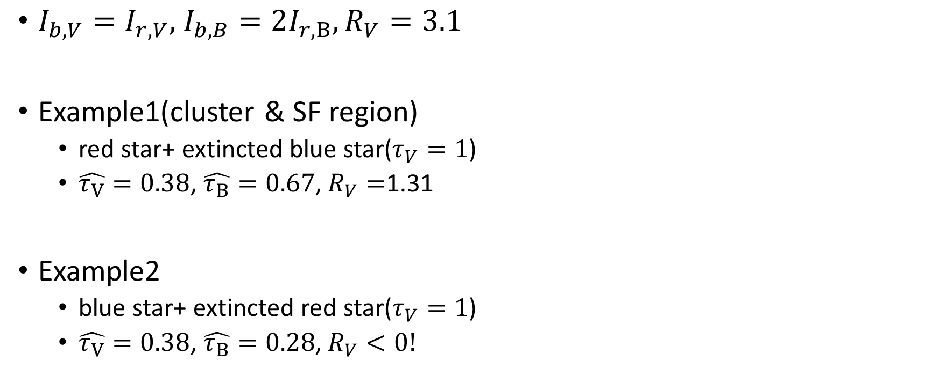
Attenuation curve-luminosity weighted
$I_{b,V}=I_{r,V},$ $I_{b,B}=2I_{r,B}, R_{V}=3.1$
Example1(cluster & SF region)
red star+ extincted blue star($τ_{V}=1$)
$\hat{τ_{V}}=0.38$, $\hat{τ_{B}}=0.67$, $R_{V}=$1.31
Example2
blue star+ extincted red star($τ_{V}=1$)
$\hat{τ_{V}}=0.38$, $\hat{τ_{B}}=0.28$, $R_{V}<0!$

Slide 12
Clumpy dust approximation
Continuous dust first
$I=I_{0}e^{−τ}$
Clumpy dust
n clumps with extinction$τ$ in the path
each has a probability p of obscuring
$I=I_{0}e^{−npτ}$ ?
$$τ$$
$$τ,p$$
n

Slide 13

Clumpy dust approximation
Number of covering clumpy
Following B(n,p)
$P\left\{X=k\right\}=\left({n \atop k}\right)p^{k}{(1−p)}^{1−k}$
average attenuated flux:
$\sum_{0}^{n}{I_{0}\left({n \atop k}\right)p^{k}{(1−p)}^{1−k}∗e^{−kτ}}$
$$τ,p$$
n

Slide 14

Clumpy dust approximation
$$\sum_{0}^{n}{I_{0}\left({n \atop k}\right)p^{k}{(1−p)}^{1−k}∗e^{−kτ}}$$
Continuous approximation
balance the tail in binomial distribution
$$\overline{I}=I_{0}\int{N(k|np,np(1−p))}∗e^{−kτ}dk$$
$$\hat{τ}≈\frac{npτ\left(2−τ+pτ\right)}{2} (τ≲1)$$
$$τ\sim 0,p\sim 0$$
$$\hat{τ}≈nσ$$
$$τ,p$$

Slide 15
Conclusion
Extinction
Depend on dust property and dust column density
Attenuation
distribution based
luminosity weighted
Inference
Mixing flattens the attenuation curve
Attenuated blue stars make the attenuation curve steep
Clumpy dust attenuate lesser than diffuse dust

