Slide 1
Bayesian Statistics
2021.9.27
Rongrong Liu
Supervisor: Zhengyi Shao

Slide 2
Outline
Various methods of fitting
Bayesian formula
Bayesian inference

Slide 3
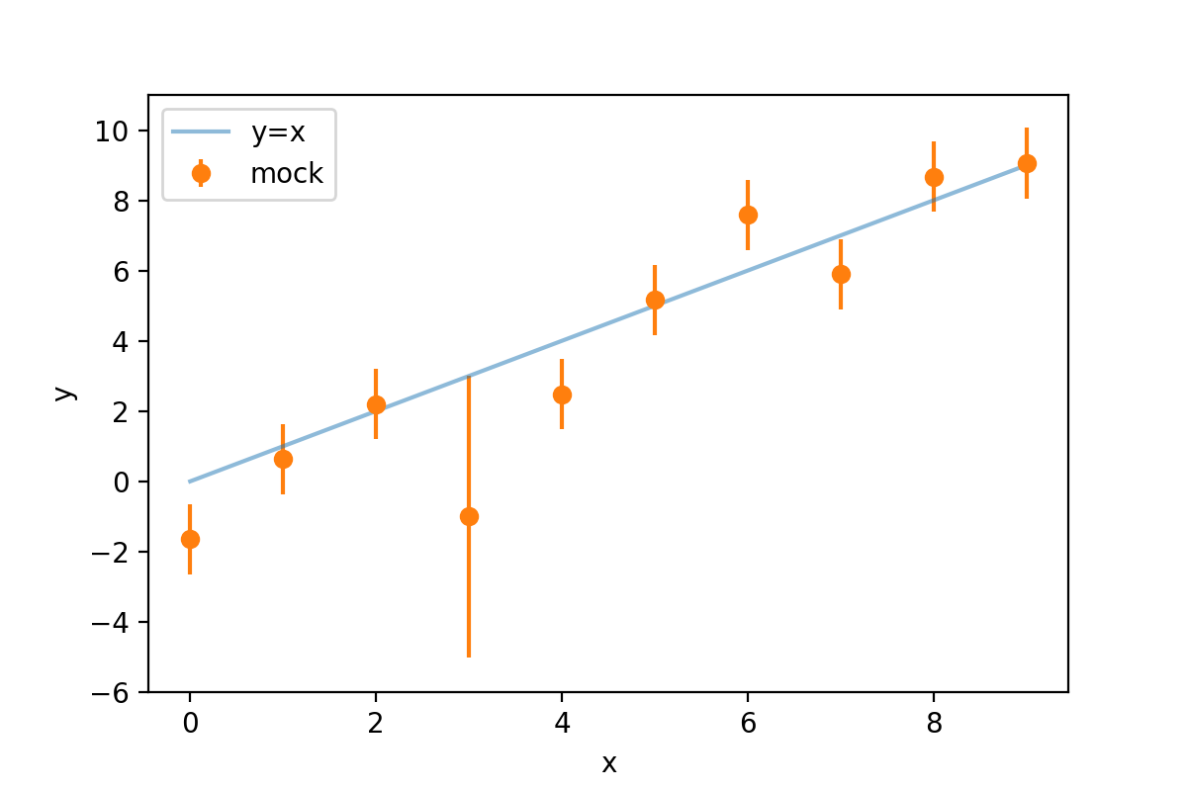
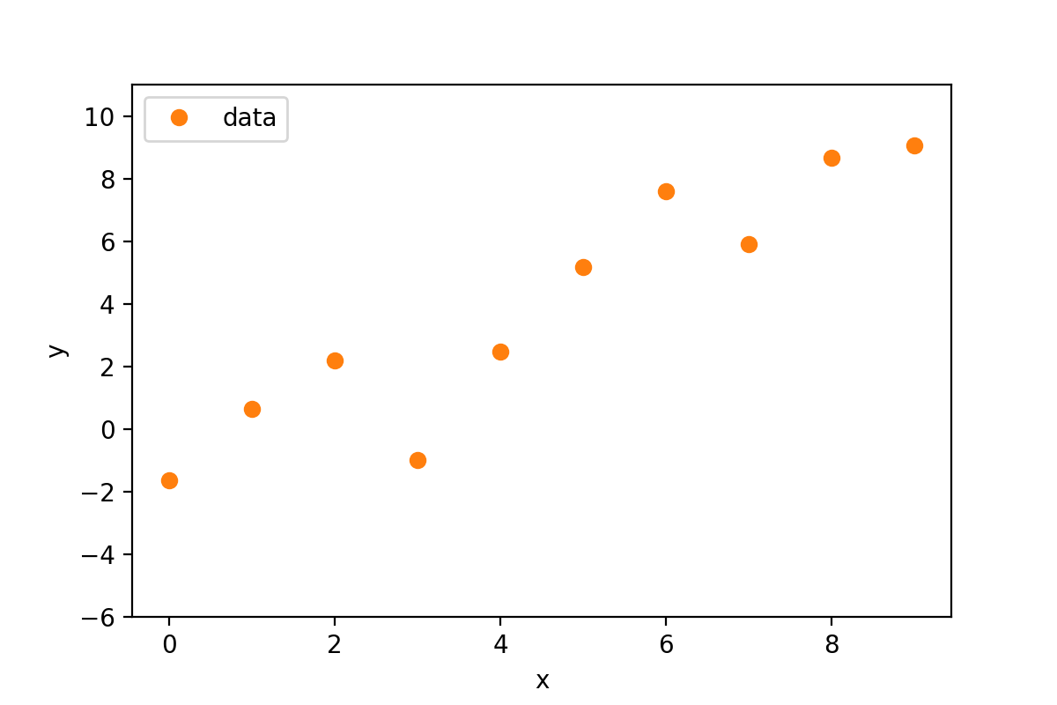
Various methods of fitting
We have some data, and we want to fit the data with a line.
$$model: y=x$$
$$mock=model+N(0,error)$$

Slide 4
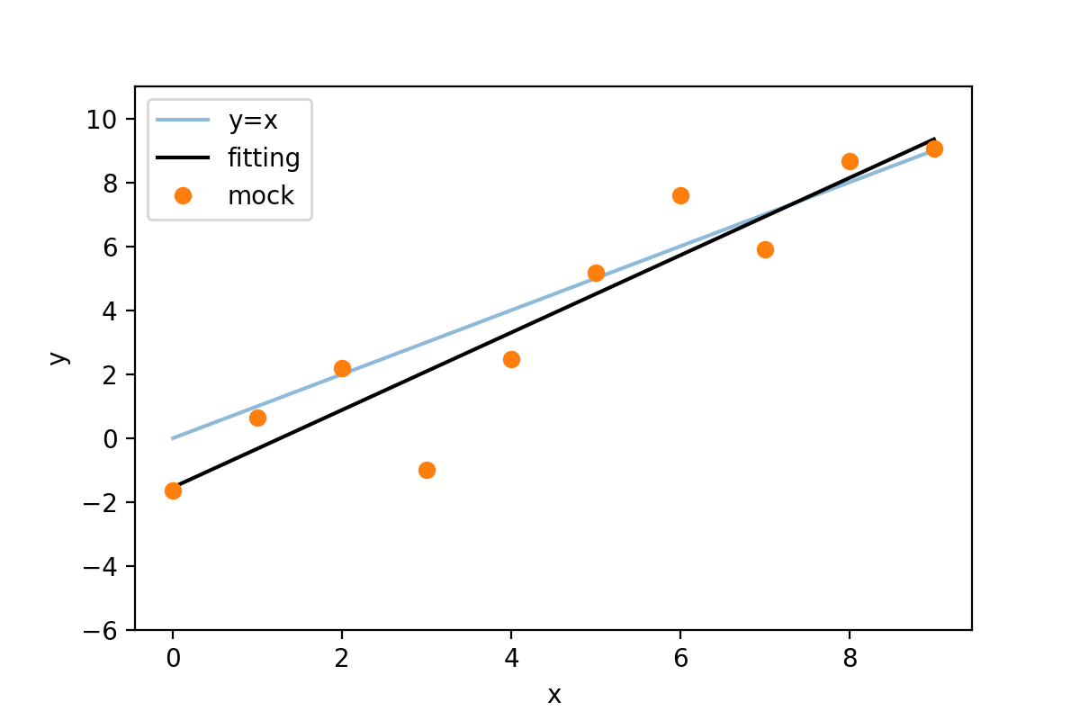

Various methods of fitting
least square
$$S^{2}=\sum_{i=1}^{n}{{(y_{i}−y\left(x_{i};a,b\right))}^{2}}$$
$$y=ax+b$$
package: scipy.optimize.leastsq
The shortest distance to the line means the best fitting.

Slide 5
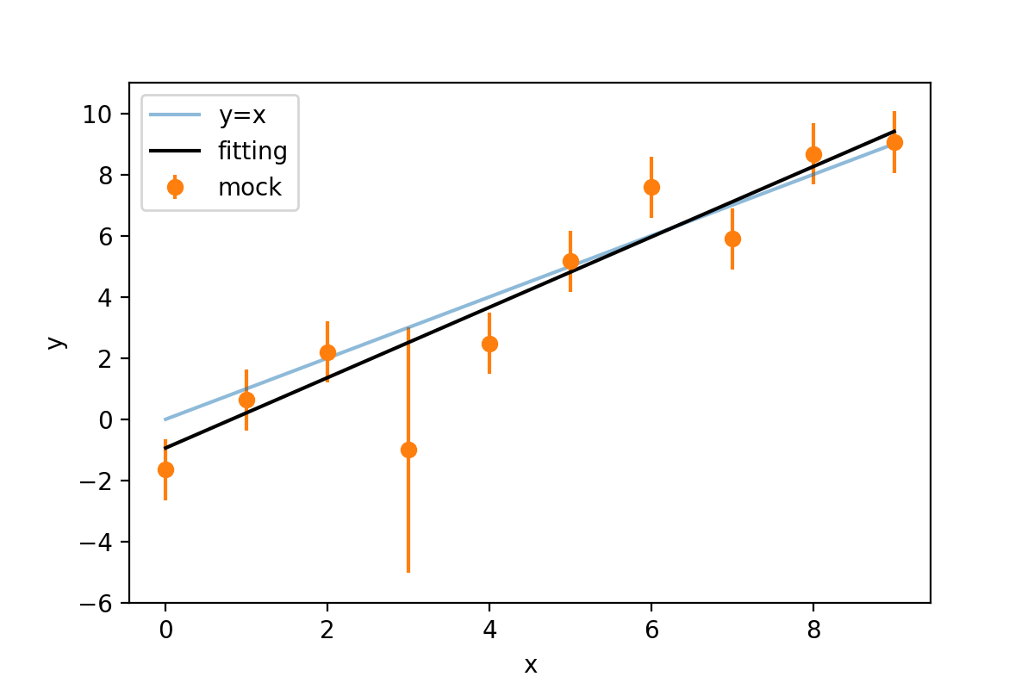
Various methods of fitting
minimum chi-square
If errors are equal, $χ^{2}∝S^{2}$
package: scipy.optimize.minimize
Larger error means lower weight.

Slide 6

Various methods of fitting
maximum likelihood
$$L\left(\left\{y_{i}\right\} | a,b\right)=\prod_{i=1}^{n}{P\left(y_{i} | a,b\right)}$$
If $y_{i} \sim N\left(μ, error_{i}\right), L∝exp⁡(−\frac{χ^{2}}{2}$)
The largest probability of the data given parameters means the best fitting.

Slide 7

Bayesian Formula
$P\left(B | A\right)=P\left(AB\right)/P(A)$
$$P\left(AB\right)=P\left(B | A\right)P\left(A\right)=P\left(A | B\right)P\left(B\right)$$

Slide 8
Bayesian Inference
Posterior: the probability of the parameters of model given data
Likelihood: the probability of data given the parameters of model
B is model, A is data
Prior: our information of parameters of the model
Evidence: the probability of data (We can use evidence to compare different models.)

Slide 9
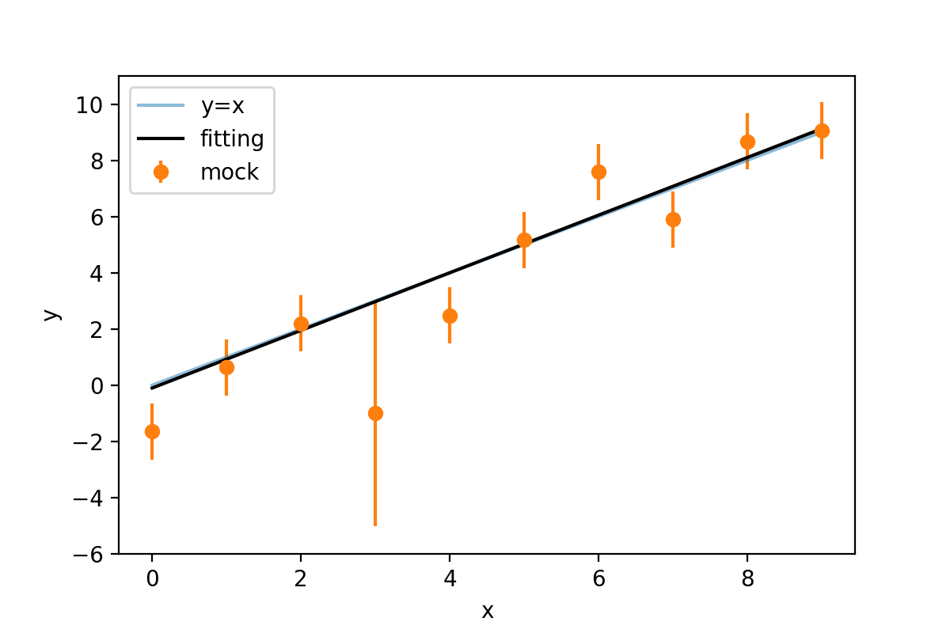

Bayesian Inference
$$P\left(a,b | \left\{y_{i}\right\}\right)∝P\left(\left\{y_{i}\right\} | a,b\right)P\left(a,b\right)$$
$$P\left(b\right)=uniform(−0.1, 0.9)$$
If prior is uniform distribution in the whole space,$P∝L$
package: dynesty
When errors of data are too large to constrain parameters, prior is dominant in fitting.

Slide 10
Summary
information of parameters
choose model
choose fitting method
different error
probability
prior
least square
minimum chi-square
maximum likelihood
Bayesian inference
equal error
data~N(u, error)
no prior

