Slide 1
SFH of dwarf galaxies in the Local Group
Jun @ Group meeting
2018.9.30

Slide 2
Content
What is a dwarf galaxy
SFH: Synthetic CMD method
SFH of dwarf galaxies in the LG

Slide 3
I. What is a dwarf galaxy
Virgo & Fornax
BCD
Size? Dark matter halo?
All galaxies that are fainter than M_{B} ≤ −16 (M_{V} ≤−17) and more spatially extended than globular clusters are dwarf galaxies (Tammann 1994)
there is no clear separation between dwarf galaxies and the larger late-type and spheroidal systems. The dIs, BCDs, dSphs, hence late-type and spheroidal galaxies tend to overlap with each other in this parameter space.
LG dwarf
(Tolstoy et al. 2009, ARA&A, 47, 371)

Slide 4
(Tolstoy+ 2009, Gallart 2007)

Slide 5
II. SFH: Synthetic CMD method
The synthetic CMD method is based on comparing observed with theoretical CMDs created via Monte-Carlo-based extractions from stellar evolution tracks, or isochrones, for a variety of star-formation laws, IMFs, binary fractions, age-metallicity relations, etc. Photometric errors, incompleteness, and stellar crowding factors also have to be estimated and included in the procedure to fully reproduce an observed CMD
A combination of assumed parameters is acceptable only if the resulting synthetic CMD satisfactorily reproduces all the main features of the observational one. This means morphology, luminosity, color distribution, and number of stars in specific evolutionary phases.
Different researchers use different approaches to assess the quality of the fit, typically using a form of likelihood analysis comparing the model and the data within the uncertainties of the measurement errors.
The method is intrinsically statistical in nature and cannot provide a unique solution for the SFH for a number of reasons, but it usefully limits the range of possible scenarios

Slide 6

An example
II. SFH: Synthetic CMD method
Aquarius
(Cole+ 2014, ApJ, 795, 54)
Uncertainty
  Random
    Finite number of stars
  Systematic
    different stellar library
    coarse grids of model
  Without a spectroscopic estimate of the metallicity, it is impossible to break age-metallicity degeneracy, unless the MSTOs are also observed
(Tolstoy+ 2009, ARA&A, 47, 371)

Slide 7
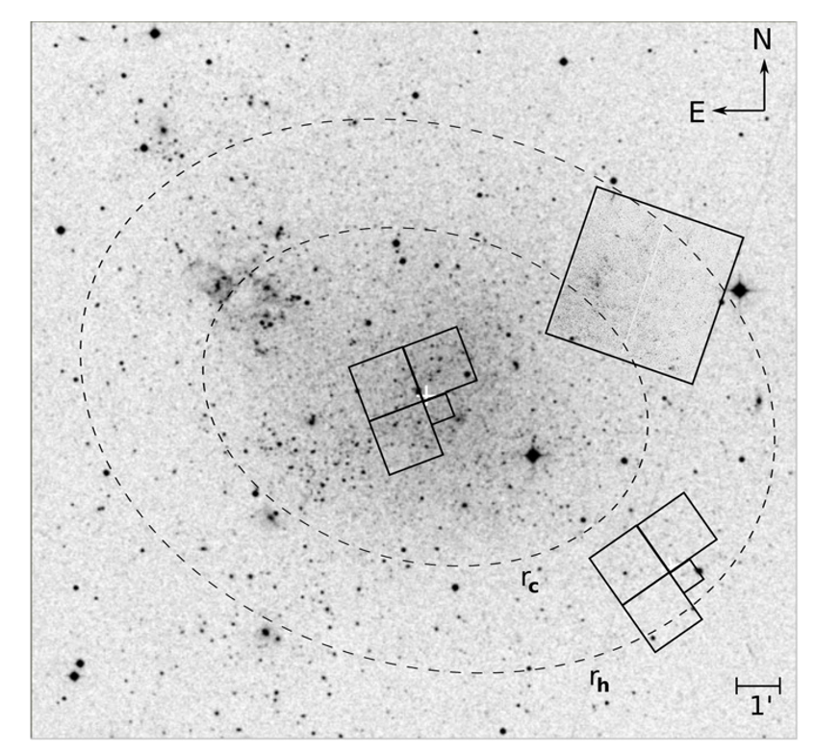
The reliability
II. SFH: Synthetic CMD method
LCID
C99
S03
IC1613
  Skillman+ 2003 tested 3 methods
    Tolstoy method: no interpolation, no bin, no binary, statistical measurements are used to guide choices between prescribed solutions.
    Cole method: interpolation√, bin √, binary √, determining the SFH by using a downhill simplex algorithm with simulated annealing to minimize the difference between the observed and synthetic Hess diagrams. The distance, reddening, and age-metallicity relation were held fixed, and the SFR is solved for as a function of time.
    Dolphin method: : interpolation√, bin √, binary √, The underlying principle of this approach is to determine the distance, extinction, SFH, and chemical enrichment evolution most likely to produce the observed CMD. Both the metallicity and SFR are solved for as a function of time.
  Despite significant differences in technique between the different modeling approaches, the basic shape of the derived SFH is robust.
(Skillman+ 2003, Tolstoy+ 2009)

Slide 8
III. SFH of dwarf galaxies in the LG
(Weisz+ 2014, ApJ, 789, 147)

Slide 9
IC1613
III. SFH of dwarf galaxies in the LG
S14
C99
S03
C99
S03
C99
S03
S14
(Cole+ 1999, ApJ, 118, 1657)
(Skillman+ 2003, ApJ, 596, 253)

Slide 10
IC1613
III. SFH of dwarf galaxies in the LG
S14
C99
S03
S14 (LCID)
C99
S03
S14
(Skillman+ 2014, ApJ, 786, 44)

Slide 11
SFH from CMD
III. SFH of dwarf galaxies in the LG
dSph, D=101 kpc
dSph, D=775 kpc
dTran, D=620 kpc
dIrr, D=800 kpc
(Tolstoy et al. 2009, ARA&A, 47, 371)

Slide 12
III. SFH of dwarf galaxies in the LG
6 LCID galaxies
(Skillman+ 2014, ApJ, 786, 44)

Slide 13
III. SFH of dwarf galaxies in the LG
40 dwarfs in LG
D < ~1 Mpc
23 dSphs
4 dEs
8 dIrrs
5 dTrans
(Weisz+ 2014, ApJ, 789, 147)

Slide 14
Leo T
Dolphin method
(Weisz+ 2014, ApJ, 789, 147)

Slide 15
III. SFH of dwarf galaxies in the LG
SFH of different type
dSph
  On average, old systems, have formed the vast majority of their stars prior to z ∼ 2 (10 Gyr ago).
  Significant scatter
dIrr
  On average, dIrrs formed ∼30% of their stellar mass prior to z ∼ 2, and show an increasing SFR toward the present, beginning around z ∼ 1 (7.6 Gyr ago)
  modest scatter
  How low mass galaxies evolve without significant environmental influence?
dTrans
  have formed >45% of their total stellar mass prior to z ∼ 2, and have experienced nearly constant SFRs since that time.
  modest scatter
  Quenching mechanisms
dE
  typically have an initial burst of star formation prior to ∼12 Gyr ago, followed by a nearly constant SFR
  little scatter
  declining SFHs starting at z ∼ 0.1 (2 Gyr ago).
(Weisz+ 2014, ApJ, 789, 147)

Slide 16
III. SFH of dwarf galaxies in the LG
SFH of different type
On average, all morphological types formed ∼30% of their stars prior to 12 Gyr, and are only statistically different after this epoch.
the luminous dSphs (e.g., Fornax, Leo I) and dIrrs generally have similar, extended SFHs, while the lower luminosity dSphs (e.g., Leo IV) do not.
3 SFH model
  single old population
  exponentially declining “τ -models,”
  constant
dSphs
  Average SFH is well-approximated by a τ -model with τ = 5 Gyr.
dIrrs, dTrans, and dEs
  all show a modest initial burst in their SFHs (>10–12 Gyr ago) followed by nearly constant or slightly rising SFHs.
(Weisz+ 2014, ApJ, 789, 147)

Slide 17
III. SFH of dwarf galaxies in the LG
SFH of different mass
M* < 10⁵ Msun
  formed ∼80% of their stellar mass prior to z ∼ 2
M* > 10⁷ Msun
  only ∼30% by the same epoch
against “downsizing” ? lowest mass galaxies have truncated their star formation at earlier times?
  Lowest mass galaxies
    within viral radius of MW or of M31
    ram pressure stripping, tidal interactions
  More massive dwarfs
    outside the virial radii of MW or M31
SFH of different Environment
All formed similar fractions of stellar mass prior to ~10-12 Gyr ago.
Field galaxies
  Little mass growth from 12 to 7 Gyr ago
  Rising SFH from 7 Gyr ago
MW satellites – large scatter
M31 & field – noticeably less
Different assembly histories
Or different external processes
(Weisz+ 2014, ApJ, 789, 147)

Slide 18
III. SFH of dwarf galaxies in the LG
Beyond the LG
Faint, crowd
Mainly BCDs
D>1 Mpc
  Few Gyr (RGB, HB)
  ?00 Myr (AGB)
  ?0 Myr (supergiant)
BCD
BCD
dI
BCD
BCD
LSB
IC1613
(Tolstoy et al. 2009, ARA&A, 47, 371)

Slide 19
III. SFH of dwarf galaxies in the LG
60 dwarfs in LV
ANGST
  ACS Nearby Galaxy Survey Treasury program
D < ~4 Mpc
12 dSph/dE
5 dSpiral
28 dIrr
12 dTrans
3 dTidal
~10 mag in M_{B}
NOT complete
(Weisz+ 2011, ApJ, 739, 5)

Slide 20
III. SFH of dwarf galaxies in the LG
All morphological types sample a comparable range of SFHs for times >~1 Gyr ago, with the exception of dTidals
within the last 1 Gyr, where dSphs exhibit a significant drop in SFRs relative to the other types
→ gas loss can occur relatively quickly and at late times?
(Weisz+ 2011, ApJ, 739, 5)

Slide 21
III. SFH of dwarf galaxies in the LG
Difference is small
Form the bulk of its stellar mass prior to z~1, independent of type
Clearly difference in the mean SFHs within the most recent 1 Gyr
  The typical dSph, dI, dTrans, and dSpiral formed ∼2%, 8%, 4%, and 5% of their total stellar mass within the most recent 1 Gyr.
  → present-day morphological typing is strongly influenced by SF that occurred in the most recent 1 Gyr.
(Weisz+ 2011, ApJ, 739, 5)

Slide 22
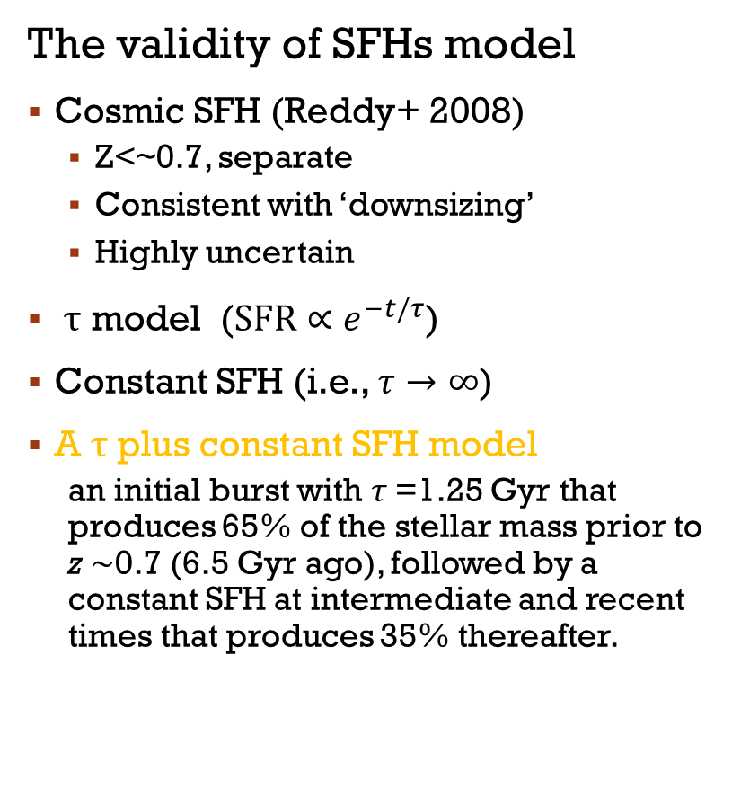
III. SFH of dwarf galaxies in the LG
The validity of SFHs model
Cosmic SFH (Reddy+ 2008)
  Z<~0.7, separate
  Consistent with ‘downsizing’
  Highly uncertain
τ model ($\text{SFR}∝e^{−t/τ}$)
Constant SFH (i.e., $τ→∞$)
A τ plus constant SFH model
  an initial burst with τ =1.25 Gyr that produces 65% of the stellar mass prior to z ∼0.7 (6.5 Gyr ago), followed by a constant SFH at intermediate and recent times that produces 35% thereafter.
(Weisz+ 2011, ApJ, 739, 5)

Slide 23
III. SFH of dwarf galaxies in the LG
dSph
Little SF in the most recent 1 Gyr compared to gas-rich dwarfs,
similar total stellar masses
SFHs that are generally extended and indistinguishable from dIs
they are located exclusively in high-density environments.
Mechanisms for gas removal
Consumption through SF ×
Stellar feedback ×
Ram pressure stripping √
Tidal effects √

Slide 24
What do you remember?

