Slide 1
HI gas and angular momentum

Slide 2
ALFALFA (Arecibo Legacy Fast ALFA) Arecibo L-band Feed array
HIPASS (21341 deg², 2004, southern sky)
ALFALFA (~6900 deg²)
2.4mJy rms @ 10kms⁻¹ resolution
3.3x3.8 arcmin x 7 beams
ALFALFA 40 (2011), ALFALFA 70(2016), ALFALFA 100(2018-03)
Spring sky (Virgo 7.5-16.5hr RA)
Fall sky (Pisces 22-3hr RA)
0-36 dec
-1600km/s<cz<18000 km/s
DATA release http://egg.astro.cornell.edu/alfalfa/data/index.php

Slide 3
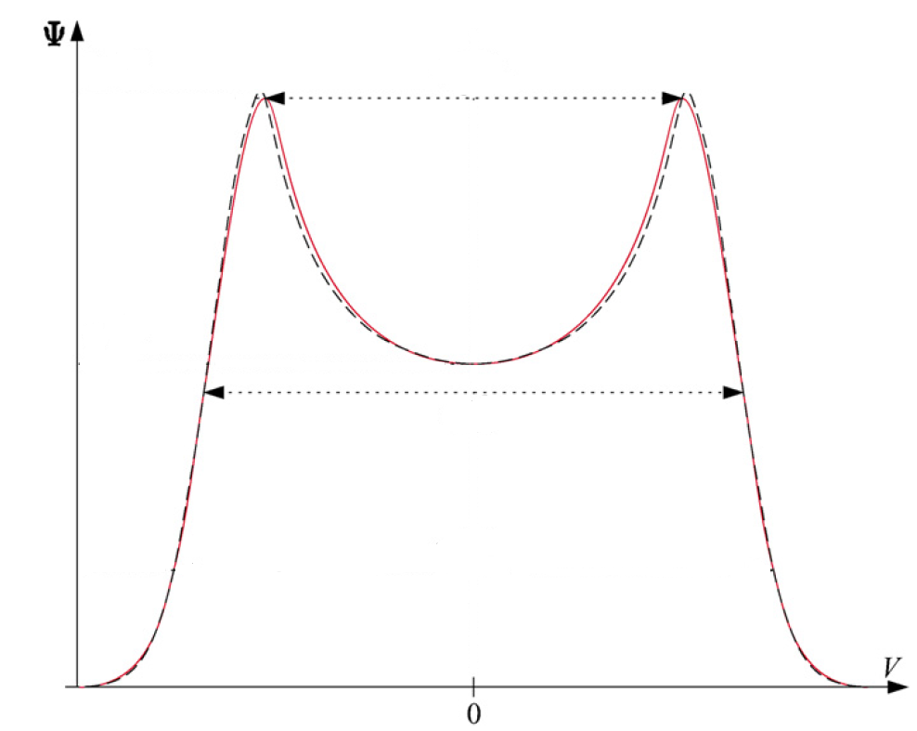
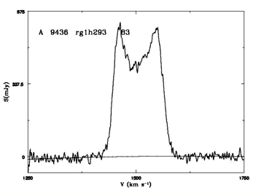
HI velocity width function
The HI velocity width function gives a perspective on the dark matter halo mass function.
W₅₀ functions

Slide 4
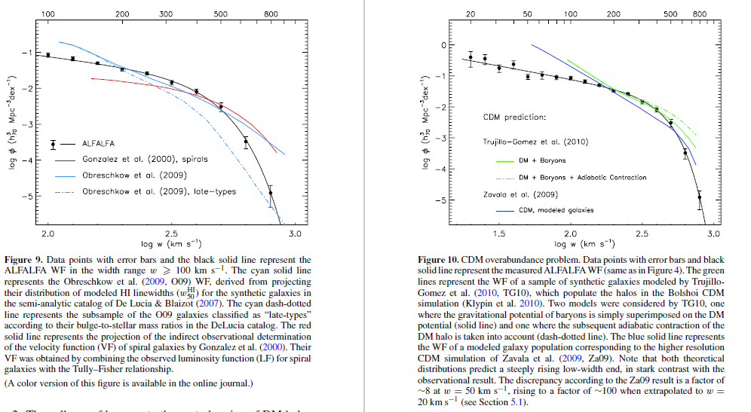

Slide 5
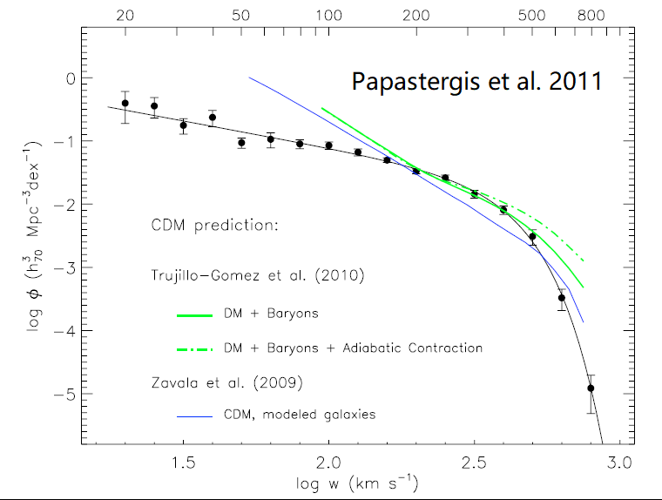
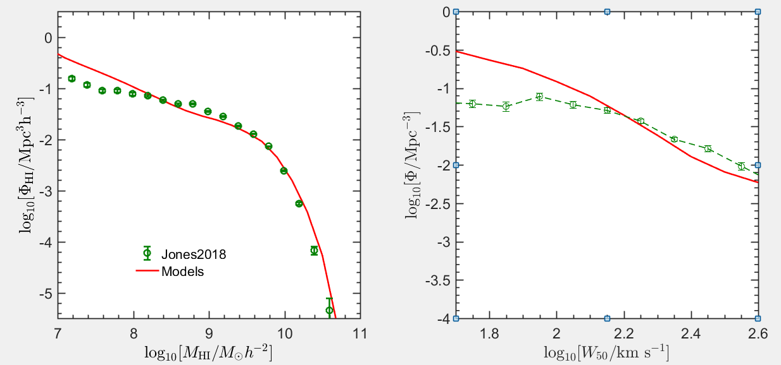
HI Velocity distribution function
HI gas distribution in haloes

Slide 6
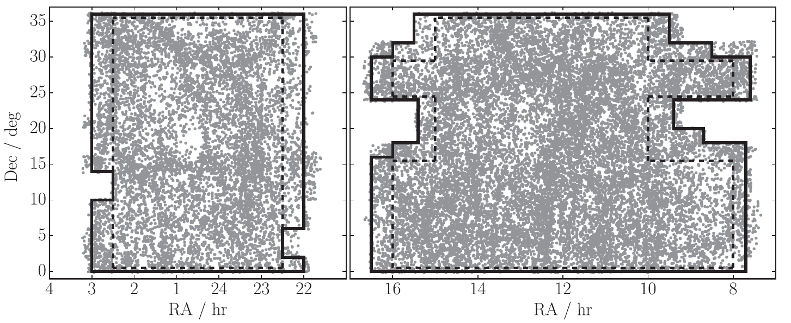
ALFALFA 100
\[\frac{{{F_{{\rm{HI}}}}}}{{{\rm{Jy km/s}}}} > 0.06{\left( {\frac{{{W_{50}}}}{{{\rm{km }}{{\rm{s}}^{{\rm{ - 1}}}}}}} \right)^{0.51}}\]

Slide 7
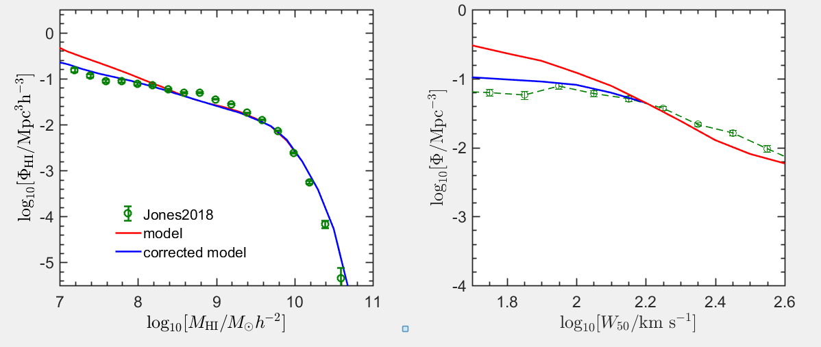
Constraint the angular momentum (lambda)
Smaller haloes with higher λ high f_{HI}
Inclination effect
Select haloes with high λ in low mass haloes

Slide 8
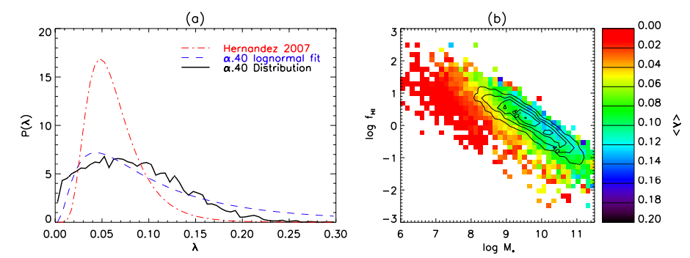
Relation between f_{HI} and j_{halo}
gas richness related to halo angular momentum
Huang Shan et al. 2012

Slide 9
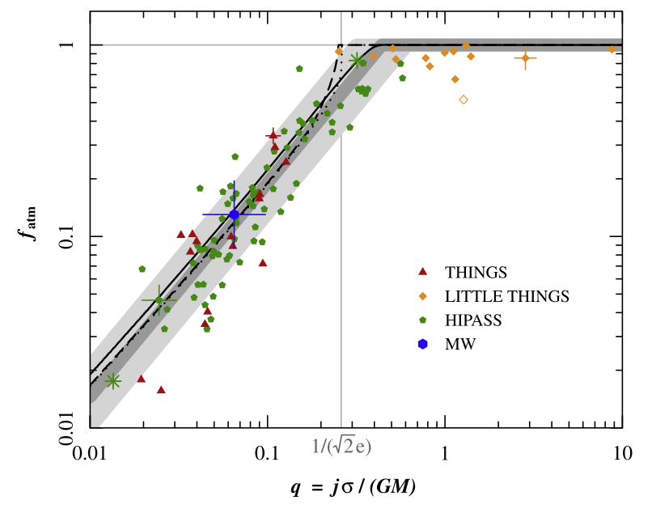
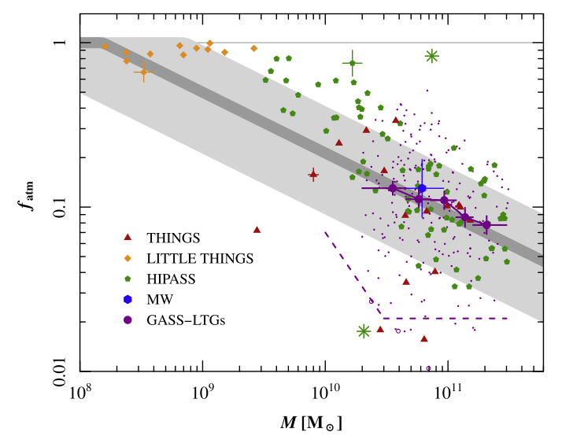
Models for f_{HI} and j_{halo} (Obreschkow et al. 2016)
isolated exponential disks
the outer HI gas disk stable in the sense of Toomre
the inner disk dominated by stars and molecules is Toomre unstable

