Slide 1
Stellar Populations of Nuclear Star Clusters
Rongrong Liu
2021.11.17

Slide 2
Outline
What is a nuclear star cluster?
Definition
Properties
Nuclear star clusters and their host galaxies
Formation mechanisms of NSCs
Cluster inspiral formation
In situ formation
different galaxies and different mechanisms
Stellar populations of NSCs in different galaxies
Metallicity and age
Transition
Spatially resolving the SFHs of NSCs
Summary
Reference
What can we do with NSCs.

Slide 3
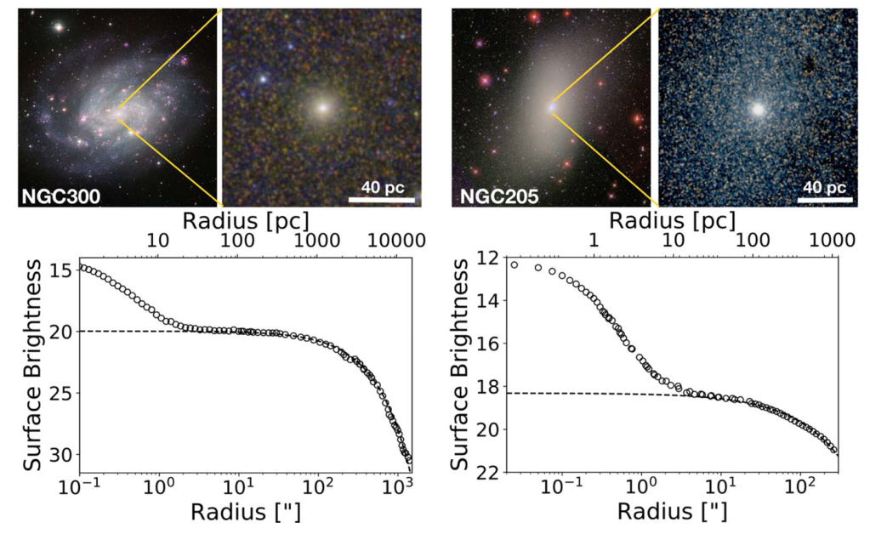
What is a nuclear star cluster?
Definition: The detection of stellar excess light above the inward extrapolation of the host galaxy’s surface brightness profile on scales of ≤50 pc

Slide 4
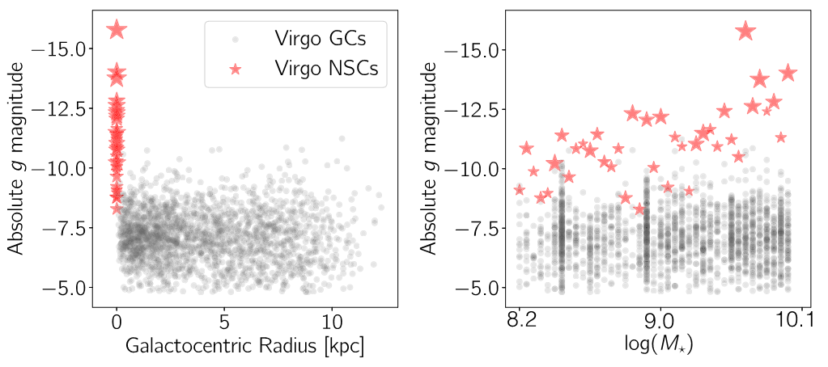
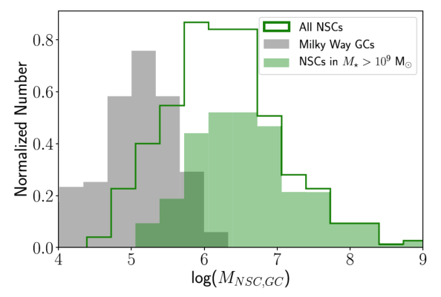
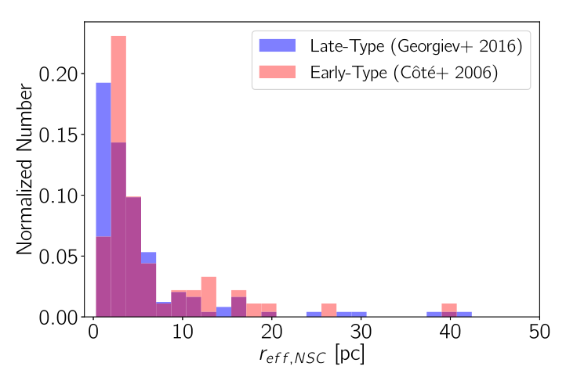
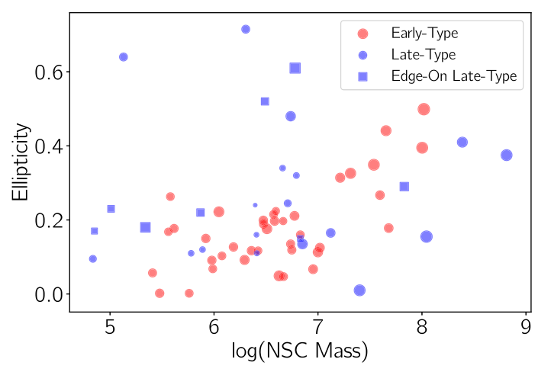
What is a nuclear star cluster?
Properties
Bright
Massive
Compact
elliptical

Slide 5
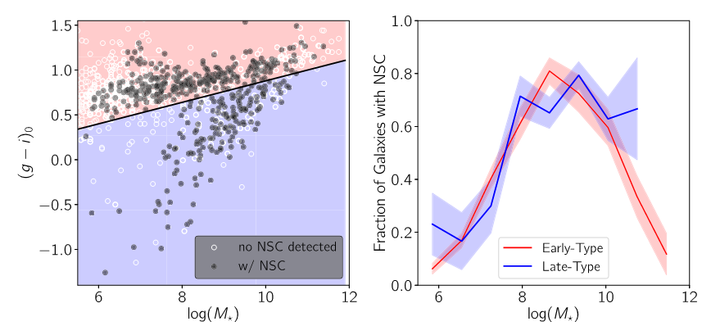
What is a nuclear star cluster?
Nuclear star clusters and their host galaxies
Galaxies with mass between 10⁸ M☉ to 10¹⁰ M☉ have more NSCs.

Slide 6
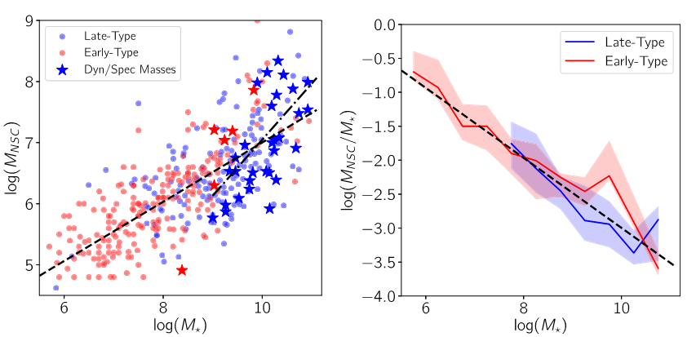
What is a nuclear star cluster?
Nuclear star clusters and their host galaxies

Slide 7
What is a nuclear star cluster?
Recent observational and theoretical works suggest that many NSC properties, including their masses, densities, and stellar populations, vary with the properties of their host galaxies.
Understanding the formation, growth, and ultimate fate of NSCs, therefore, is crucial for a complete picture of galaxy evolution.

Slide 8
Formation mechanisms of NSCs
Cluster inspiral formation
Dynamical friction drives star clusters into the nucleus.
Older and more metal-poor than their surrounding host galaxies
In situ formation
Gas infall trigger the star formation at center.
rather young and metal-rich when compared to the surrounding population
Stellar population analysis is critical to study formation mechanism of NSCs.

Slide 9
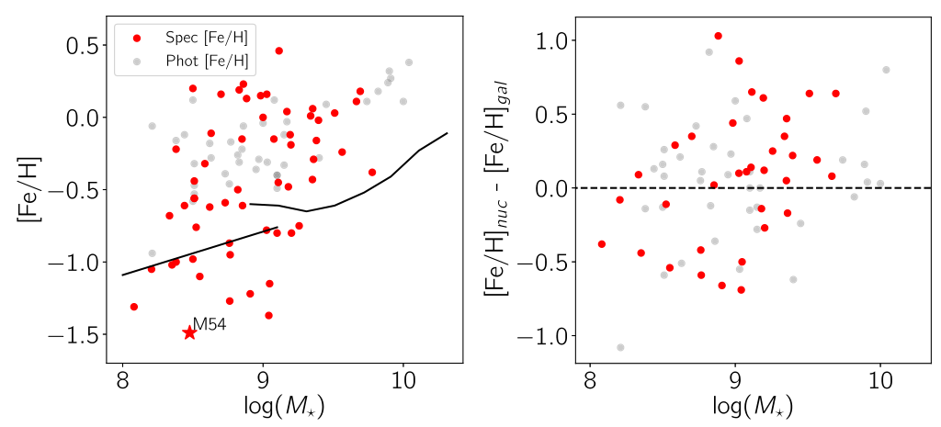
Formation mechanisms of NSCs
different galaxies and different mechanisms
NSCs grow through both globular cluster inspiral and in situ formation.
A transition at M*∽10 ⁹ M☉
In situ formation
more metal-rich than their surrounding host galaxies
Cluster inspiral formation
more metal-poor than their surrounding host galaxies
The sample of NSCs is small, so the result is not solid, we need more data.

Slide 10
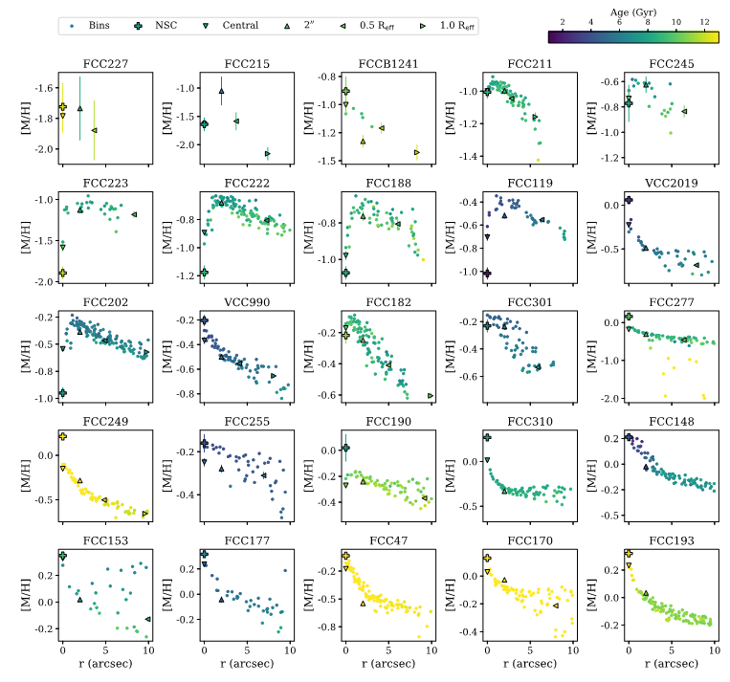
Stellar populations of NSCs in different galaxies
25 galaxies from MUSE
(spatially resolved spectra)
M _{gal} ∼ 10 ⁸ - 10 ^{10.5} M☉
Metallicity and age
NSCs in low mass galaxies are more metal-poor than surrounding. (blue rectangle)
NSCs in massive galaxies are more metal-rich than surrounding(red rectangle)
The ages are complex.
Low mass
massive

Slide 11
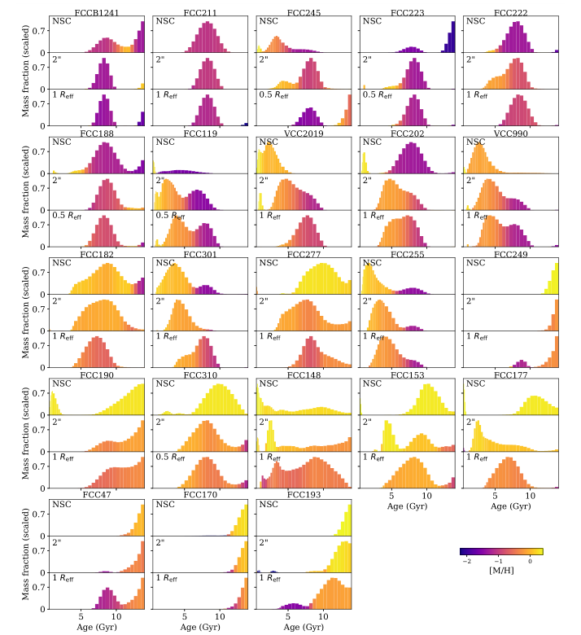
Star formation history
Most of NSCs in low mass galaxies are older than surrounding.
NSCs in medium mass galaxies have two peaks in age.
NSCs in massive galaxies have both young and old populations

Slide 12
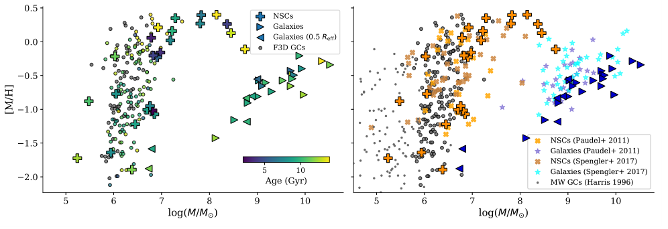
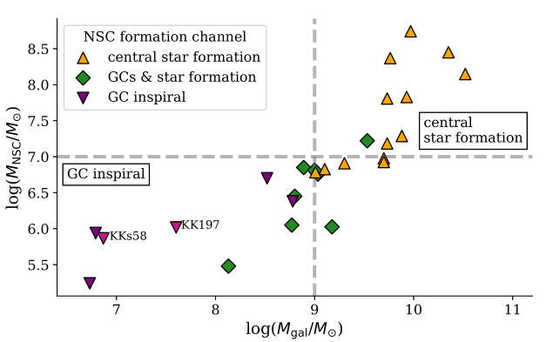
Stellar populations of NSCs in different galaxies
The transition appears to happen for NSC masses with M _{NSC} ∼10 ⁷ M☉ and galaxies with masses M _{gal} ∼ 10 ⁹ M☉
Transition
We need study spatially resolved stellar populations of NSCs to understand their inner structures.

Slide 13
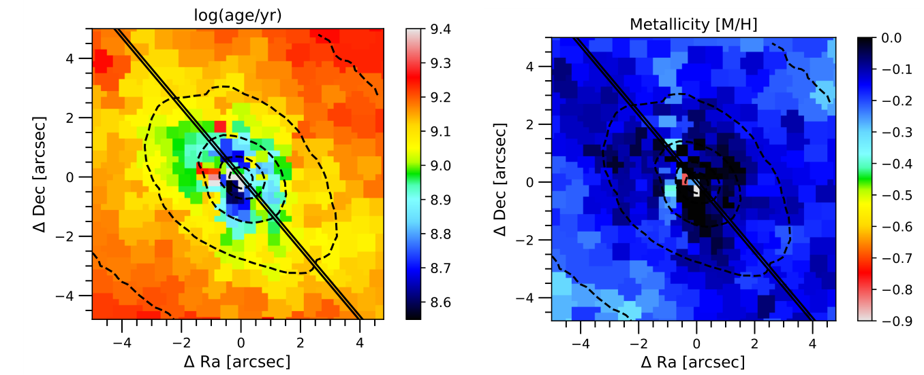
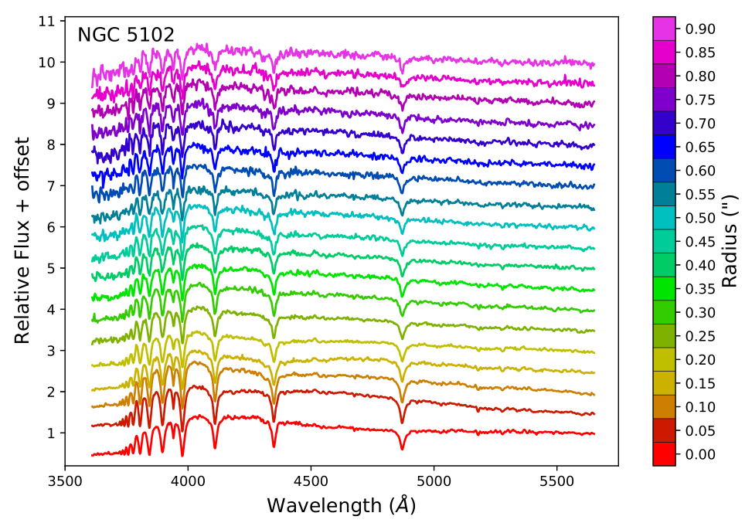
Spatially resolving the SFHs of NSCs
NGC 5102：6.9 ×10 ⁹ M☉, NSC: 7.30 ×10 ⁷ M☉, r _{eff}: 1.6”
Data: long-slit spectroscopic data from HST’s STIS
Map from MUSE
Solid black lines show the location of the STIS slit
Spectra of different radius from STIS

Slide 14
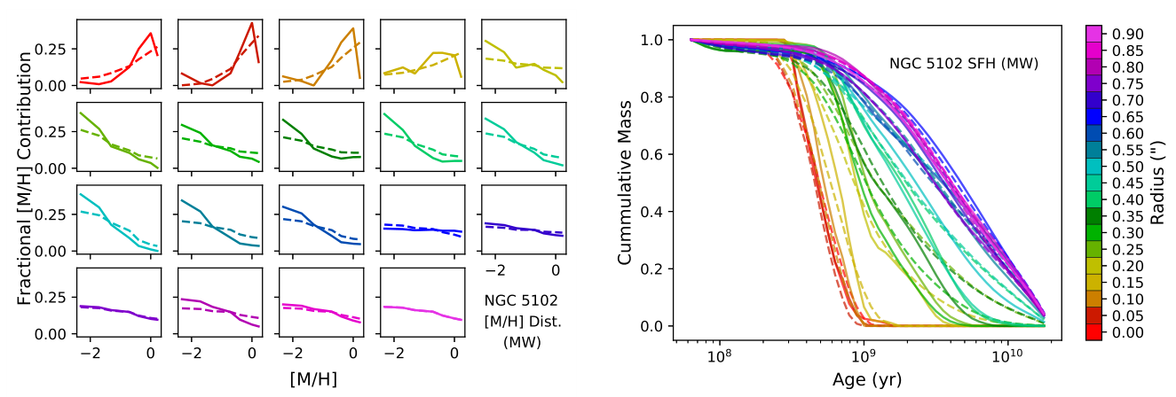
Spatially resolving the SFHs of NSCs
Metallicity and age from ppxf
in situ star formation at very center,
while cluster inspiral formation at larger radii.

Slide 15
Summary
Nuclear star clusters (NSCs) are extremely dense and massive star clusters occupying the innermost region or ‘nucleus’ of most galaxies.
There are two dominant theories of formation mechanism
Cluster inspiral formation — old and metal-poor population
In situ formation — young and metal-rich population
NSCs in massive galaxies: metal-rich, both very old and young
NSCs in low mass galaxies: metal-poor, old
The transition appears to happen for NSC masses with M _{NSC} ∼10 ⁷ M☉ and galaxies with masses M _{gal} ∼ 10 ⁹ M☉
Spatially resolved SFHs of NSC at the transition indicate a picture of in situ formation at very center and cluster inspiral formation at larger radii.

Slide 16
Reference
Neumayer, N., Seth, A., & Böker, T. 2020, A&A Rev., 28, 4
Fahrion, K., Lyubenova, M., van de Ven, G., et al. 2021, A&A, 650, A137
Hannah, C. H., Seth, A. C., Nguyen, D. D., et al. 2021, arXiv:210912251 [astro-ph], http://arxiv.org/abs/2109.12251

