Slide 1
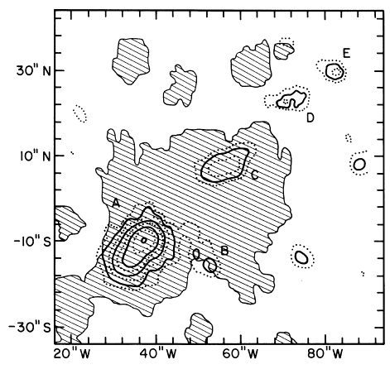
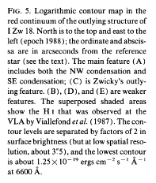
A story about I Zw 18
——the BCD prototype
N
E
Davidson et al. (1989)
Mengting Ju
2021.9.8

Slide 2
BCDs (Blue Compact Dwarfs)
BCDs are low-mass galaxies that are experiencing starbursts.
BCDs are the most metal-poor galaxies
resemble primeval galaxy in the nearby universe.
Dwarfs are the most common type of galaxy in the universe, but they are difficult to observe, especially at high redshifts.
BCDs are easily observed because they have strong emission lines.
Actually, BCDs also contain old stars, with ages >2–3 Gyr
BCDs may be transition-type dwarfs, but it is unclear whether they are evolutionary connections with other dwarfs
Notes:
All these observational characteristics make BCD resemble a primeval galaxy in the nearby Universe.

Slide 3
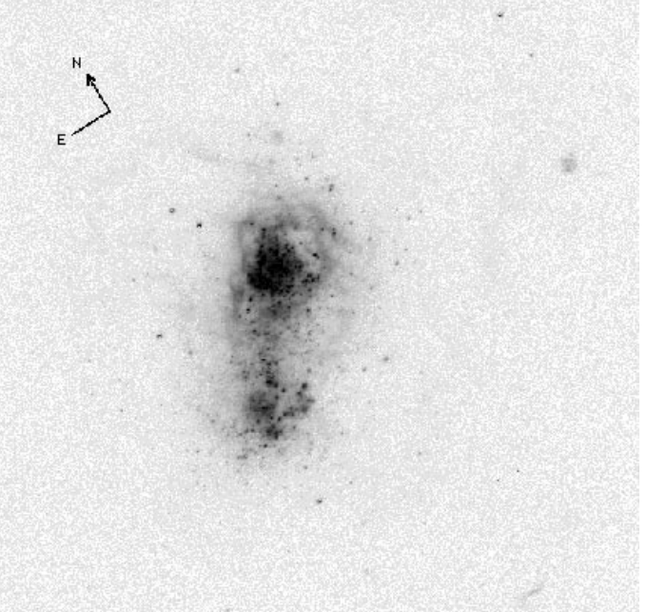
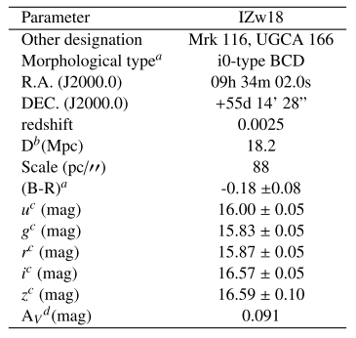
I Zw 18
HST/WFPC2 F555W filter
The BCD galaxy I Zw 18 is one of the most intriguing objects in the local universe.
metal-poor (12+log(O/H) ∼ 7.22 1/30 Z⊙, Izotov & Thuan 1999)
a current star formation rate (SFR) as high as ≈ 1M⊙/yr (Annibali et al. 2013)
Alessandra et al. (1999)

Slide 4
BCDs (Blue Compact Dwarf galaxies)
BCD星系是目前为止发现的金属丰度最贫的一类星系
所以和宇宙第一代星系形成有关联
矮星系占多数，但是高红移的矮星系很难观测。
所以它可以看成是高红移星系甚至是第一代星系的对应体
通常认为BCD跟踪了第一代星系，但是它也存在年老恒星。
I Zw18 是一个典型的BCD星系
金属丰度
很强的SFR
存在年老恒星

Slide 5
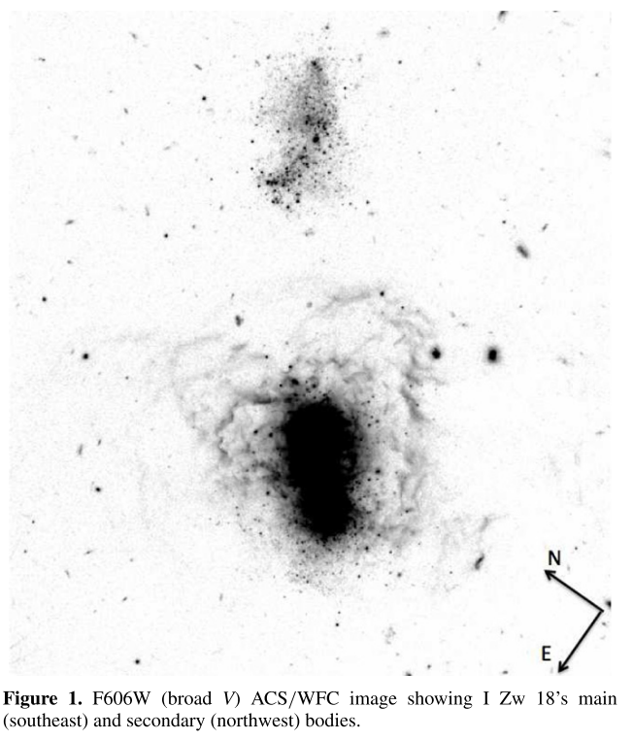
I Zw 18 is not a truly young galaxy
Annibali et al. (2013) use deep HST/ACS data
F606W (∼broad V), F814W (∼I)
111, 481, 590, 548, and 265 sources in regions A, B, C, D, and E
A+B+C=main body
A → the most crowded one
B → shell of ionized gas
C → outskirts
D+E= secondary body
E is more crowded than region D
secondary
body
Main
body
Annibali et al. 2013

Slide 6
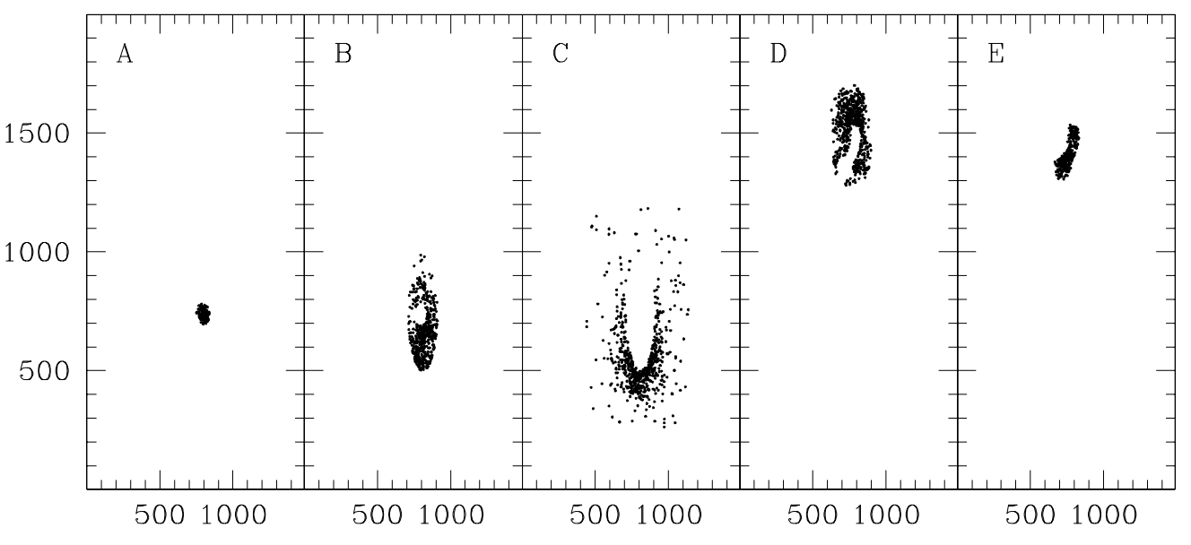
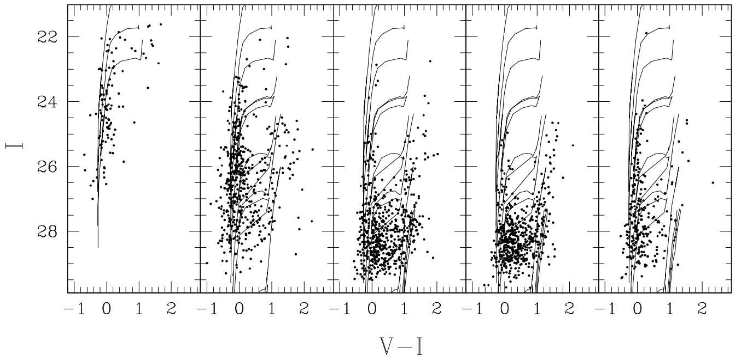
I Zw 18 is not a truly young galaxy
the definition of the so called basis functions
simple star formation episodes of fixed duration
the statistical analysis for the identification of the best SFH .
Notes:
Padova 94 stellar tracks

Slide 7
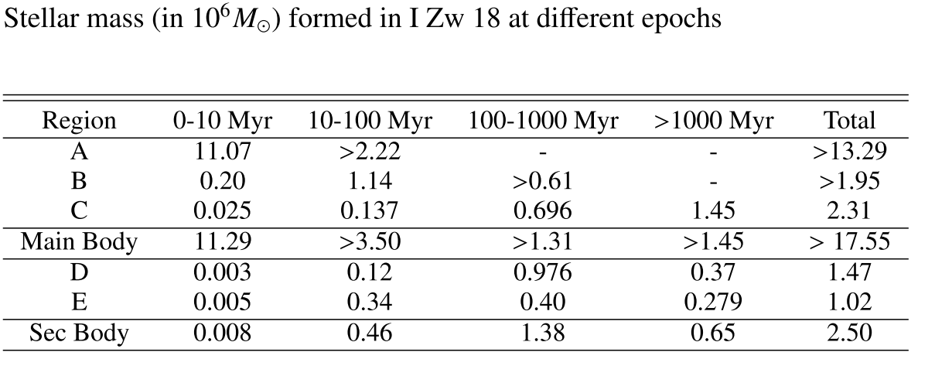
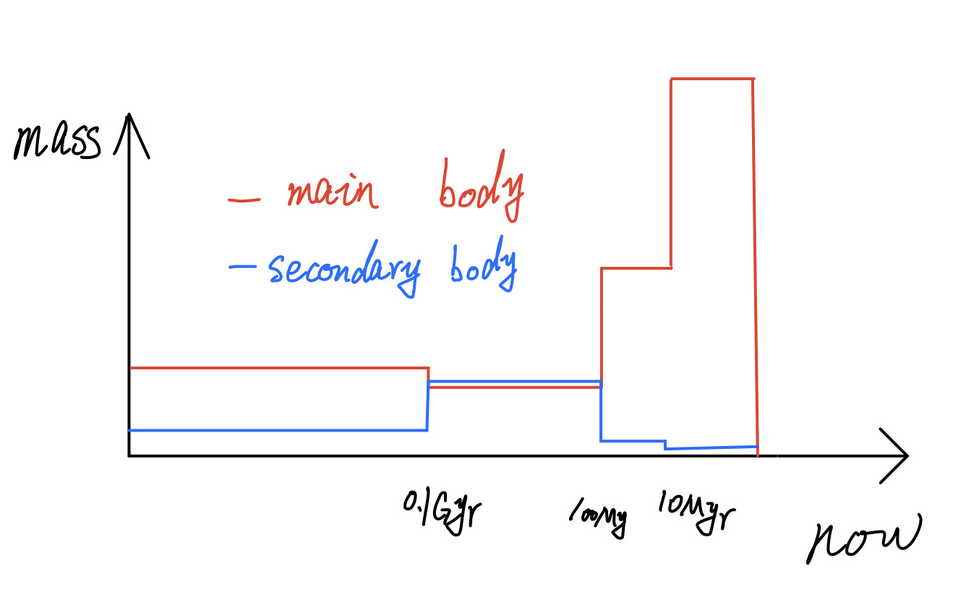
I Zw 18 is not a truly young galaxy
it is not a truly young galaxy at its first bursts of star formation
a burst occurred 6-10 Myr ago at a rate as high as 1.6M⊙/yr, in region A.
in the secondary body the SF was more active before 10 Myr ago
What triggered the starburst?
Why is the metallicity so low?

Slide 8
Dynamics of I Zw 18
Lelli et al. 2012
Public HI data taken from the VLA archive
Smoothed velocity to a resolution of 5.2km/s (10.4km/s for the high-resolution data)
Smoothed spatially to 20”,5”,2” for the low, intermediate and high resolution data
~2”
~5”
~20”

Slide 9
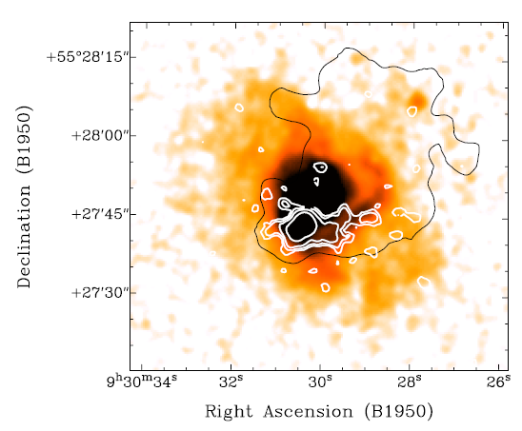
Field of view
2”
Main body
Contours show HI emission
HI map at 2“ resolution corresponds to the main body , we can also call it A-component.

Slide 10
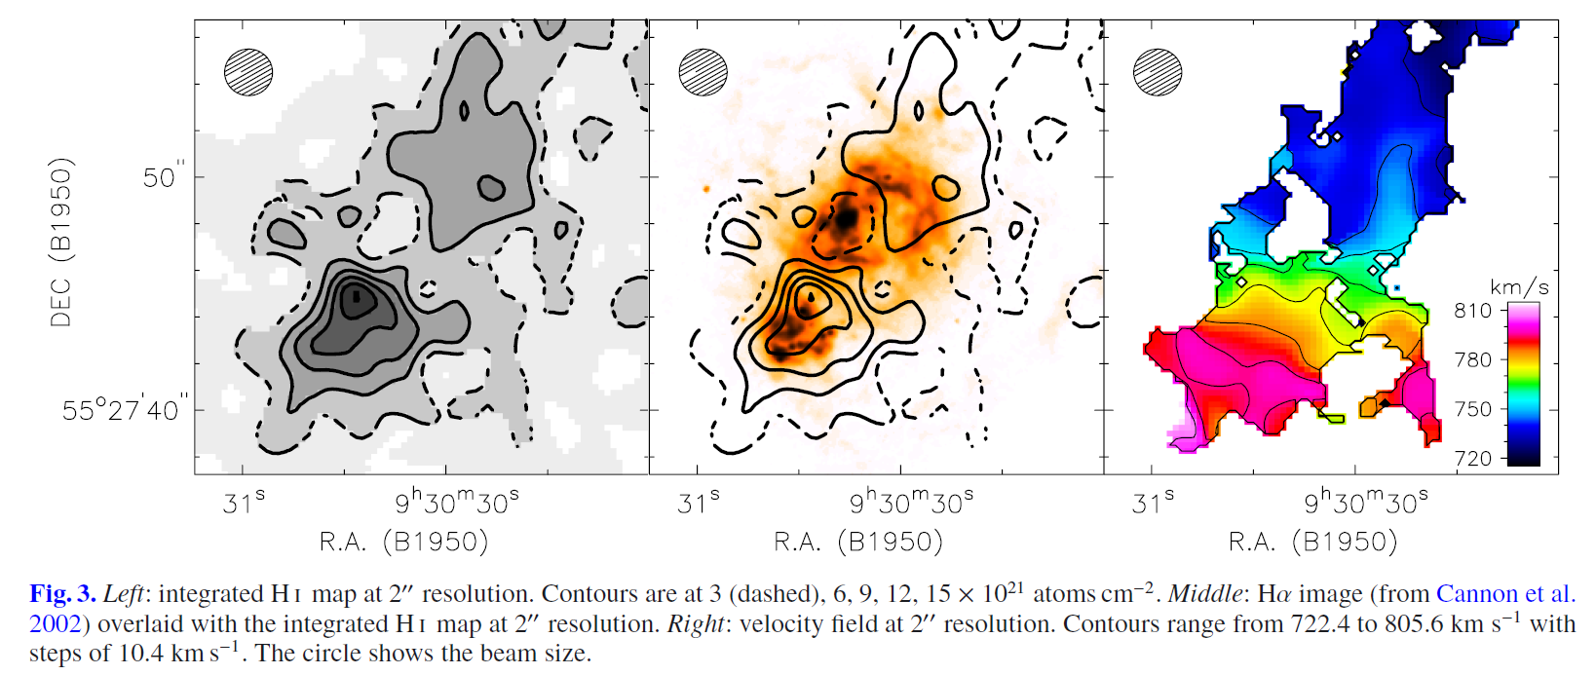
Dynamics of I Zw 18 A (main body)
strong concentrations of HI
A rotation disk
HI distribution is not axisymmetric
2”
van Zee et al. (1998b)
Interpreted gradient as rotation or merger?
Skillman & Kennicutt (1993)

Slide 11
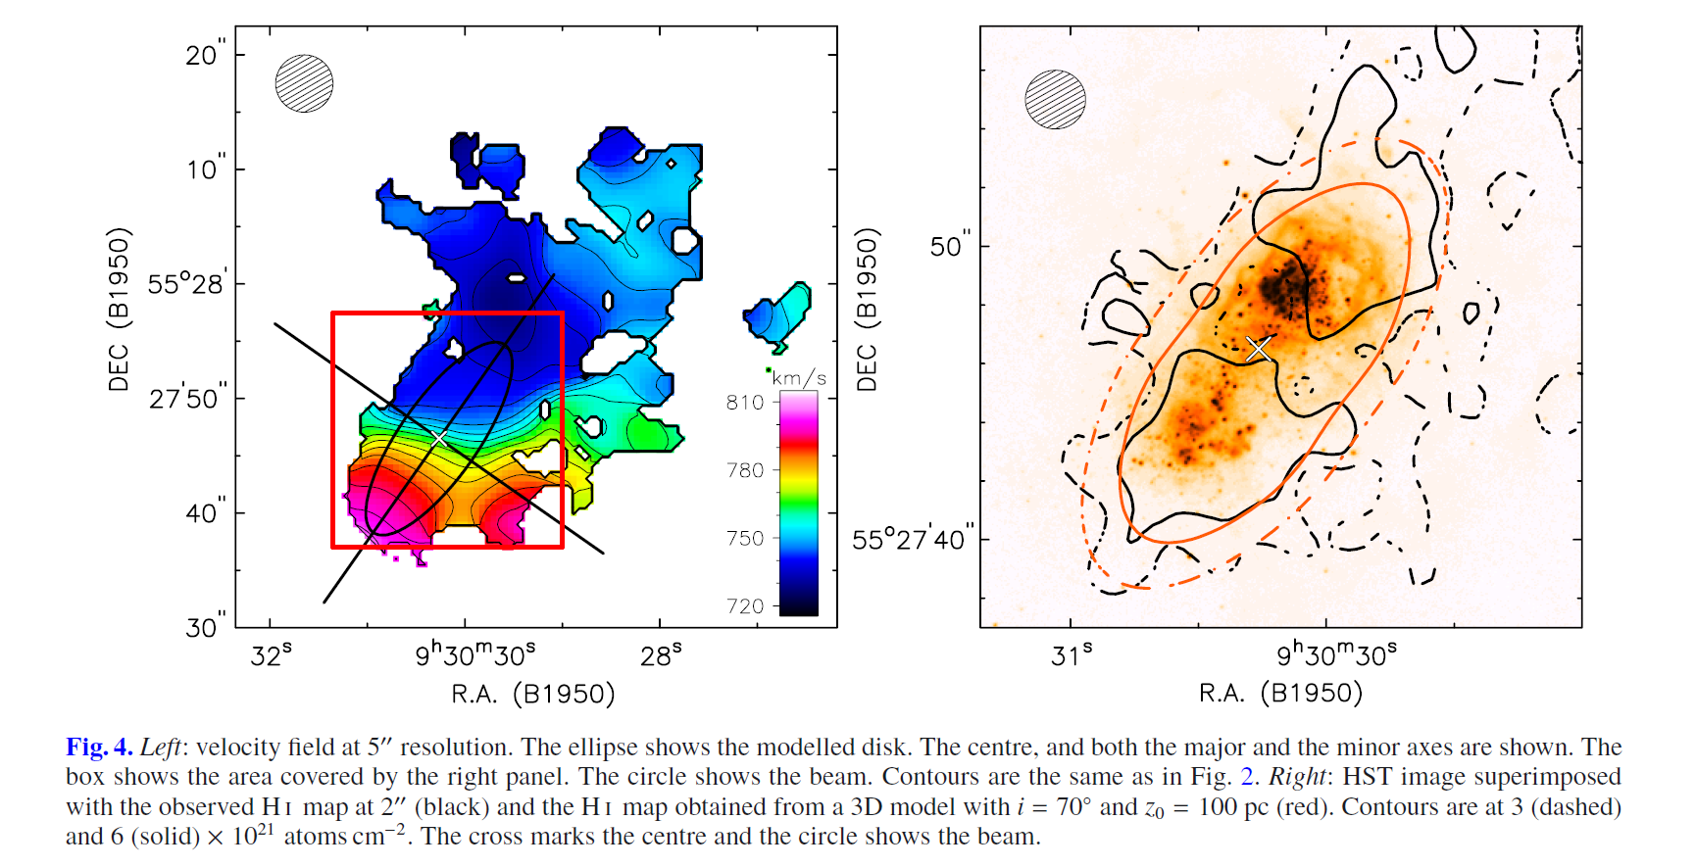
3D kinematical models
built a disk model with a uniform density distribution
fixing z0, σ_{HI} and the rotation curve
the scale height z0=100pc, the velocity dispersion σ_{HI}=7.5km/s
Rotation curve: solid body (slowly rising rotation curve)
differential (steeply rising and flat rotation curve).
reproduce the HI density distribution observed at 2” resolution
5”
2”

Slide 12
3D kinematical models (major axis )
The velocity gradient is grossly reproduced by all the models
a rotating disk is a good representation of the data
close to center at high rotational velocities
concentrated near the systemic velocity
The differentially rotating model correctly reproduces
NW side is not reproduced as well as the SE side
NW starburst region is more active than the SE one

Slide 13
3D kinematical models (minor axis )
Can not reproduce
kinematic asymmetry
radial motions or bar-like may cause non-orthogonality between two axes
Adding 15km/s can not reproduce all details, but better than now
the HI disk is differentially rotating and has a global inflow/outflow motion.

Slide 14
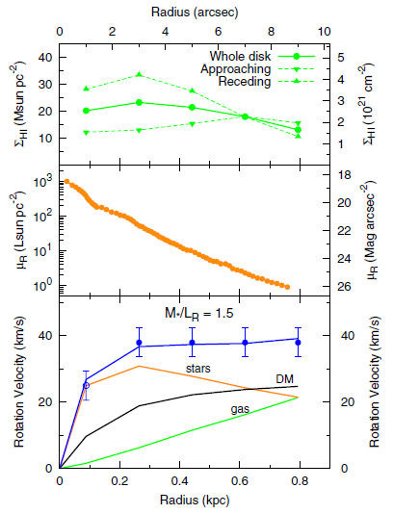
Mass models
SE
NW
there is a strong central concentration of mass
HI map at 2” (gas)
HST R-band image subtracting Hα (stars) with ρ(z) = sech²(z/z0)
assumed a pseudo-isothermal halo (dark matter)
subtract
the nebular emission
the H₂ mass and old stars within ∼400 pc may be dynamically important

Slide 15
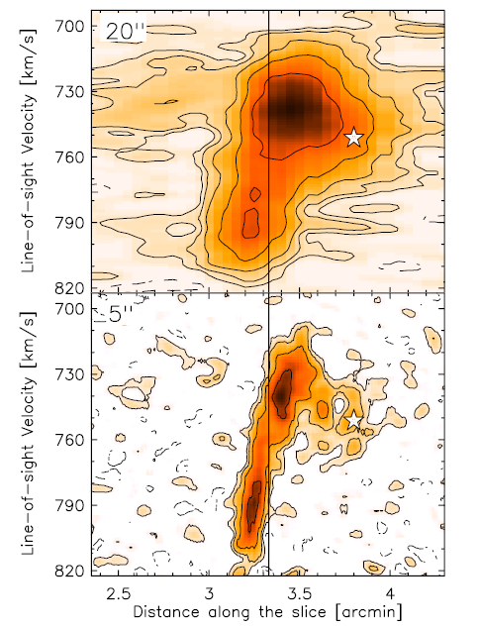
The extended emission
C
HI ‘tail’
~13.5 kpc

Slide 16
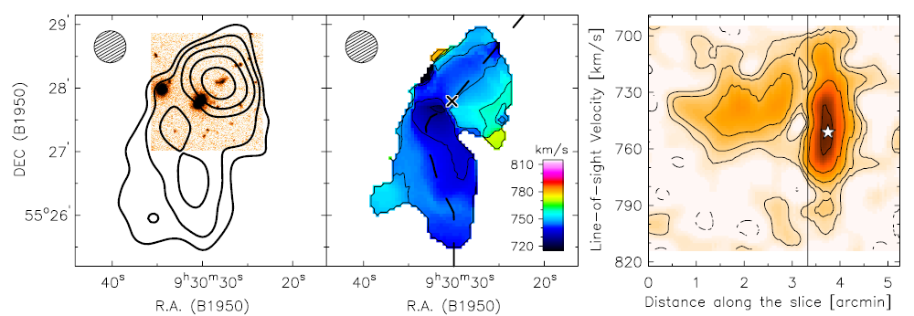
The extended emission
Subtracted the HI disk of main body
low-resolution datacube – high-resolution = residual
Smooth residual to 30” resolution
HI tail seems to be connected in both space and velocity to the HI structure around I Zw 18 C

Slide 17
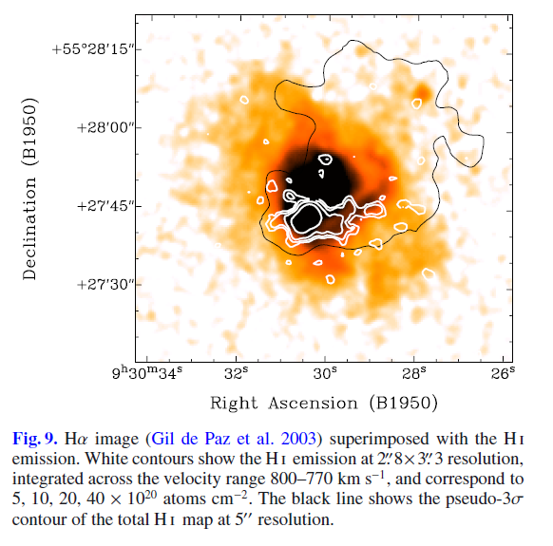
HI and Hα emission
HI and Hα emission also presents a prominent arc to the west
radiation-bound ionization front driven into the ISM
stellar emission

Slide 18
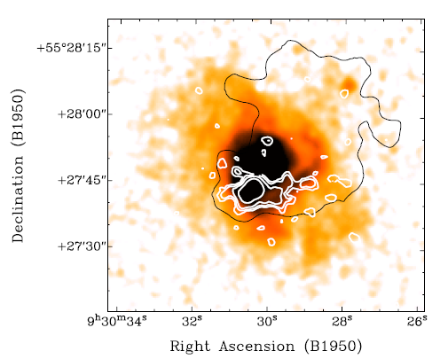
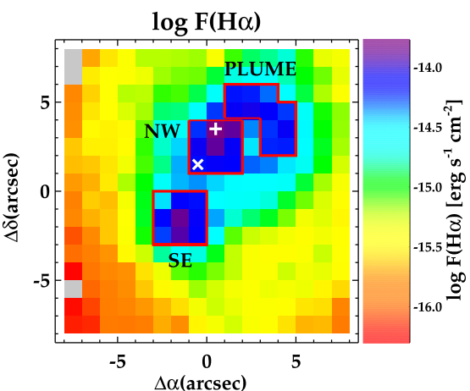
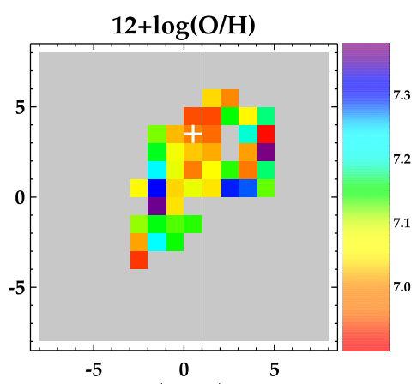
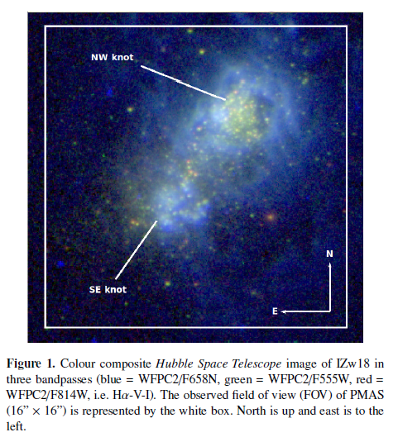
IFS data of main body
Kehrig et al. 2016
PMAS (from ∼ 3640 to 7200 Å with∼ 2 Å/pixel)
derived from Te[Oiii]
16” × 16” (∼ 1.4 kpc × 1.4 kpc)

Slide 19
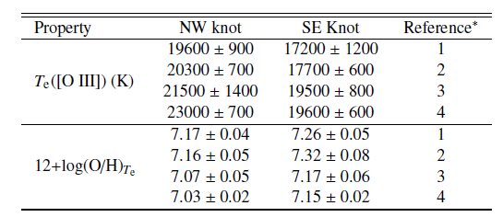
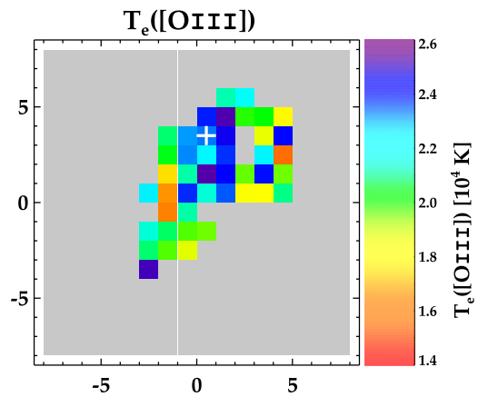
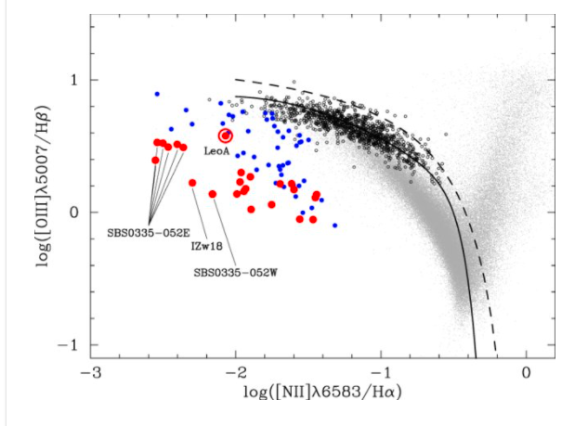
high-excitation diffuse gas
derived the Te values of [OIII] using the [OIII]λ4363/[OIII]λ4959,5007 line ratio
the first time that Te[Oiii] values> 22,000 K are derived
Izotov et al., 2012

Slide 20
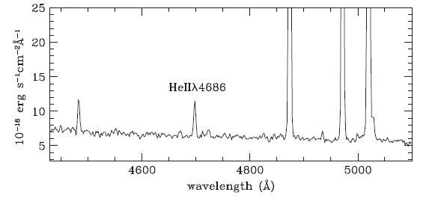
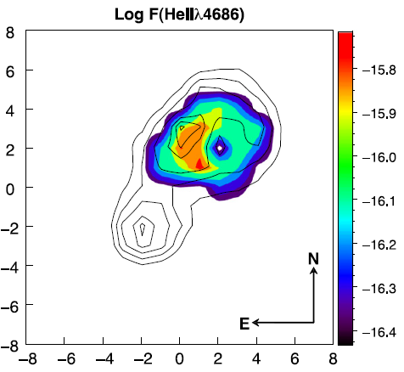
high-excitation diffuse gas
Kehrig et al. (2015)
HeIIλ4686 (⩾ 54 eV) was found in the NW knot
conventional He II-ionizing sources (e.g., WRs, shocks, X-ray binaries) cannot account for the total He II-ionization budget in IZw 18.
Can Interpret by super-massive O stars or nearly metal-free ionizing stars

Slide 21
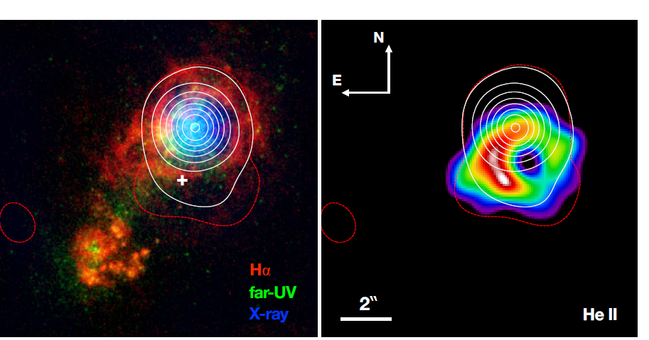
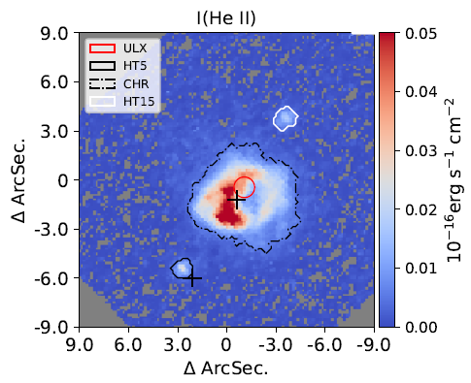
high-mass X-ray binary(HMXB)
Combine low metallicity massive stars and the emission from HMXB cannot reproduce
3 He II Regions
Chandra ACIS X-ray contours
PMAS
Chandra X-ray
KCWI
Ryan et al., 2021
Kehrig et al., 2021
Notes:
photoionization models that

Slide 22
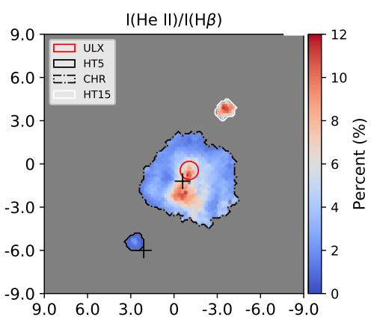
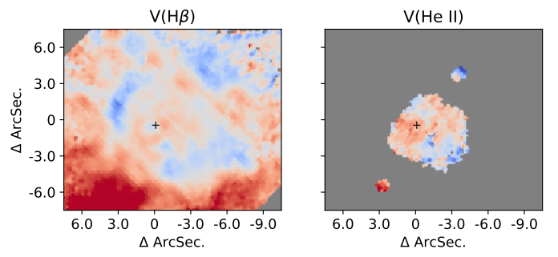
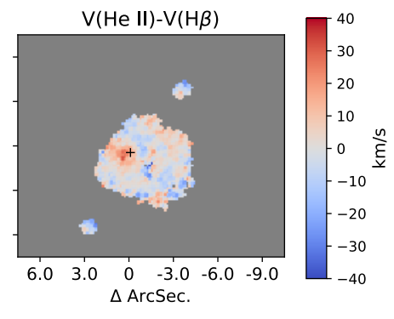
Wolf-Rayet Stars, Jet or Beamed X-ray
no kinematic anomalies driven by jet/outflow activity
isotropic X-ray emission is hard to generate the observed He II emission
early-type Nitrogen-rich Wolf-Rayet stars
with low winds could power the two He III regions, .
Notes:
in which case the alignment with the ULX would be coincidental

Slide 23
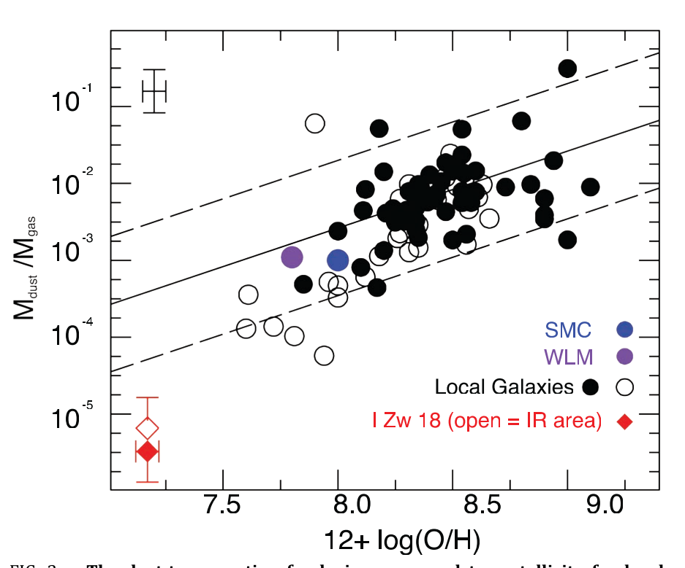
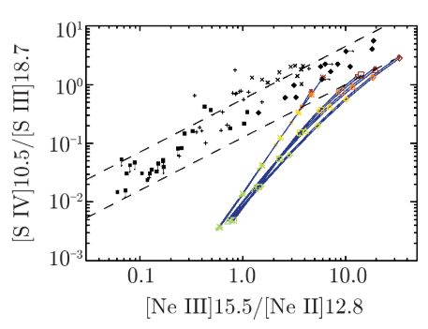
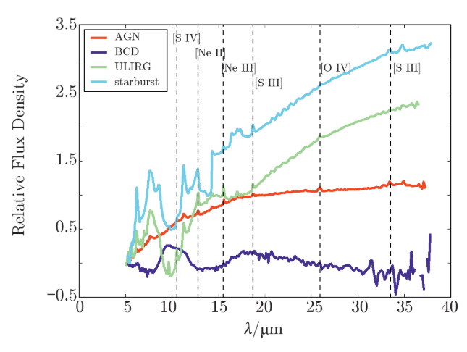

Slide 24
Summary
I Zw 18 has low metallicity and high SFR
The mechanism that triggered the starburst is most likely to have been an interaction/merger between gas-rich dwarf galaxies.
C-component may be a ‘relic’
In the SF region, the origin of high-excitation diffuse gas still difficult to understand
It is a good object to study high-z galaxy.
Low metallicity
Many HII region

Slide 25
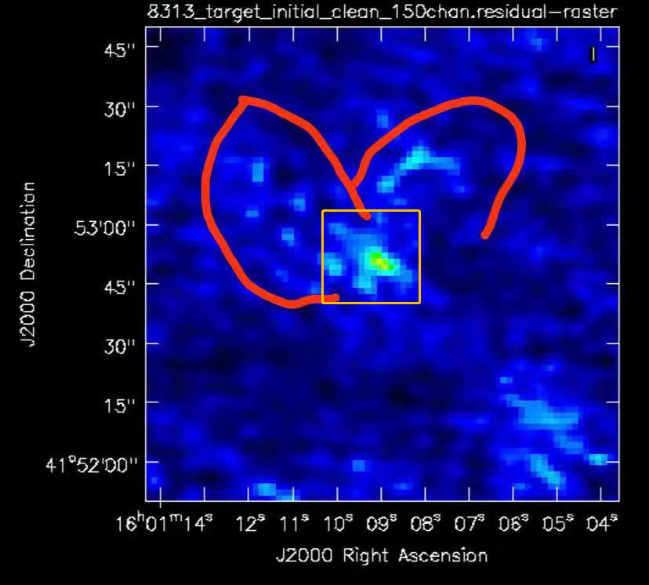
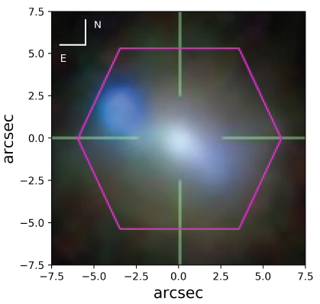
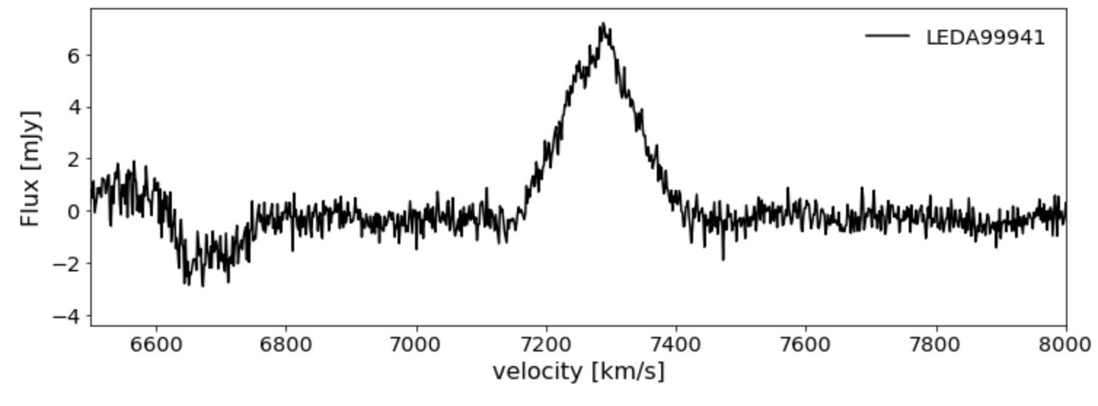
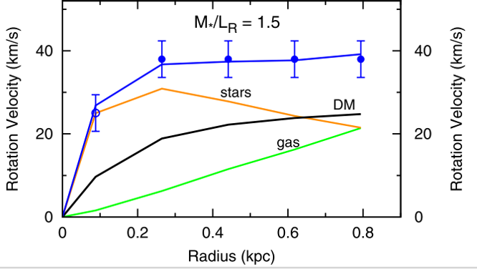
My work

