Slide 1
Mapping Star Formation History with MaNGA
2021.3.31
Speaker: Rongrong Liu
Supervisor: Zhengyi Shao

Slide 2
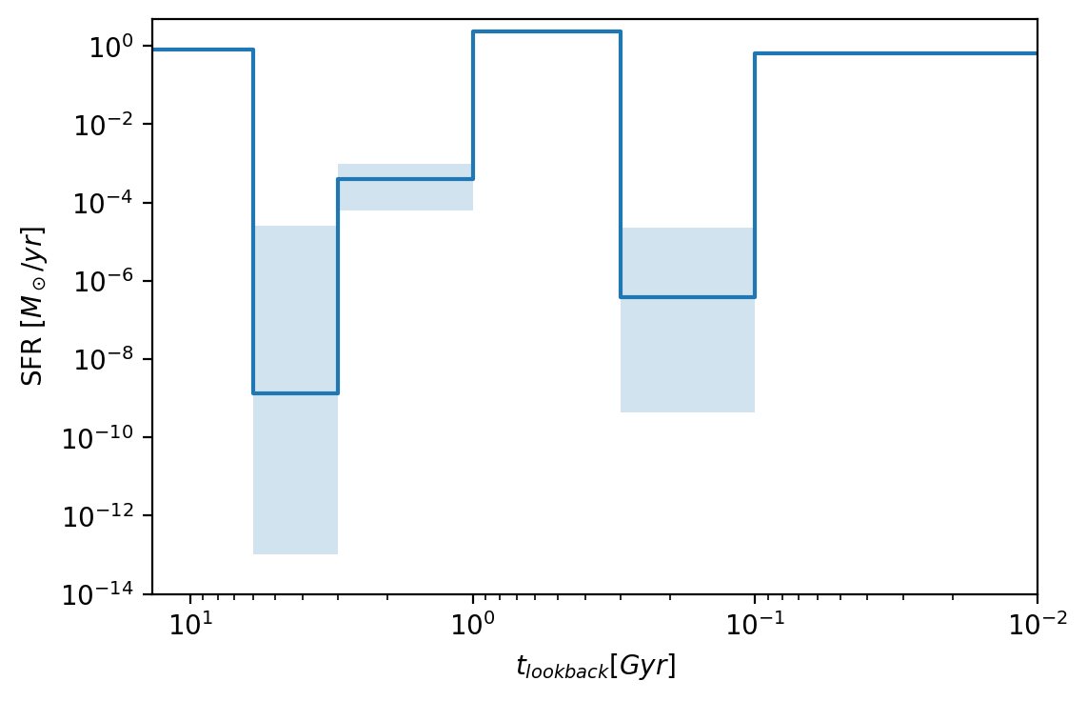
Background — Star Formation History (SFH)
We can get information about evolution of galaxy from SFH.
The left picture represent a very young region, but the right picture has a so complex history, that we can not determine if it originates from merger or inflow.

Slide 3
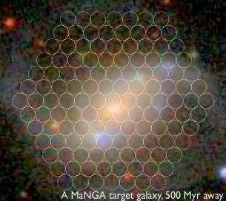
Background — Spatially Resolved SFH
g-band image from DESI
Integral-field spectroscopy (IFS) enable us to get spatially resolved spectrum
of galaxy.
Combining photometry with IFS, we can get spatially resolved SFH, and obtain more information about evolution of galaxy .

Slide 4
Background — my work
Get spatially resolved SFH of galaxies with MaNGA

Slide 5
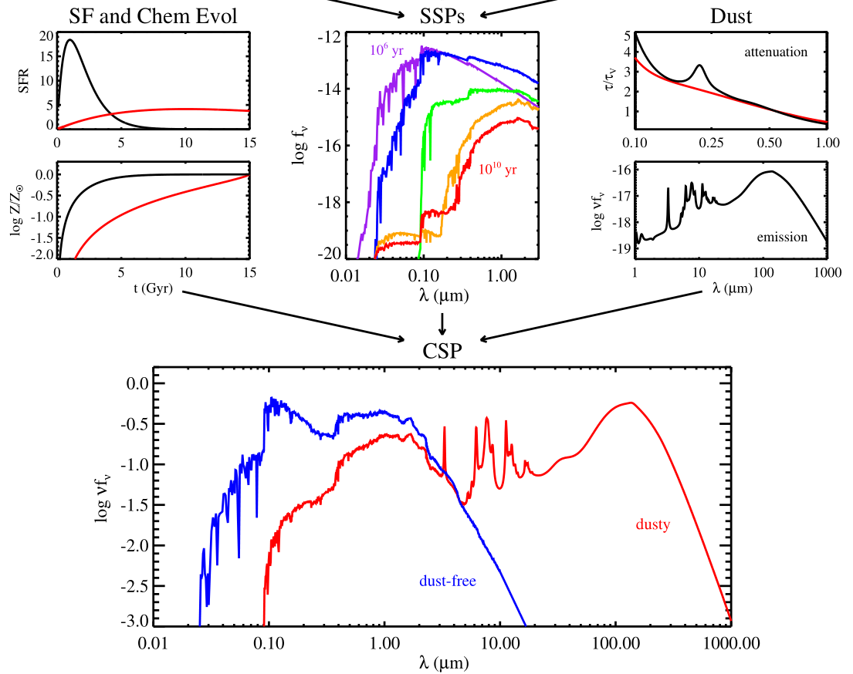
Method — Stellar Population Synthesis (SPS)
Code: prospector
SED fitting and full spectrum fitting
Non-parametric SFH
Bayesian framework
Conroy, C. 2013, ARA&A, 51, 393

Slide 6
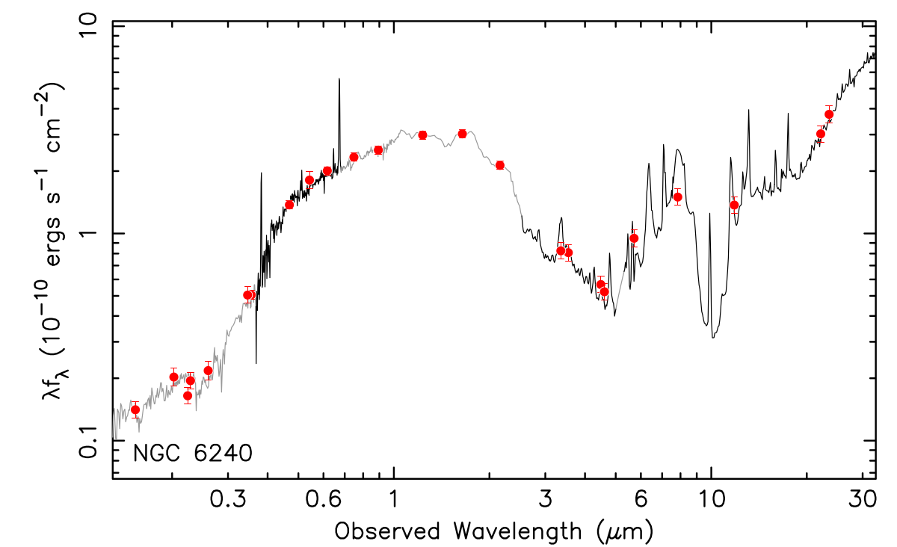
Method — Photometry + Spectral Feature Fitting
Photometry has information of continuum and can extend range of wavelength.
Spectral feature like lick indices that we have known well have detail information of spectrum, and is not sensitive to calibration.
I have added lick indices into prospector.
photometry
spectrum
spectral feature
Brown，2014，ApJS，212,18

Slide 7
Method — non-parametric SFH
$$SFR∝\left(t−t_{0}\right) e^{\left( −\frac{t−t_{0}}{τ}\right)}$$
— Mock SFH — non-parametric SFH — parametric SFH
Non-parametric SFH is not dependent on model of SFH.
In a fitting, we fit each mass in 6 age bins— m₁,m₂,m₃,m₄,m₅,m₆
Joel Leja, et. al, 2019, ApJ, 876:3

Slide 8
Method — construct new parameters
Bayesian framework
After we get probability density distribution(PDF) of parameters, we can construct new parameter, Q, and obtain PDF of Q.
For example, Q=sum(m₁,m₂,m₃,m₄,m₅,m₆)— total mass
Q=$\sum_{i=1}^{6}{{age}_{i}∗m_{i}}/\sum_{i=1}^{6}{m_{i}}$ — mean age
Q=mass_{<1Gyr}/total mass — fraction of young mass
This method do not need resampling. And we can construct parameters we do not study before.
nested sampling(JAXNS)

Slide 9
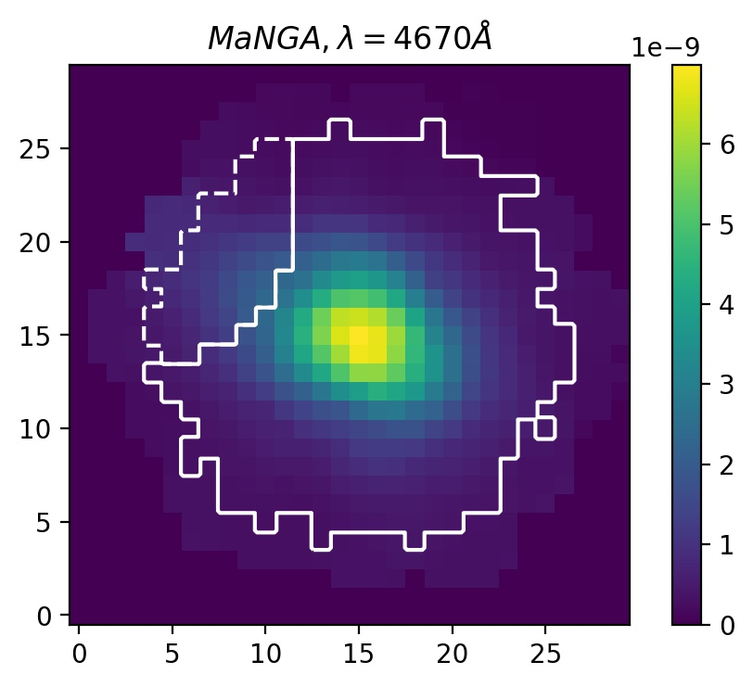
Example
g-band

Slide 10
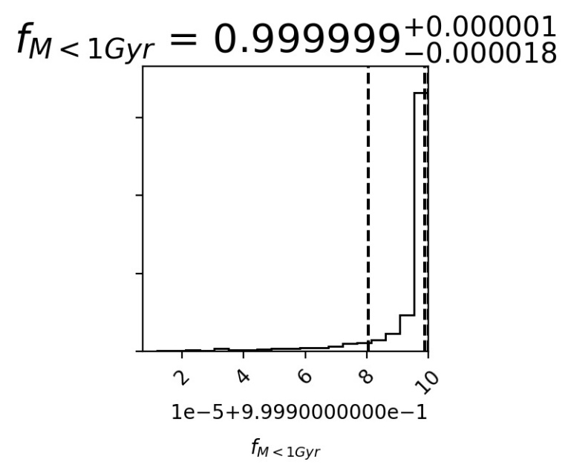
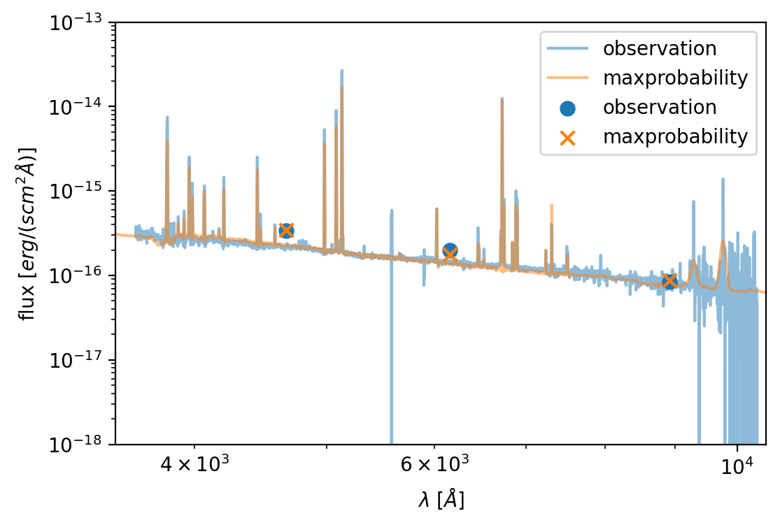
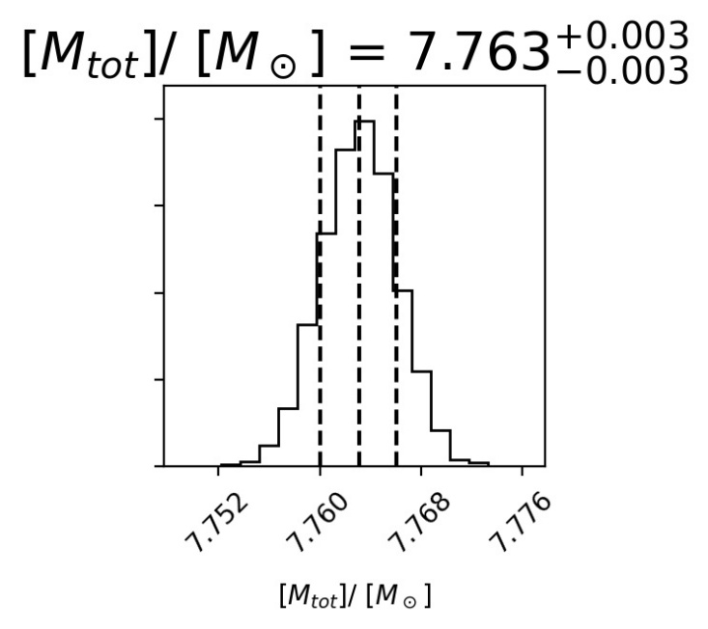
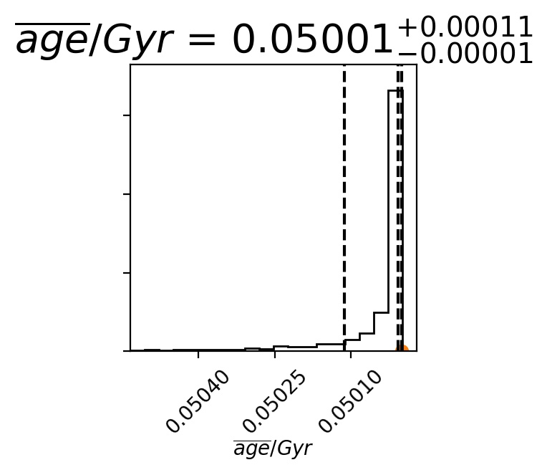
Example — results of clump
fitting
fitting

Slide 11
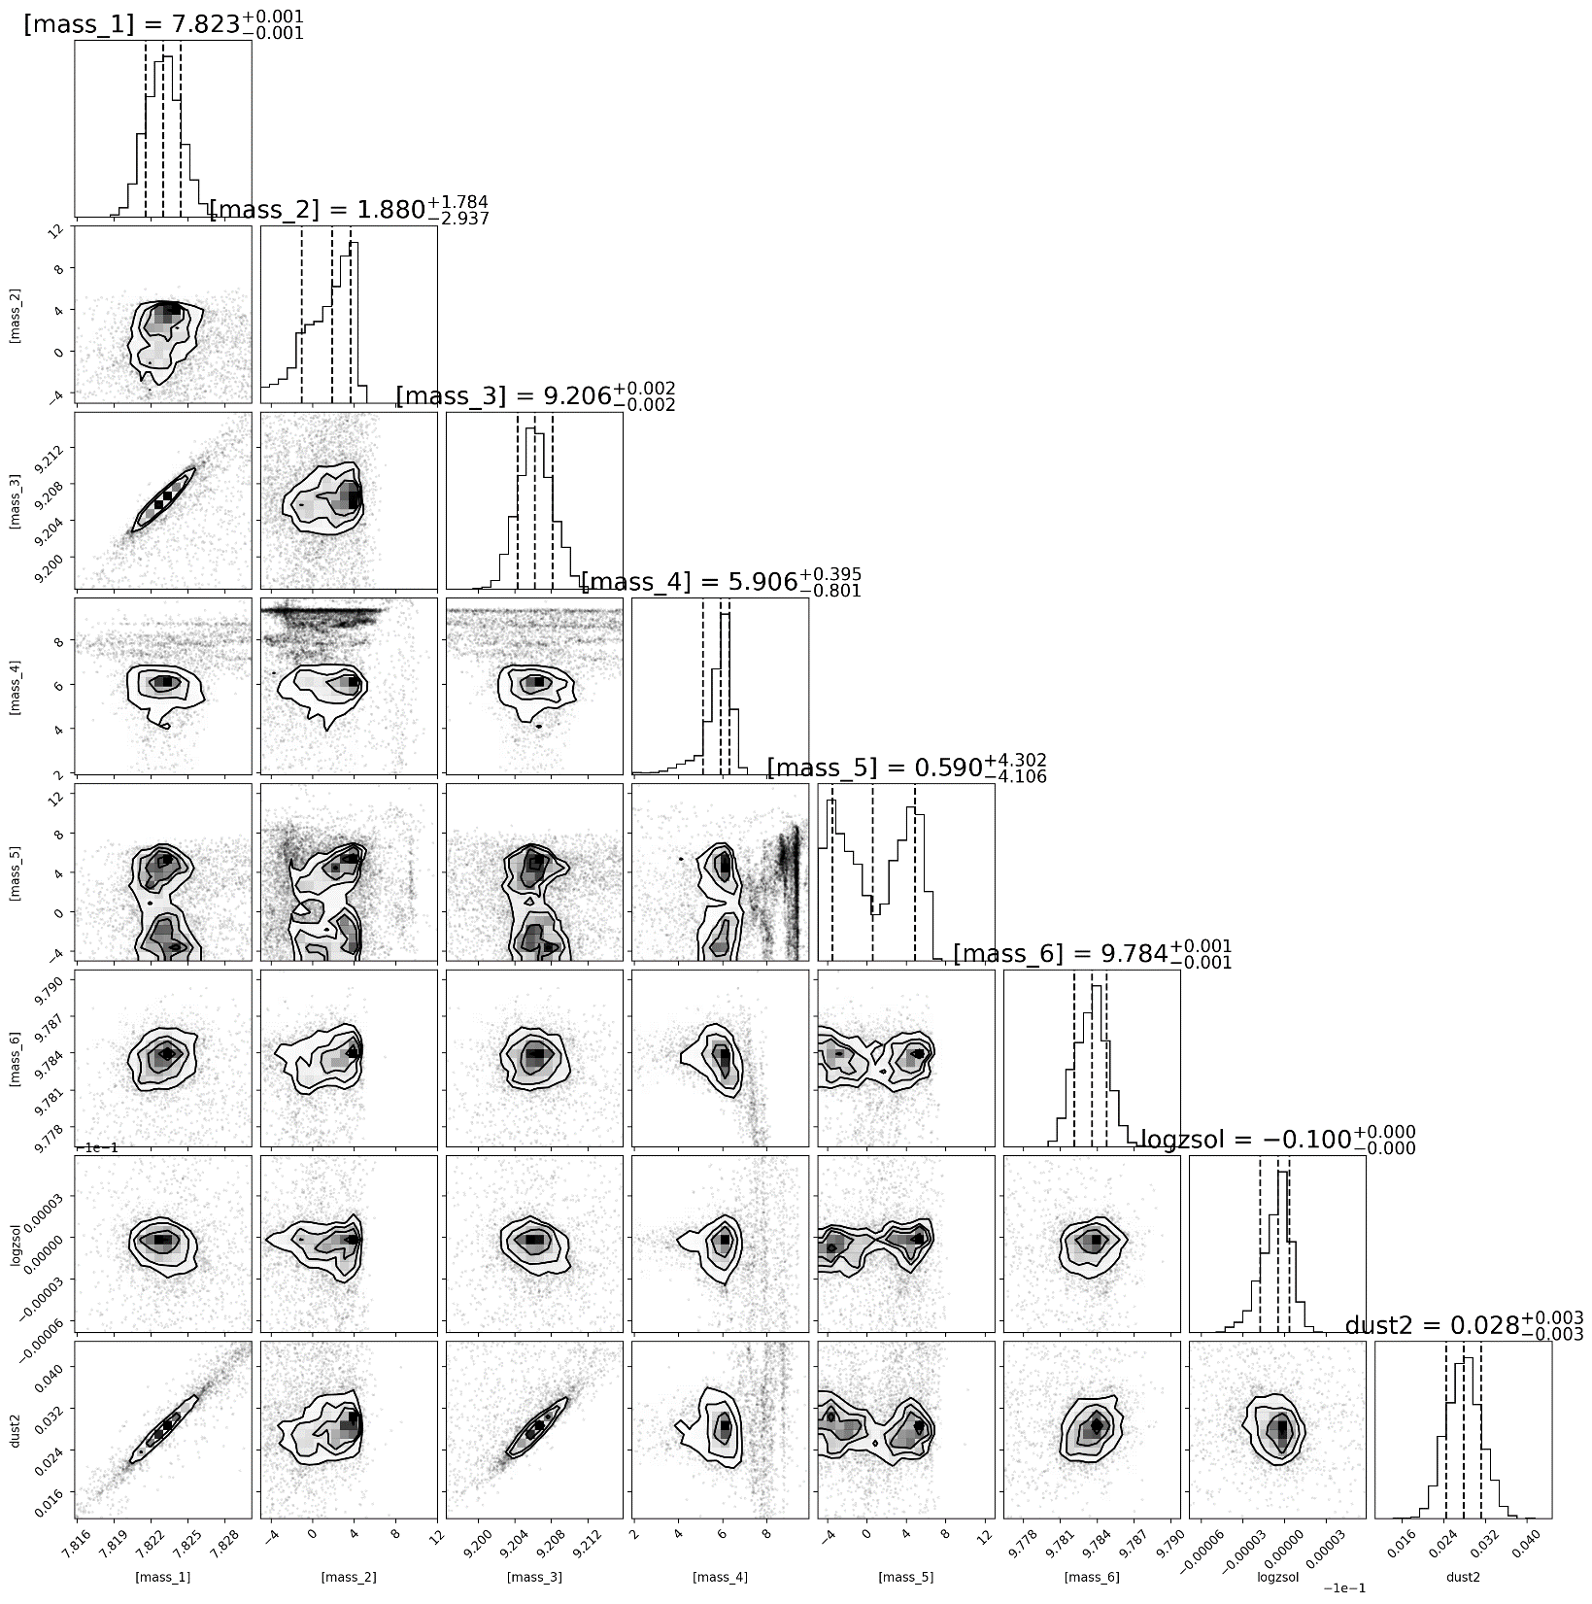
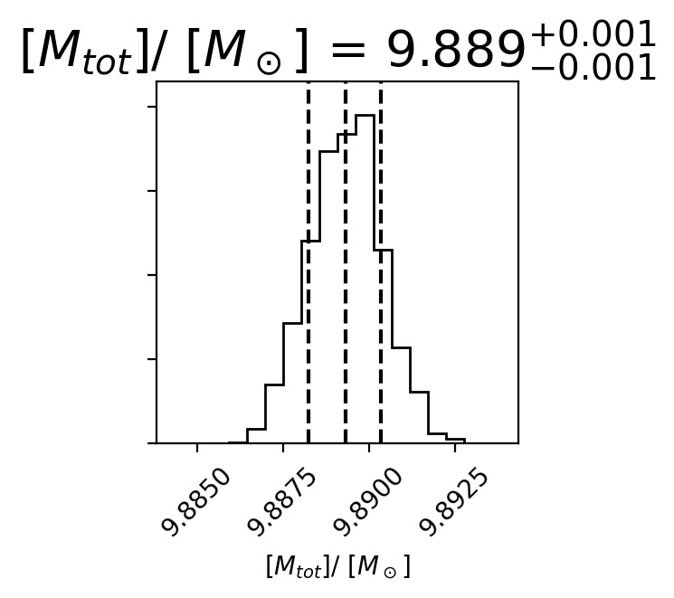
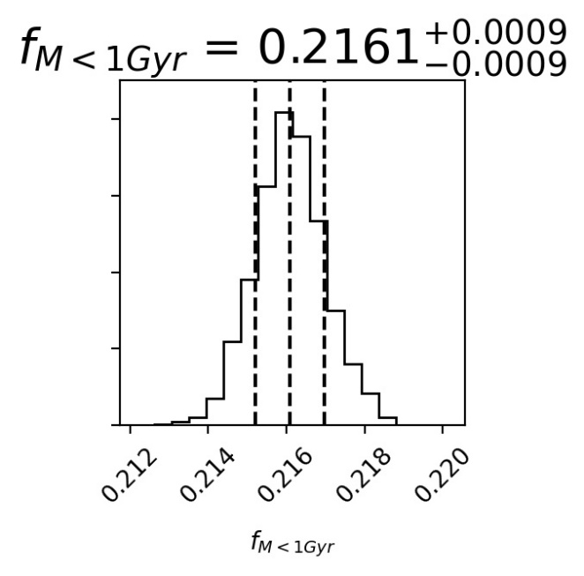
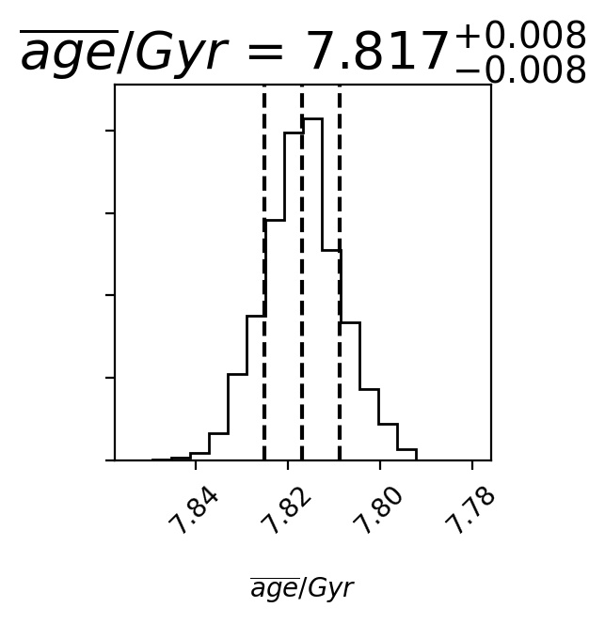
Example — results of host
fitting
fitting

Slide 12
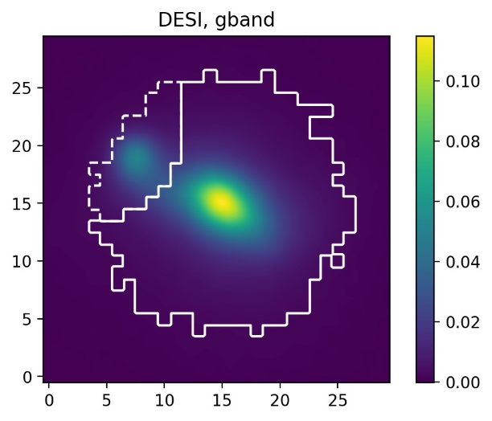
Example — clump vs host
logM_{tot}=7.763[M⊙]
$\overline{age}$=0.05Gyr
f_{M<1Gyr}=1.00
logM_{tot}=9.889[M⊙]
$\overline{age}$=7.82Gyr
f_{M<1Gyr}=0.22

Slide 13
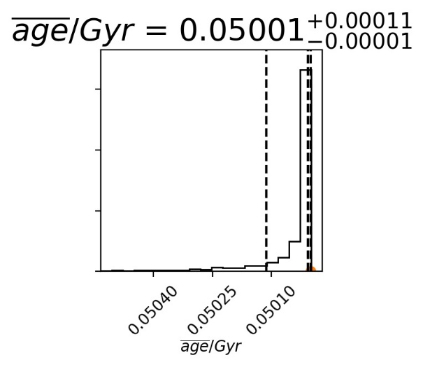
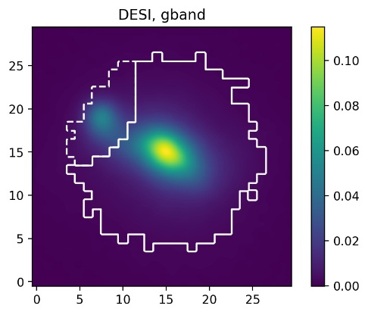
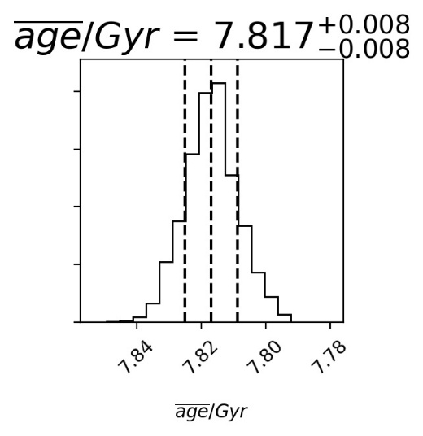
Example — clump vs host

Slide 14
Swift-MaNGA Value Added Catalog(SwiM)
150 galaxies:
1) a large number of emission line and spectral indices maps
2) Swift UVOT images (uvw1, uvw2, and uvm2),SDSS ugriz images, all matched to the same angular resolution and spatial sampling as the uvw2 band
We can map SFH or other properties with SwiM.

Slide 15
Conclusion
1) Using SED + lick indices fitting, with non-parametric SFH and Bayesian framework, we can obtain PDFs of parameters.
With PDFs of parameters, we can construct new parameter, Q, and obtain PDF of Q without resampling. We can construct total mass, mean age, fraction of mass<1Gyr and other parameters we interest.
2) We have applied our method to one galaxy, which proves our method powerful.
With SwiM, we can obtain spatially resolved SFH of 150 galaxies.

Slide 16
Conclusion
3) Potential application
Benefitting from Bayesian framework, we can not only construct additional parameters with PDF which are not limited to those known, but also compare different models (e.g., different IMF or chemical evolutionary models) with Bayesian evidence.
Our method can be applied to more IFS data. And we can further study the assembly history of galaxy.

