Slide 1
Transformer
Notes:
Question: scaling doc project???
https://voidism.github.io/note/2019/02/05/Transformer_Intro/
http://nlp.seas.harvard.edu/2018/04/03/attention.html
The best one: https://lilianweng.github.io/lil-log/2018/06/24/attention-attention.html
Also good: https://mchromiak.github.io/articles/2017/Sep/12/Transformer-Attention-is-all-you-need/#.XOoQfogzY2w
Matrix view: http://jalammar.github.io/illustrated-transformer/
https://github.com/jessevig/bertviz BERT vis
可以讀:
https://zhuanlan.zhihu.com/p/47470866
BERT: 這篇不錯 主要是分析 BERT
https://zhuanlan.zhihu.com/p/58430637

Slide 2
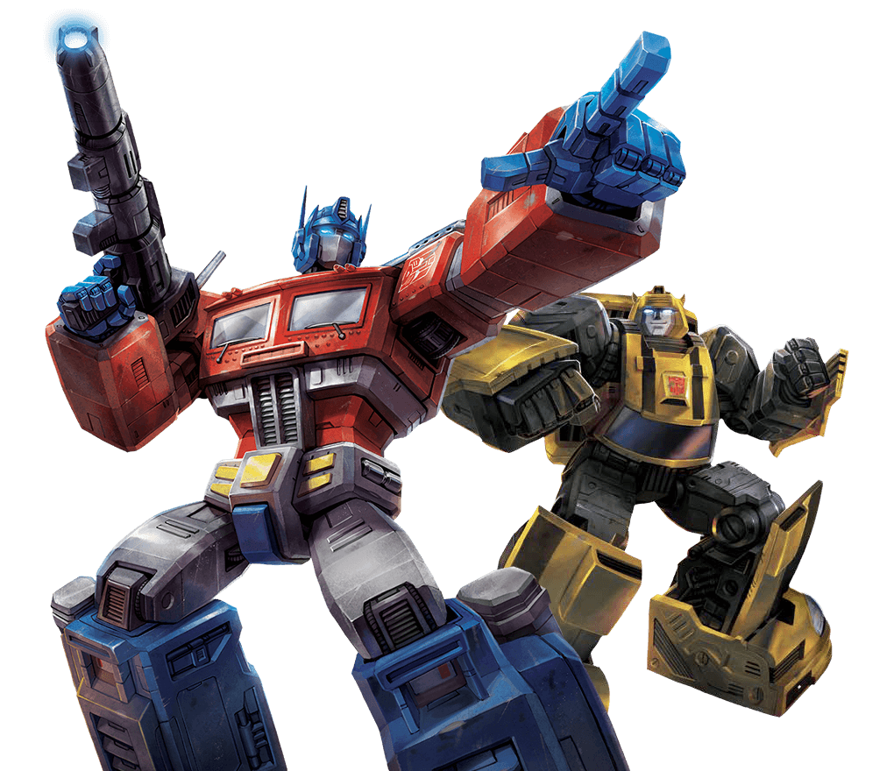
Transformer
Seq2seq 模型 “Self-attention”
Notes:
BERT: A transformer learned from lots of unannotated text

Slide 3
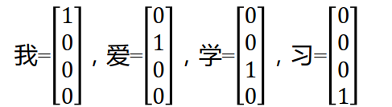
Word Embedding
one-hot
例如，有语料库如下：
John likes to watch movies. Mary likes movies too.
John also likes to watch football games.
假设我们的词汇表排序结果如下：
{"John": 1, "likes": 2, "to": 3, "watch": 4, "movies": 5, "also":6, "football": 7, "games": 8, "Mary": 9, "too": 10}
那么则有如下word的向量表示：
John: [1, 0, 0, 0, 0, 0, 0, 0, 0, 0]
likes: [0, 1, 0, 0, 0, 0, 0, 0, 0, 0]
……

Slide 4
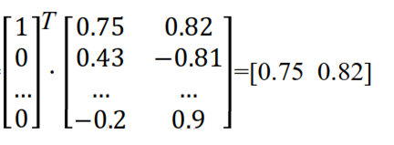
Word Embedding
Word2vec
可以理解为一种对单词onehot向量的一种降维处理。
通过一种映射关系将一个n维的onehot向量转化为一个m维的空间实数向量（可以理解为原来坐标轴上的点被压缩嵌入到一个更加紧凑的空间内）
由于onehot向量在矩阵乘法的特殊性，我们得到的表示映射关系的n*m的矩阵中的每k行，其实就表示语料库中的第k个单词。

Slide 5
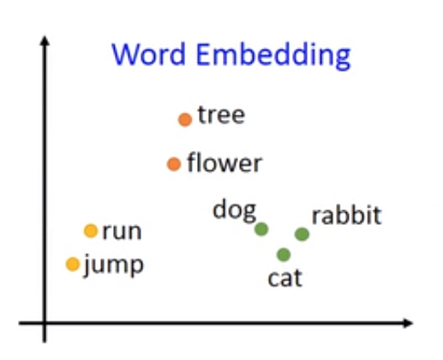
Word Embedding
word embedding
Embedding在数学上表示一个maping, f: X -> Y， 也就是一个function，其中该函数是injective（单射）；
每个Y只有唯一的X对应structure-preserving (结构保存，比如在X所属的空间上X1 < X2,那么映射后在Y所属空间上同理 Y1 < Y2)；
那么对于word embedding，就是将单词word映射到另外一个空间，其中这个映射具有injective和structure-preserving的特点。

Slide 6
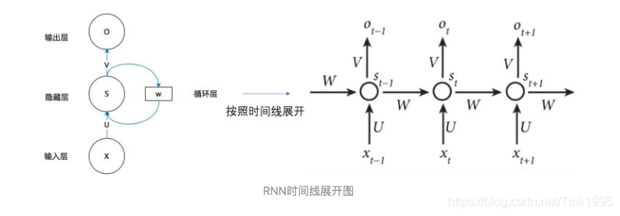
RNN
为了结合上下文！！！
例如：
牛吃草
草吃牛

Slide 7
Sequence
Next layer
$$b^{1}$$
$$b^{2}$$
$$b^{3}$$
$$b^{4}$$
$$a^{1}$$
$$a^{2}$$
$$a^{3}$$
$$a^{4}$$
$$a^{1}$$
$$a^{2}$$
$$a^{3}$$
$$a^{4}$$
Previous layer
Using CNN to replace RNN
Hard to parallel !

Slide 8
Sequence
Filters in higher layer can consider longer sequence
Next layer
$$b^{1}$$
$$b^{2}$$
$$b^{3}$$
$$b^{4}$$
$$b^{1}$$
$$b^{2}$$
$$b^{3}$$
$$b^{4}$$
……
……
……
……
$$a^{1}$$
$$a^{2}$$
$$a^{3}$$
$$a^{4}$$
$$a^{1}$$
$$a^{2}$$
$$a^{3}$$
$$a^{4}$$
Previous layer
Using CNN to replace RNN
Hard to parallel
(CNN can parallel)

Slide 9
Self-Attention
$b^{i}$ is obtained based on the whole input sequence.
$b^{1}$, $b^{2}$, $b^{3}$, $b^{4}$ can be parallelly computed.
$$b^{1}$$
$$b^{2}$$
$$b^{3}$$
$$b^{4}$$
$$b^{1}$$
$$b^{2}$$
$$b^{3}$$
$$b^{4}$$
Self-Attention Layer
$$a^{1}$$
$$a^{2}$$
$$a^{3}$$
$$a^{4}$$
$$a^{1}$$
$$a^{2}$$
$$a^{3}$$
$$a^{4}$$
You can try to replace any thing that has been done by RNN with self-attention.

Slide 10
Self-attention
$q$: query (to match others)
https://arxiv.org/abs/1706.03762
$$q^{i}=W^{q}a^{i}$$
$k$: key (to be matched)
$$k^{i}=W^{k}a^{i}$$
Attention is all you need.
$v$: information to be extracted
$$v^{i}=W^{v}a^{i}$$
$$q^{1}$$
$$k^{1}$$
$$v^{1}$$
$$q^{2}$$
$$k^{2}$$
$$v^{2}$$
$$q^{3}$$
$$k^{3}$$
$$v^{3}$$
$$q^{4}$$
$$k^{4}$$
$$v^{4}$$
$$a^{1}$$
$$a^{2}$$
$$a^{3}$$
$$a^{4}$$
$$a^{i}=Wx^{i}$$
$$x^{1}$$
$$x^{2}$$
$$x^{3}$$
$$x^{4}$$

Slide 11
Self-attention
d is the dim of $q$ and $k$
拿每個 query q 去對每個 key k 做 attention
Scaled Dot-Product Attention:
$$α_{1,i}=q^{1}∙k^{i}/\sqrt{d}$$
dot product
$$α_{1,1}$$
$$α_{1,2}$$
$$α_{1,3}$$
$$α_{1,4}$$
$$q^{1}$$
$$k^{1}$$
$$v^{1}$$
$$q^{2}$$
$$k^{2}$$
$$v^{2}$$
$$q^{3}$$
$$k^{3}$$
$$v^{3}$$
$$q^{4}$$
$$k^{4}$$
$$v^{4}$$
$$a^{1}$$
$$a^{2}$$
$$a^{3}$$
$$a^{4}$$
$$x^{1}$$
$$x^{2}$$
$$x^{3}$$
$$x^{4}$$

Slide 12
Self-attention
$${\hat{α}}_{1,i}=exp\left(α_{1,i} \right)/\sum_{j}{exp\left(α_{1,j} \right)}$$
$${\hat{α}}_{1,1}$$
$${\hat{α}}_{1,2}$$
$${\hat{α}}_{1,3}$$
$${\hat{α}}_{1,4}$$
Soft-max
$$α_{1,1}$$
$$α_{1,2}$$
$$α_{1,3}$$
$$α_{1,4}$$
$$q^{1}$$
$$k^{1}$$
$$v^{1}$$
$$q^{2}$$
$$k^{2}$$
$$v^{2}$$
$$q^{3}$$
$$k^{3}$$
$$v^{3}$$
$$q^{4}$$
$$k^{4}$$
$$v^{4}$$
$$a^{1}$$
$$a^{2}$$
$$a^{3}$$
$$a^{4}$$
$$x^{1}$$
$$x^{2}$$
$$x^{3}$$
$$x^{4}$$

Slide 13
Self-attention
$$b^{1}=\sum_{i}{{\hat{α}}_{1,i}v^{i} }$$
Considering the whole sequence
$$b^{1}$$
$${\hat{α}}_{1,1}$$
$${\hat{α}}_{1,2}$$
$${\hat{α}}_{1,3}$$
$${\hat{α}}_{1,4}$$
$$q^{1}$$
$$k^{1}$$
$$v^{1}$$
$$q^{2}$$
$$k^{2}$$
$$v^{2}$$
$$q^{3}$$
$$k^{3}$$
$$v^{3}$$
$$q^{4}$$
$$k^{4}$$
$$v^{4}$$
$$a^{1}$$
$$a^{2}$$
$$a^{3}$$
$$a^{4}$$
$$x^{1}$$
$$x^{2}$$
$$x^{3}$$
$$x^{4}$$
Notes:
Relation between attention and CNN
Global receptive field (compared to convolutional architectures)

Slide 14
Self-attention
$$b^{2}=\sum_{i}{{\hat{α}}_{2,i}v^{i} }$$
拿每個 query q 去對每個 key k 做 attention
$$b^{2}$$
$${\hat{α}}_{2,1}$$
$${\hat{α}}_{2,2}$$
$${\hat{α}}_{2,3}$$
$${\hat{α}}_{2,4}$$
$$q^{1}$$
$$k^{1}$$
$$v^{1}$$
$$q^{2}$$
$$k^{2}$$
$$v^{2}$$
$$q^{3}$$
$$k^{3}$$
$$v^{3}$$
$$q^{4}$$
$$k^{4}$$
$$v^{4}$$
$$a^{1}$$
$$a^{2}$$
$$a^{3}$$
$$a^{4}$$
$$x^{1}$$
$$x^{2}$$
$$x^{3}$$
$$x^{4}$$
Notes:
Relation between attention and CNN
Global receptive field (compared to convolutional architectures)

Slide 15
Self-attention
$b^{1}$, $b^{2}$, $b^{3}$, $b^{4}$ can be parallelly computed.
$$b^{1}$$
$$b^{2}$$
$$b^{3}$$
$$b^{4}$$
Self-Attention Layer
$$a^{1}$$
$$a^{2}$$
$$a^{3}$$
$$a^{4}$$
$$x^{1}$$
$$x^{2}$$
$$x^{3}$$
$$x^{4}$$
Notes:
Relation between attention and CNN
Global receptive field (compared to convolutional architectures)

Slide 16
Self-attention
$$q^{1}$$
$$q^{2}$$
$$q^{3}$$
$$q^{4}$$
$$a^{1}$$
$$a^{2}$$
=
$$a^{3}$$
$$W^{q}$$
$$a^{4}$$
$$Q$$
$$I$$
$$a^{1}$$
$$a^{2}$$
$$k^{1}$$
$$a^{3}$$
$$k^{2}$$
$$a^{4}$$
$$k^{3}$$
$$q^{i}=W^{q}a^{i}$$
$$k^{4}$$
=
$$W^{k}$$
$$K$$
$$I$$
$$k^{i}=W^{k}a^{i}$$
$$a^{1}$$
$$a^{2}$$
$$a^{3}$$
$$v^{1}$$
$$a^{4}$$
$$v^{2}$$
$$v^{3}$$
$$v^{4}$$
=
$$W^{v}$$
$$v^{i}=W^{v}a^{i}$$
$$V$$
$$I$$
$$q^{1}$$
$$k^{1}$$
$$v^{1}$$
$$q^{2}$$
$$k^{2}$$
$$v^{2}$$
$$q^{3}$$
$$k^{3}$$
$$v^{3}$$
$$q^{4}$$
$$k^{4}$$
$$v^{4}$$
$$a^{1}$$
$$a^{2}$$
$$a^{3}$$
$$a^{4}$$
$$x^{1}$$
$$x^{2}$$
$$x^{3}$$
$$x^{4}$$

Slide 17
Self-attention
$$b^{1}$$
$${\hat{α}}_{1,1}$$
$${\hat{α}}_{1,2}$$
$${\hat{α}}_{1,3}$$
$${\hat{α}}_{1,4}$$
$$q^{1}$$
$$k^{1}$$
$$v^{1}$$
$$q^{2}$$
$$k^{2}$$
$$v^{2}$$
$$q^{3}$$
$$k^{3}$$
$$v^{3}$$
$$q^{4}$$
$$k^{4}$$
$$v^{4}$$
$$α_{1,1}=$$
$$k^{1}$$
$$q^{1}$$
$$α_{1,2}=$$
$$k^{2}$$
$$q^{1}$$
$$α_{1,1}$$
$$k^{1}$$
$$α_{1,2}$$
$$k^{2}$$
$$α_{1,3}=$$
$$k^{3}$$
$$q^{1}$$
$$α_{1,4}=$$
$$k^{4}$$
$$q^{1}$$
$$=$$
$$q^{1}$$
$$α_{1,3}$$
$$k^{3}$$
$$α_{1,4}$$
$$k^{4}$$
(ignore $\sqrt{d}$ for simplicity)
Notes:
Relation between attention and CNN
Global receptive field (compared to convolutional architectures)

Slide 18
Self-attention
$$b^{2}=\sum_{i}{{\hat{α}}_{2,i}v^{i} }$$
$$b^{2}$$
$${\hat{α}}_{2,1}$$
$${\hat{α}}_{2,2}$$
$${\hat{α}}_{2,3}$$
$${\hat{α}}_{2,4}$$
$$q^{1}$$
$$k^{1}$$
$$v^{1}$$
$$q^{2}$$
$$k^{2}$$
$$v^{2}$$
$$q^{3}$$
$$k^{3}$$
$$v^{3}$$
$$q^{4}$$
$$k^{4}$$
$$v^{4}$$
$${\hat{α}}_{1,1}$$
$${\hat{α}}_{2,1}$$
$${\hat{α}}_{3,1}$$
$${\hat{α}}_{4,1}$$
$$α_{1,1}$$
$$α_{2,1}$$
$$α_{3,1}$$
$$α_{4,1}$$
$$k^{1}$$
$${\hat{α}}_{1,2}$$
$${\hat{α}}_{2,2}$$
$${\hat{α}}_{3,2}$$
$${\hat{α}}_{4,2}$$
$$α_{1,2}$$
$$α_{2,2}$$
$$α_{3,2}$$
$$α_{4,2}$$
$$k^{2}$$
$${\hat{α}}_{1,3}$$
$${\hat{α}}_{2,3}$$
$${\hat{α}}_{3,3}$$
$$=$$
$$q^{1}$$
$$q^{2}$$
$$q^{3}$$
$$q^{4}$$
$${\hat{α}}_{4,3}$$
$$α_{1,3}$$
$$α_{2,3}$$
$$α_{3,3}$$
$$α_{4,3}$$
$$k^{3}$$
$${\hat{α}}_{1,4}$$
$${\hat{α}}_{2,4}$$
$${\hat{α}}_{3,4}$$
$${\hat{α}}_{4,4}$$
$$α_{1,4}$$
$$α_{2,4}$$
$$α_{3,4}$$
$$α_{4,4}$$
$$k^{4}$$
$$Q$$
$$\hat{A}$$
$$A$$
$$K^{T}$$
Notes:
Relation between attention and CNN
Global receptive field (compared to convolutional architectures)

Slide 19
Self-attention
$$b^{2}=\sum_{i}{{\hat{α}}_{2,i}v^{i} }$$
$$b^{2}$$
$${\hat{α}}_{2,1}$$
$${\hat{α}}_{2,2}$$
$${\hat{α}}_{2,3}$$
$${\hat{α}}_{2,4}$$
$$q^{1}$$
$$k^{1}$$
$$v^{1}$$
$$q^{2}$$
$$k^{2}$$
$$v^{2}$$
$$q^{3}$$
$$k^{3}$$
$$v^{3}$$
$$q^{4}$$
$$k^{4}$$
$$v^{4}$$
$${\hat{α}}_{1,1}$$
$${\hat{α}}_{2,1}$$
$${\hat{α}}_{3,1}$$
$${\hat{α}}_{4,1}$$
$${\hat{α}}_{1,2}$$
$${\hat{α}}_{2,2}$$
$${\hat{α}}_{3,2}$$
$${\hat{α}}_{4,2}$$
$$b^{1}$$
=
$$b^{2}$$
$$b^{3}$$
$$b^{4}$$
$$v^{1}$$
$$v^{2}$$
$$v^{3}$$
$$v^{4}$$
$${\hat{α}}_{1,3}$$
$${\hat{α}}_{2,3}$$
$${\hat{α}}_{3,3}$$
$${\hat{α}}_{4,3}$$
$$O$$
$$V$$
$${\hat{α}}_{1,4}$$
$${\hat{α}}_{2,4}$$
$${\hat{α}}_{3,4}$$
$${\hat{α}}_{4,4}$$
$$\hat{A}$$
Notes:
Relation between attention and CNN
Global receptive field (compared to convolutional architectures)

Slide 20
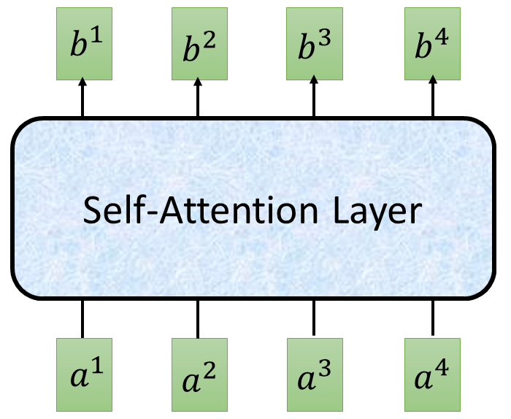
Self-attention
$$O$$
$$Q$$
=
$$I$$
$$W^{q}$$
$$K$$
=
$$I$$
$$W^{k}$$
$$V$$
=
$$I$$
$$I$$
$$W^{v}$$
$$\hat{A}$$
$$A$$
=
$$Q$$
$$K^{T}$$
$$\hat{A}$$
$$O$$
=
$$V$$
反正就是一堆矩陣乘法，用 GPU 可以加速

Slide 21
Multi-head Self-attention
(2 heads as example)
$$q^{i,1}=W^{q,1}q^{i}$$
$$b^{i,1}$$
$$q^{i,2}=W^{q,2}q^{i}$$
$$q^{i,1}$$
$$q^{i,2}$$
$$k^{i,1}$$
$$k^{i,2}$$
$$v^{i,1}$$
$$v^{i,2}$$
$$q^{j,1}$$
$$q^{j,2}$$
$$k^{j,1}$$
$$k^{j,2}$$
$$v^{j,1}$$
$$v^{j,2}$$
$$q^{i}$$
$$k^{i}$$
$$v^{i}$$
$$q^{j}$$
$$k^{j}$$
$$v^{j}$$
$$q^{i}=W^{q}a^{i}$$
$$a^{i}$$
$$a^{j}$$

Slide 22
Multi-head Self-attention
(2 heads as example)
$$q^{i,1}=W^{q,1}q^{i}$$
$$b^{i,1}$$
$$q^{i,2}=W^{q,2}q^{i}$$
$$b^{i,2}$$
$$q^{i,1}$$
$$q^{i,2}$$
$$k^{i,1}$$
$$k^{i,2}$$
$$v^{i,1}$$
$$v^{i,2}$$
$$q^{j,1}$$
$$q^{j,2}$$
$$k^{j,1}$$
$$k^{j,2}$$
$$v^{j,1}$$
$$v^{j,2}$$
$$q^{i}$$
$$k^{i}$$
$$v^{i}$$
$$q^{j}$$
$$k^{j}$$
$$v^{j}$$
$$q^{i}=W^{q}x^{i}$$
$$a^{i}$$
$$a^{j}$$

Slide 23
Multi-head Self-attention
(2 heads as example)
$$b^{i,1}$$
$$b^{i}$$
$$b^{i,1}$$
$$b^{i,2}$$
$$b^{i}$$
=
$$W^{O}$$
$$b^{i,2}$$
$$q^{i,1}$$
$$q^{i,2}$$
$$k^{i,1}$$
$$k^{i,2}$$
$$v^{i,1}$$
$$v^{i,2}$$
$$q^{j,1}$$
$$q^{j,2}$$
$$k^{j,1}$$
$$k^{j,2}$$
$$v^{j,1}$$
$$v^{j,2}$$
$$q^{i}$$
$$k^{i}$$
$$v^{i}$$
$$q^{j}$$
$$k^{j}$$
$$v^{j}$$
$$a^{i}$$
$$a^{j}$$

Slide 24
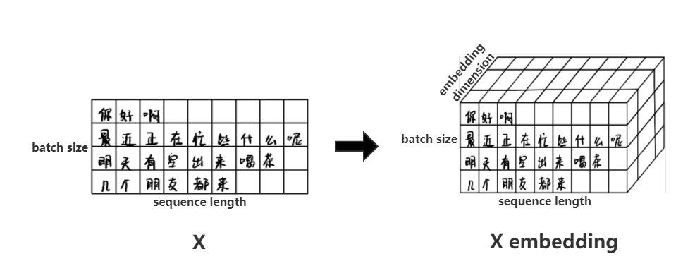
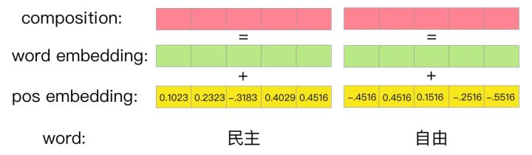
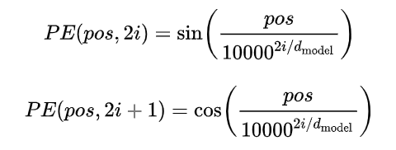
Positional Encoding

Slide 25
Positional Encoding
$$q^{i}$$
$$k^{i}$$
$$v^{i}$$
$$e^{i}$$
+
$$a^{i}$$
No position information in self-attention.
Original paper: each position has a unique positional vector $e^{i}$ (not learned from data)
In other words: each $x^{i}$ appends a one-hot vector $p^{i}$
$$x^{i}$$
$$x^{i}$$
$$a^{i}$$
$$W$$
=
$$W^{I}$$
$$x^{i}$$
$$p^{i}$$
$$W^{I}$$
$$W^{P}$$
$$p^{i}=$$
………
0
$$e^{i}$$
1
i-th dim
$$W^{P}$$
+
$$p^{i}$$
0
…

Slide 26
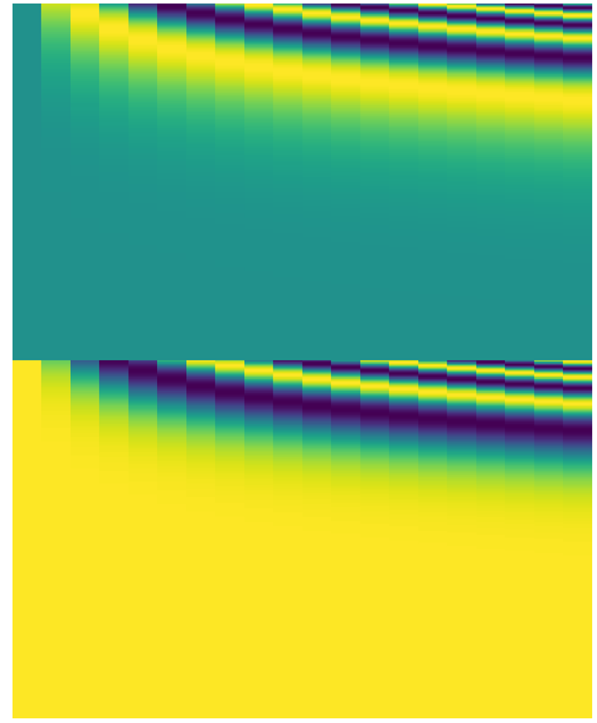
$$x^{i}$$
$$W$$
$$p^{i}$$
$$W^{I}$$
$$W^{P}$$
$$a^{i}$$
=
$$W^{I}$$
$$x^{i}$$
$$e^{i}$$
+
$$W^{P}$$
$$p^{i}$$
-1
1
source of image: http://jalammar.github.io/illustrated-transformer/

Slide 27
Seq2seq with Attention
Review: https://www.youtube.com/watch?v=ZjfjPzXw6og&feature=youtu.be
$$c^{1}$$
$$c^{2}$$
$$o^{1}$$
$$o^{2}$$
$$o^{3}$$
$$h^{1}$$
$$h^{2}$$
$$h^{3}$$
$$h^{4}$$
Self-Attention Layer
Self-Attention Layer
$$x^{1}$$
$$x^{2}$$
$$x^{3}$$
$$x^{4}$$
$$c^{1}$$
$$c^{2}$$
$$c^{3}$$
Encoder
Decoder

Slide 28
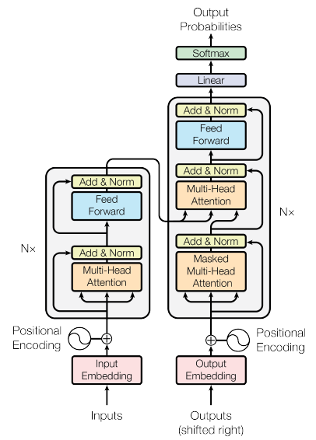
Transformer
machine
learning
Using Chinese to English translation as example
Encoder
Decoder
機 器 學 習
<BOS>
machine

Slide 29
Transformer
Layer Norm:
https://arxiv.org/abs/1607.06450
Batch Size
Layer
Norm
$$b^{′}$$
Batch Norm:
$$μ=0,$$
$$σ=1$$
https://www.youtube.com/watch?v=BZh1ltr5Rkg
+
Batch
$$b$$
$$μ=0,σ=1$$
Layer
…
$$a$$
attend on the input sequence
Masked: attend on the generated sequence
Notes:
(two layer2, with one relu)

Slide 30
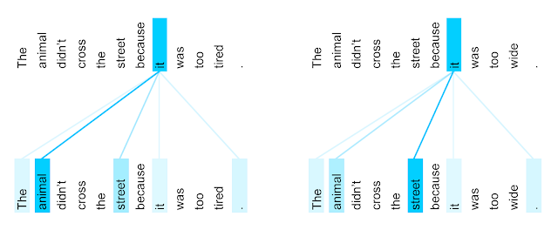
Attention Visualization
The encoder self-attention distribution for the word “it” from the 5th to the 6th layer of a Transformer trained on English to French translation (one of eight attention heads).
https://ai.googleblog.com/2017/08/transformer-novel-neural-network.html

Slide 31
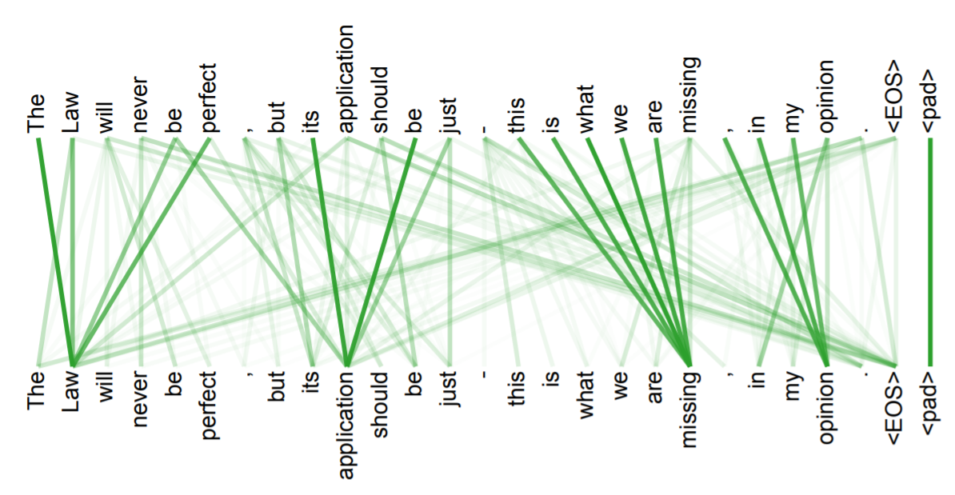
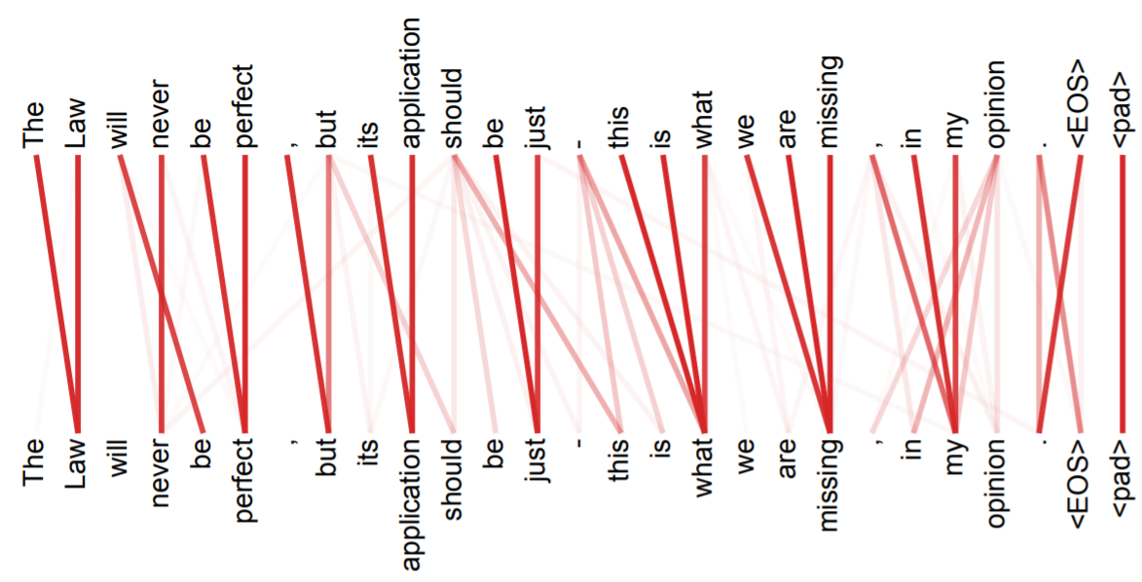
Multi-head
Attention

