Slide 1
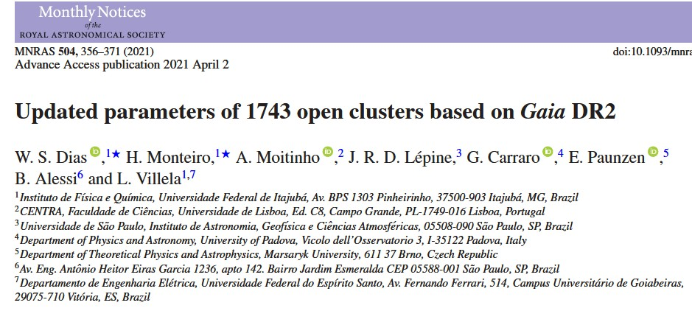

Slide 2
– Dias 疏散星团表的前世今生

Slide 3
Major Galactic Open Cluster catalogues ~ before Gaia
Kharchenko’s Milky Way Stellar Clusters (MWSC)
Dias’ Catalog of Optically Visible Open Clusters and Candidates
WEBDA

Slide 4
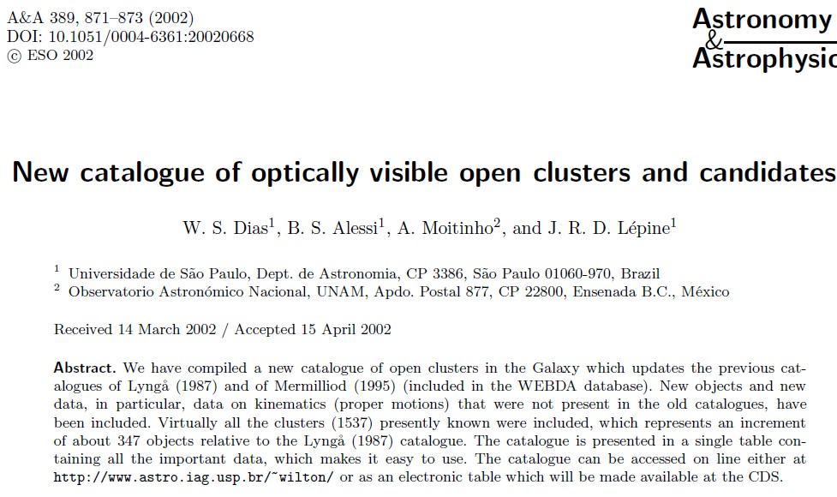
~ 近20 年啦！…
~ “DAML”

Slide 5
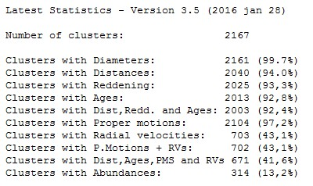
Dias catalog (DAML_2002) updated version
Updating yearly;
mostly confirmed OCs
-- A compilation of literature data
http://www.wilton.unifei.edu.br/ocdb/

Slide 6
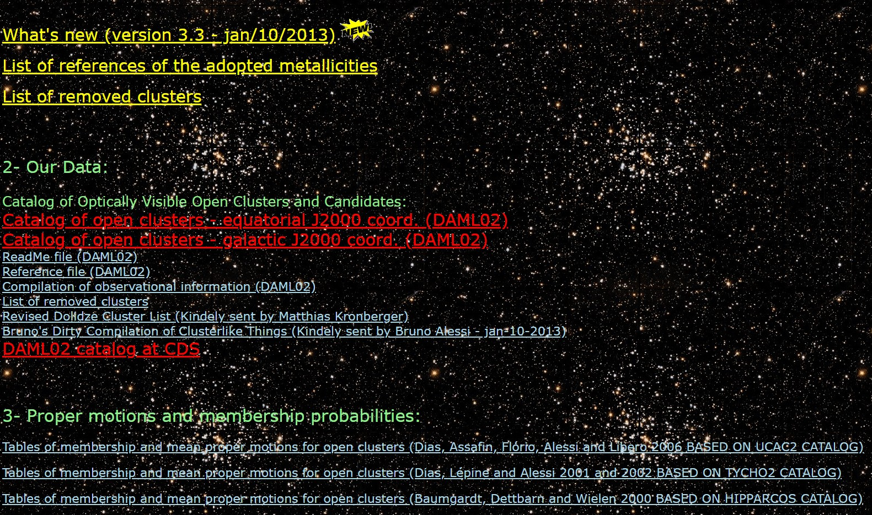
http://www.astro.iag.usp.br/ocdb/file/ ~ 已失效

Slide 7
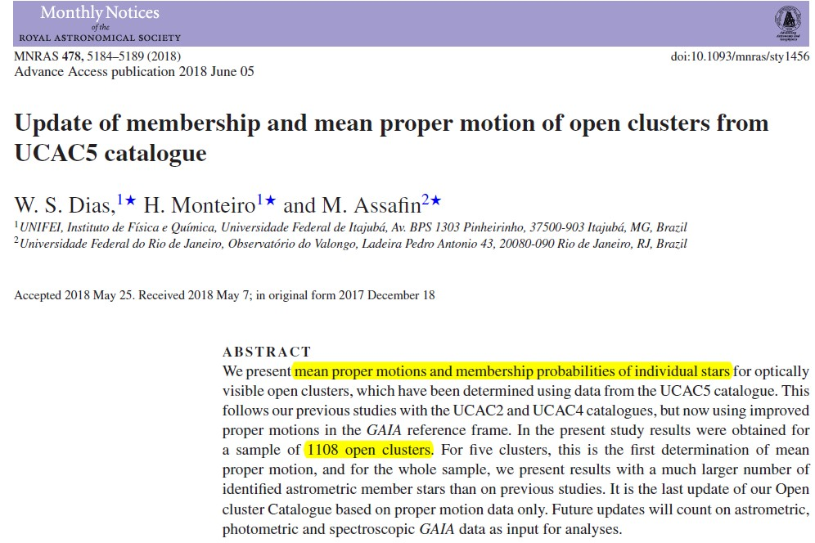
疏散星团成员判定与星团平均自行的工作 ~ 持续更新

Slide 8
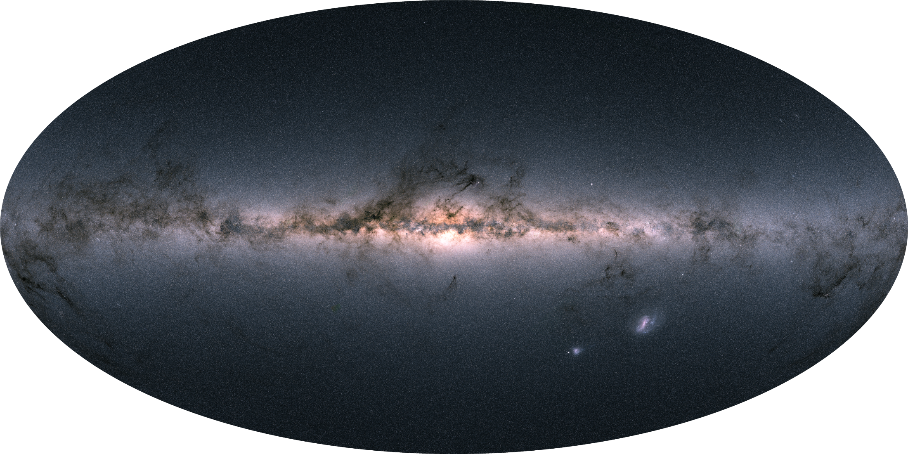
5-parameter: 1.3 billion, G_limit ~ 21mag
Plx ~0.1mas@G=17, ~0.7mas@G=20
PM ~0.2mas/yr@G=17 ，~1.2mas/yr@G=20
Gaia 眼中的银河系

Slide 9
Since Gaia_DR2 ……
N=1229
2018.10
N=1441
2020.1
N=1867
2020.8

Slide 10
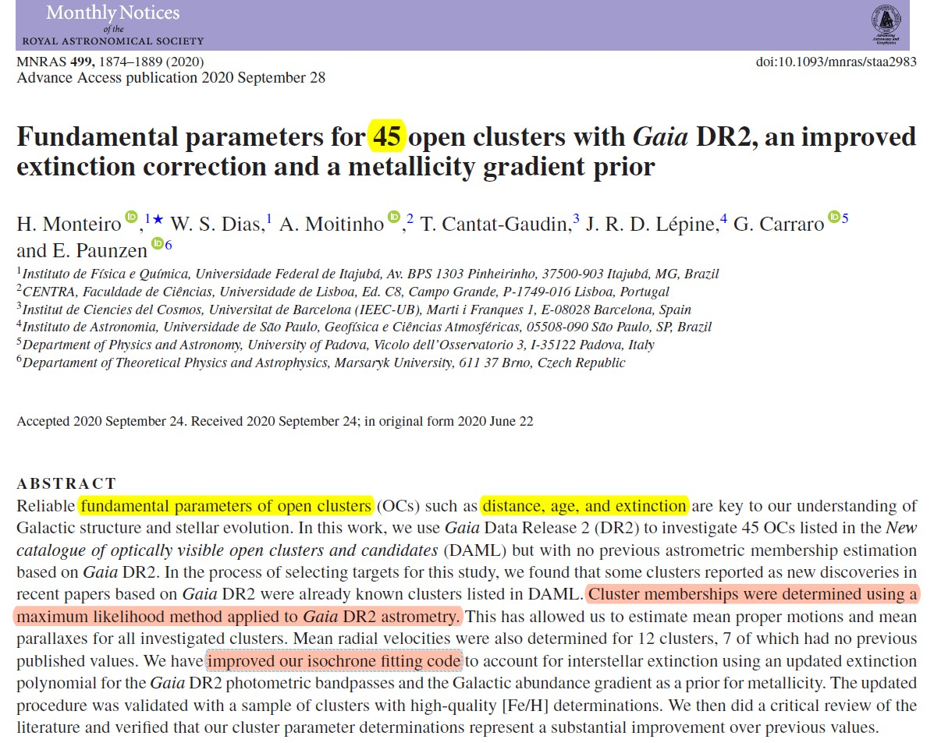
(Monteiro et al. 2020)

Slide 11
(Dias) 王者归来 ~ “as part of an ongoing project to bring DAML into the Gaia era”

Slide 12
… follow up recent paper (Monteiro et al. 2020)
use published membership probability derived from Gaia DR2
applied their isochrone fitting code, ref. Monteiro et al. (2020), to G_{BP} & G_{RP}
homogeneous sample of fundamental parameters (distance, age, extinction)
of 1743 OCs based on Gaia_DR2
& mean Rv of 831 OCs (198 new)
& a list of likely not physical or dubious OCs

Slide 13
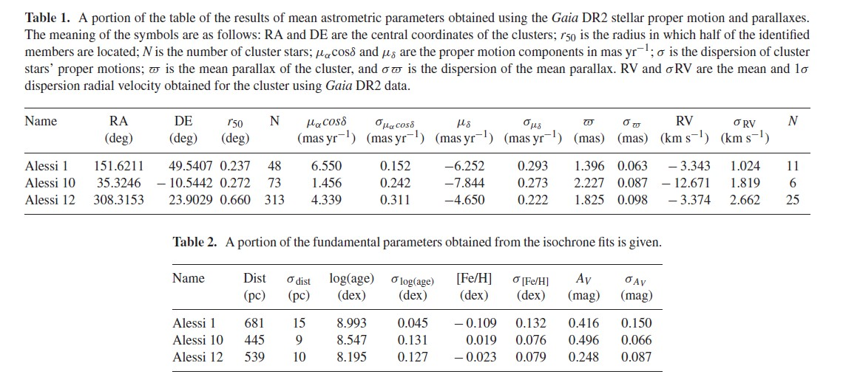
星团样本初选： 2337个星团~ 所有已发表成员判定结果(基于Gaia_DR2)
部分星团成员概率重新独立计算(最大似然法)
等龄线拟合过程 (ref. Monteiro et al. 2020)
1743个星团平均性质：大小、自行、视向速度、距离、年龄丰度、消光
星团成员观测性质及成员概率

Slide 14
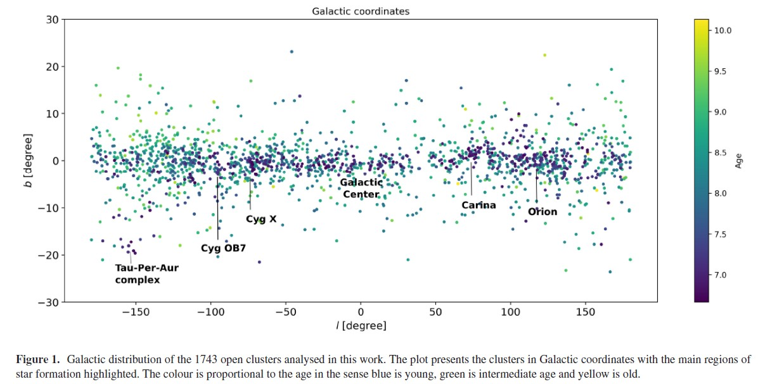
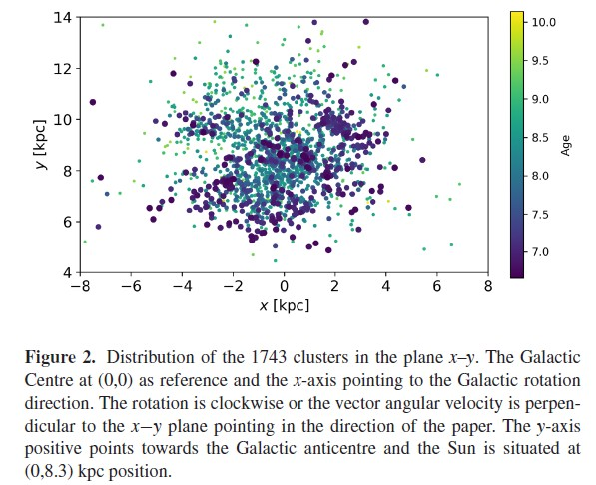
星团表样本空间分布情况

Slide 15
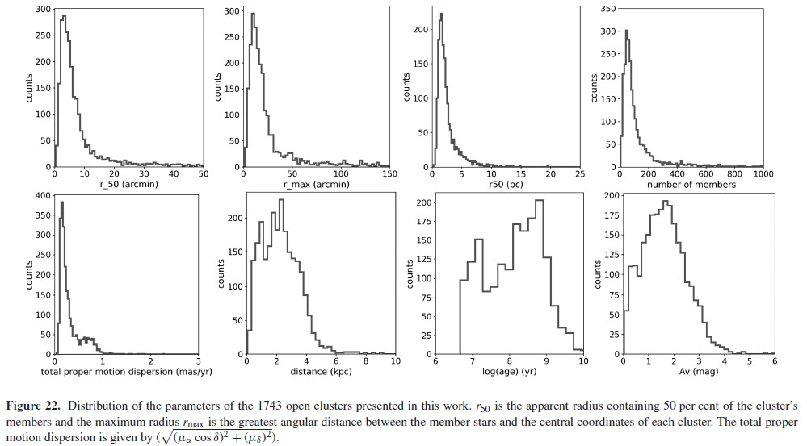
星团参数分布
r50, rmax, N, sigma_pm, dist, logt, Av

Slide 16
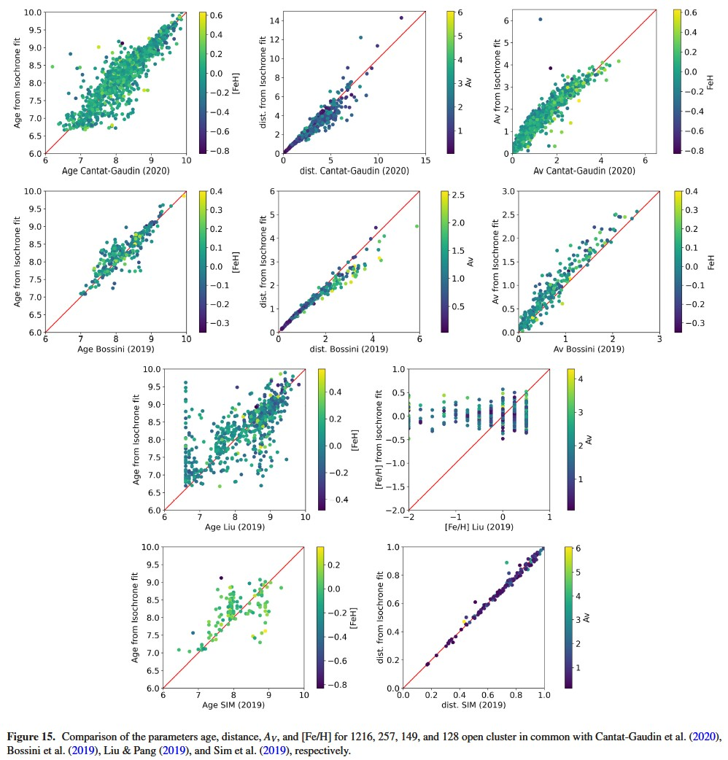
Comparison with
catalogs after Gaia
Cantat-Gaudin_2020
Bossini_2019
Liu&Pang_2019
Sim_2019

Slide 17
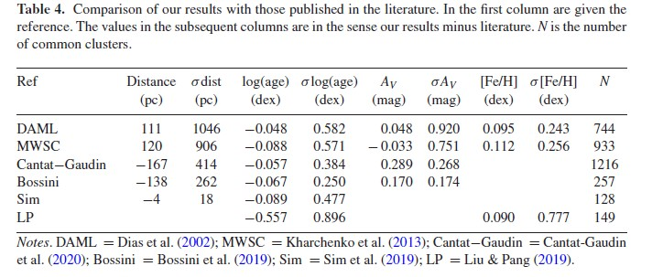
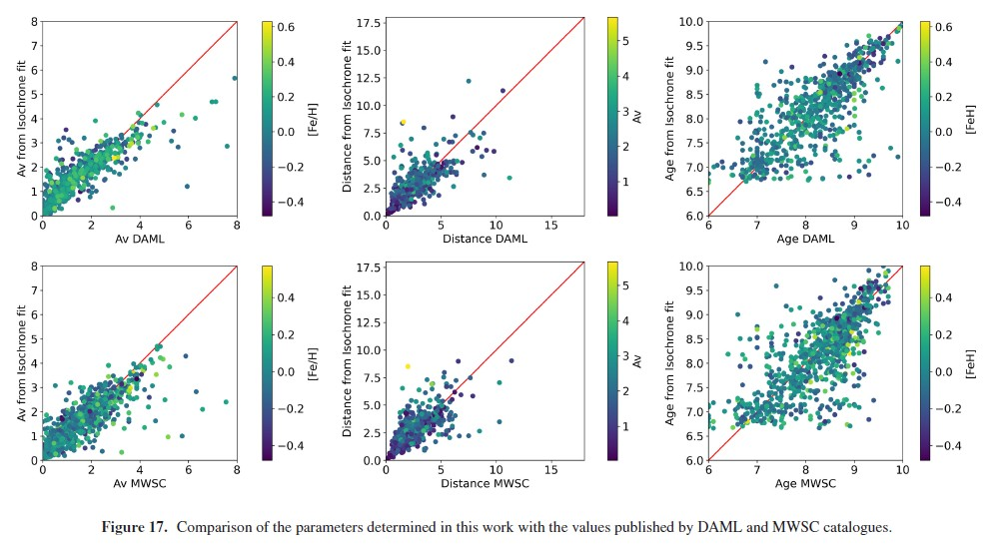
Comparison with catalog
before Gaia
DAML
MWSC

Slide 18
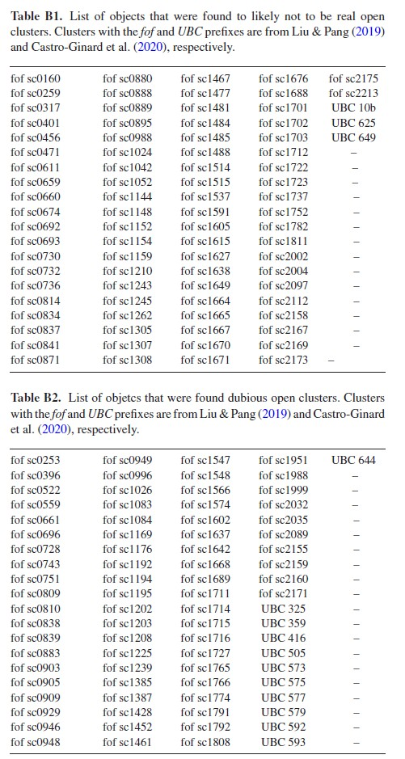
85 objects ~ not real OCs
81 objects ~ dubious OCs

Slide 19
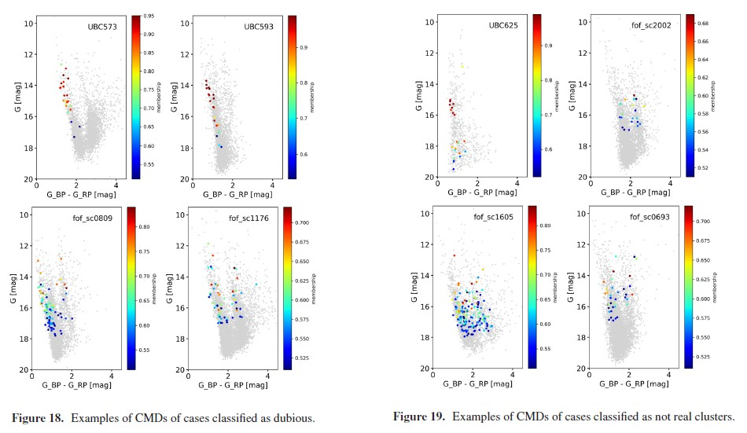
CMD example
Dubious OCs
Not real OCs

Slide 20
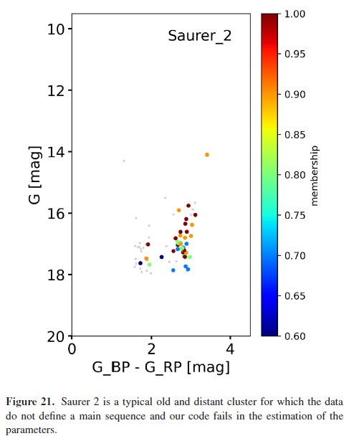
A case of real cluster that is too faint to have enough Gaia DR2 based
membership determinations to define a clear CMD sequence
Saurer_2 is REAL !

Slide 21
~ DAML_2002→ 744 citations (MWSC→403)

Slide 22
~ DAML_2002→ 744 citations (MWSC→403)

Slide 24
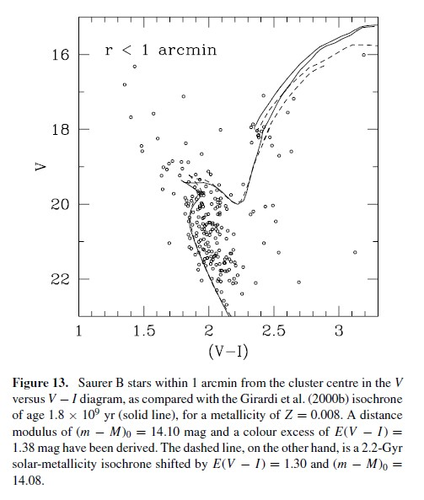
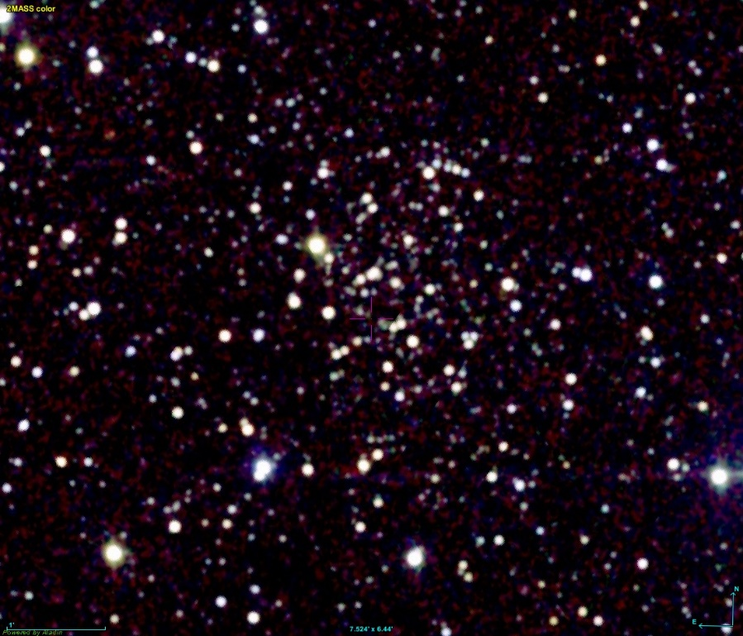
Dist ~ 6.4kpc
Age ~ 2Gyr

