Slide 1
韩国SDSS 总结
https://trac.sdss.org/wiki/Meetings/2018Collab
居梦婷
27/6/2018

Slide 3
Star formation and end
特殊源
质量和环境
旋转曲线

Slide 4
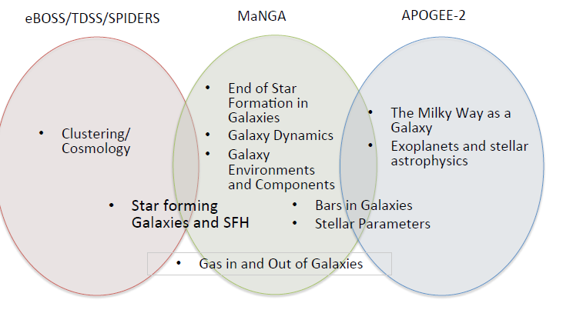

Slide 5
Bars
Bar Fraction in Early- and Late-type Spirals , Yun Hee Lee,
A Bar pattern speeds and centre dark matter fractions of MaNGA barred galaxies , Rui Guo,
3. Measuring the Bar Pattern Speed of MaNGA Galaxies from Stellar and H alpha Kinematics, Yanfei Zou,
4. Stellar kinematic signatures and the cold high-velocity peaks of the Milky Way bar/bulge, Yingying Zhou
5. Characterizing Galaxy Velocity Fields Using the Radon Transform , David Stark
2，3. Bar的角速度
4. 高速星（apogee）
5. 新的工具去表征非圆星系的速度场

Slide 6
Dynamics
Rotation Curves of SDSS-IV MaNGA Galaxies and their Mass and Environmental Dependence , Haeun Chung
Polar Ring Galaxy in MaNGA , Shuai Feng
The Schwarzschild modelling for MaNGA early-type galaxies , Yunpeng Jin
Gravity tests with latest observations , Jian Li
Further improving the Fundamental Plane with SDSS data , Christoph Saulder

Slide 7
Environment and component
1. Hierarchical Assembly of Stellar Envelopes in Galaxy Clusters , Meng Gu,
2. Environmental Dependence of Galaxy Properties in the Framework of the Cosmic Web, Ho Seong Hwang
3. Environment dependence of alpha-to-iron abundance distribution in MaNGA MPL-6 galaxies, Zheng Zheng,
4.Properties of pseudo-bulges, classical bulges and elliptical galaxies in the Sloan Digital Sky Survey, Yifei Luo
5. Untangling galaxy component with MaNGA , Martha Tabor,
6. The host of blue compact dwarf galaxies in MaNGA , Mengting Ju

Slide 8
1. 星系团中Stellar Envelopes（已发表arXiv 1805.04520）星系团间光度，（年龄和金属）
2.星系性质-形态，sfr，颜色，质量与simulation比较 结论是各项异性的环境对星系性质影响重大
3.[α/Fe]分布和环境影响，结论是
Mgb/<Fe> - 𝛔* relation (especially for old population) is correlated with
Environment
Mgb/<Fe> gradients depend on vd and also weakly on environment/
formation history
4.经典核球和伪核球性质
5.Bulges and disk
6.我的工作

Slide 9
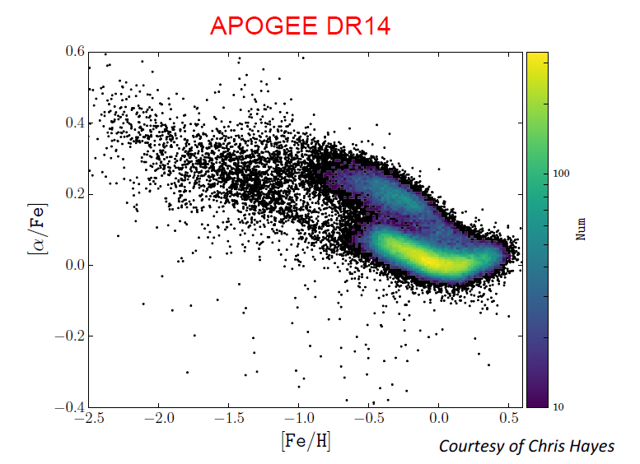
Α元素主要是二型超新星爆发
Fe I型（小质量

Slide 11
List of DR15 papers to be led by C-MaNGA:
1.alpha-abundance + environment (Zheng Zheng, Sept.)
2.central and ring-like post-starburst galaxies (Yanmei Chen, 31 July)
self-similar SFH in post-starburst galaxies (Zhuo Cheng, Sept)
4. Halpha blobs (Xihan Ji, Sept)
5. IMF variation inferred by Bayesian analysis (Shuang Zhou, Aug)
Central star formation driven by bars (Lin Lin, currently based on MPL5)
Star formation in AGN host galaxies(Longji Bing et al., July)
Changing-look AGN and their host galaxy properties(XiaolingYu et al.,August)
An early-type galaxy with an inner star-forming disk(Songlin Li et al., June)10.

Slide 12
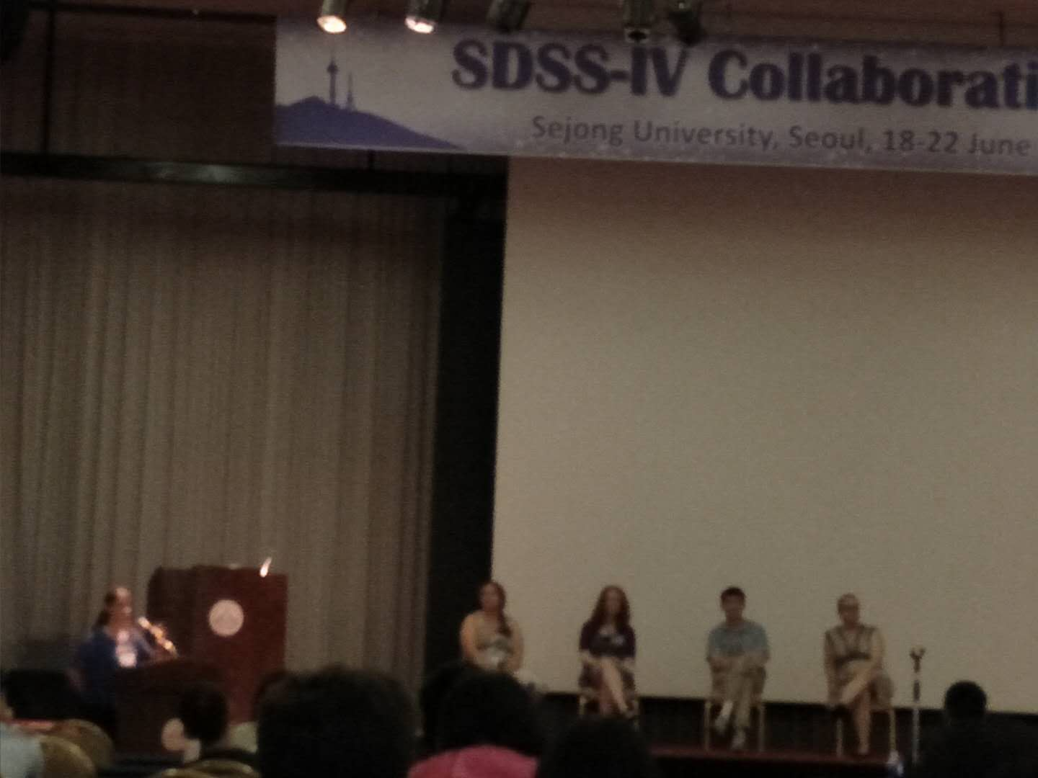
日常
合照没找到

