Slide 1
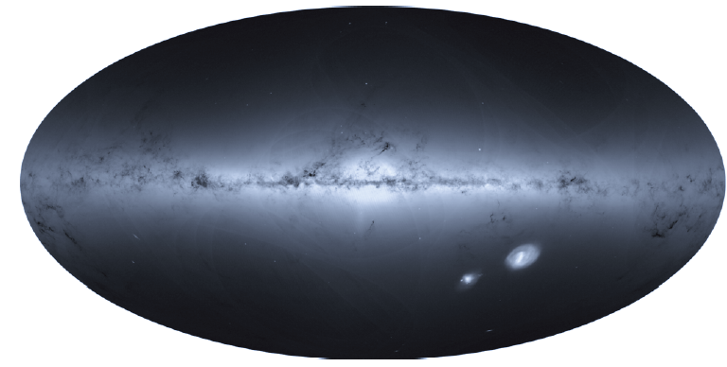
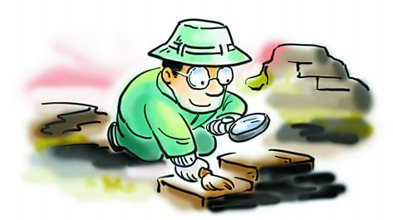
Using the Gaia parallax correctly
The importance and the composition of the parallax uncertainty
1.468 billion sources
zyshao@shao.ac.cn
2021-03-24

Slide 2
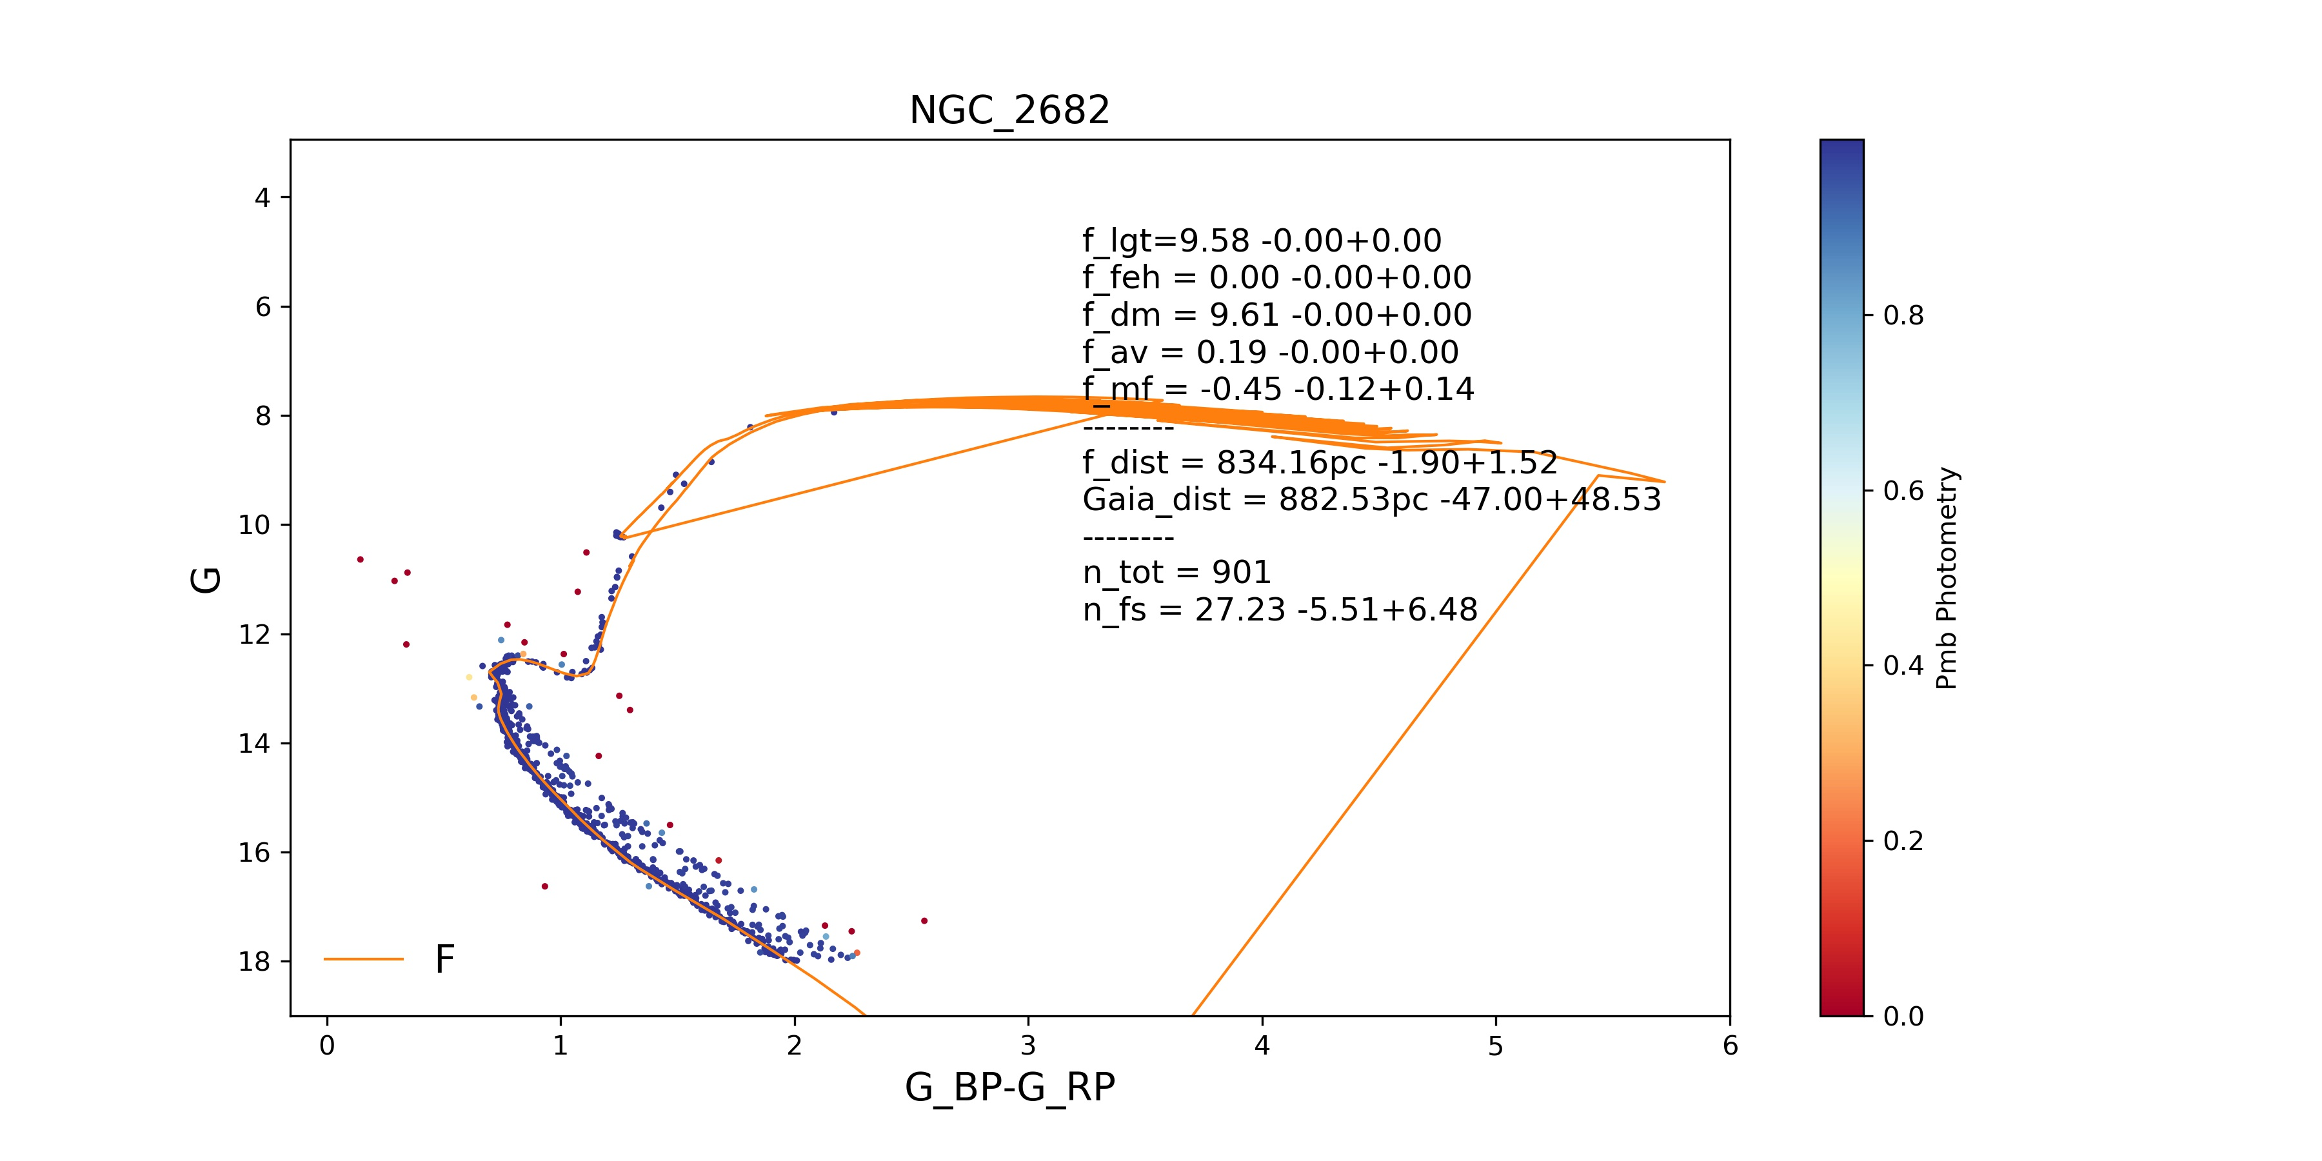
1. Distance is not a direct measurement:
it is a derived value from parallax (ϖ) or distance module (DM)
Parallax measurements of Gaia
Photometric distance of stellar cluster: DM = m – M
e.g. the isochrone fitting of a cluster
𝜛
PM
𝜛_{obs} ⇒ 1/D
+ very precise fitting result : ∆DM < 0.005
- Depends on the stellar model, [Fe/H], Av……
Parallax: to derive accurate D for nearby stars, and calibrate the standard candles:
variable stars, red clumps, isochrones of Stellar Clusters …

Slide 3
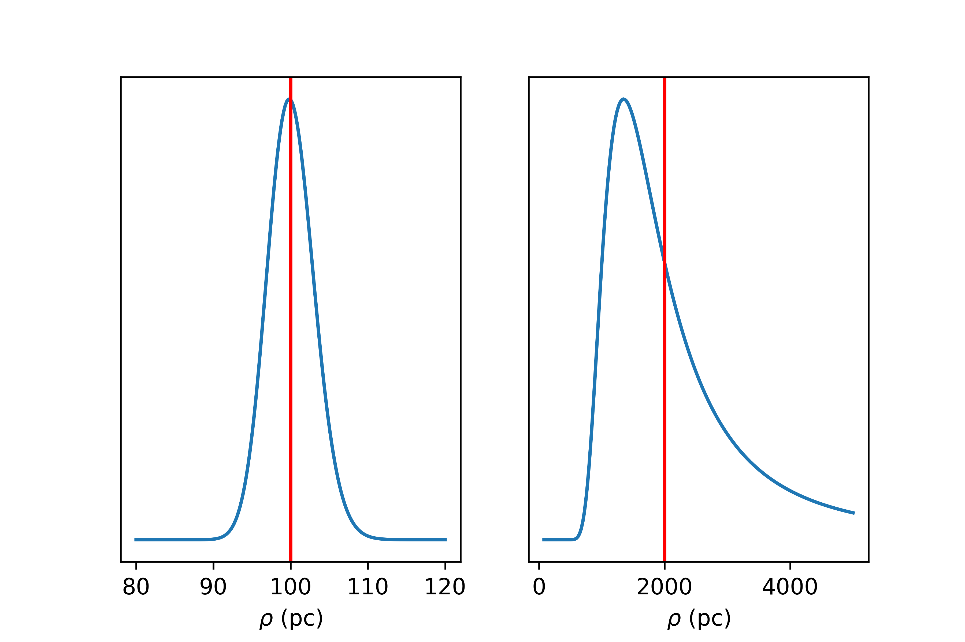
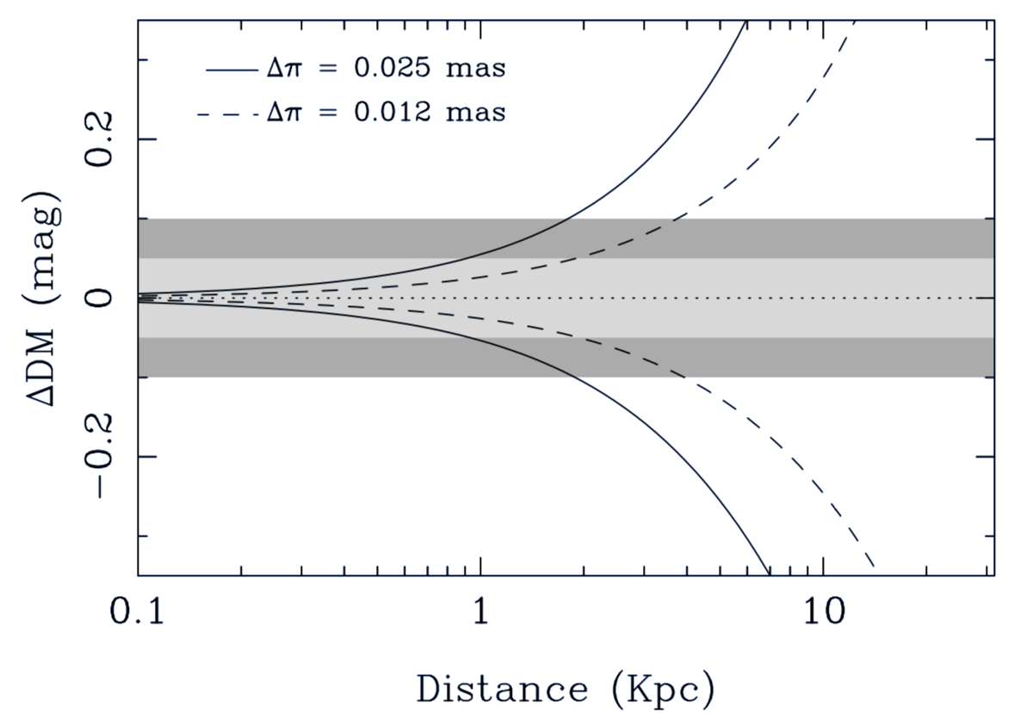
2. Why photometric distance (DM) is still important in the era of Gaia?
σ_{𝜛} = 0.3mas, f = σ_{𝜛} /𝜛 (relative error)
∆DM ≲ 0.05 or 0.1 mag for typical photometric data
vs ∆𝜛 ≈ 0.012 or 0.025 mas (Gaia EDR3)
f = 0.050
f = 0.025
𝜛 = 10, f = 0.03; 𝜛 = 0.5, f = 0.60
+ Independent to any stellar properties and models
- PDF of distance is asymmetric for a larger f value
- f increase very faster with decrease of 𝜛
Even a very small ∆𝜛, may have very large relative uncertainty at a scale length of MW !
It is very important to reduce the uncertainty and use it correctly !

Slide 4
3. The composition of the parallax error: Random and systematic
- Formal uncertainties in data release of Gaia were estimated from the pipeline (𝜎_{i}) and do not represent the total error (𝜎_{ext}). The external (total) uncertainty contains:
${ σ}_{ext}^{2}$ = ${ k^{2} σ}_{i}^{2}$ ${+ σ}_{s}^{2}$
Random error:
- uncorrelated between different sources
- Formal internal uncertainty 𝜎_{i} is a (possibly underestimated) estimate of its standard deviation and usually k > 1.0
Systematic error: ~ 0.025 mas
- ‘bias’ or ‘noise’ of the zero-point
- May depend on several variables (position, magnitude, colour, ……)
Smoothed (5°) maps of quasar parallaxes

Slide 5
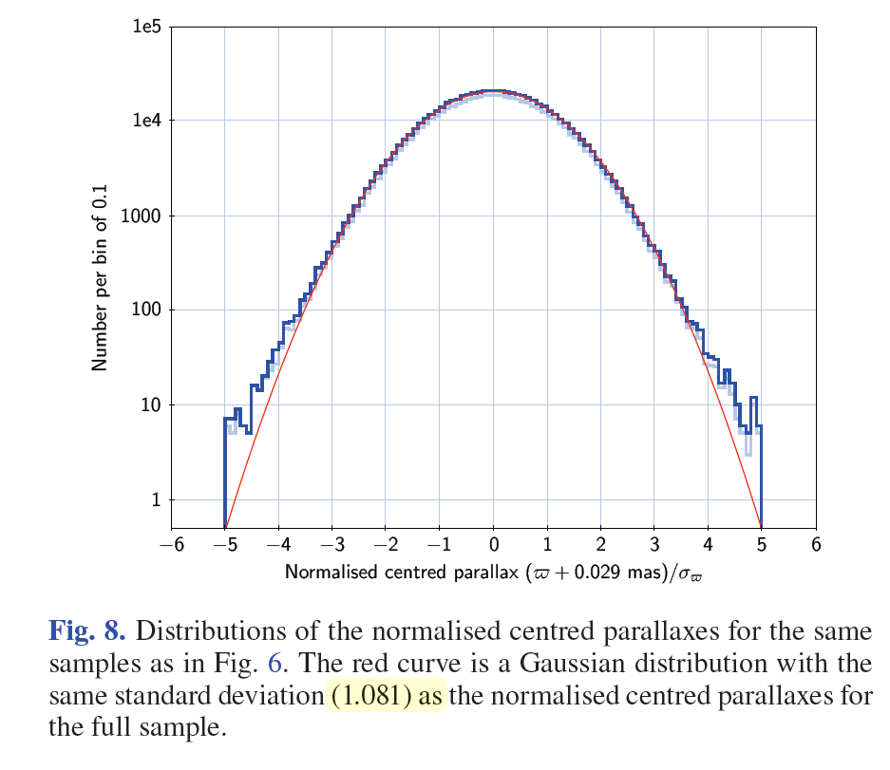
4. How to Estimate the K factor:
${ σ}_{ext}^{2}$ = ${ k^{2} σ}_{i}^{2}$ ${+ σ}_{s}^{2}$
in the faint limit photon noise dominates (𝜎_{i} ≫ 𝜎_{s} ) so 𝜎_{ext} = k 𝜎_{i}
4.1 Using the 𝜛 distribution of QSOs → 𝜎_{ext}
- QSOs have expected 𝜛 of Zero
- (𝜛 - 𝜛₀) follows the normal distribution with scatter of 𝜎_{ext}
Fabricius + 2020 (Gaia Team)
- It is about k₅=1.05 for 5p solutions (improved from DR2), slightly more for very faint stars
- k₆ =1.22 for 6p solutions, and larger for sources with nonzero excess noise or those in the LMC (a denser region !).

Slide 6
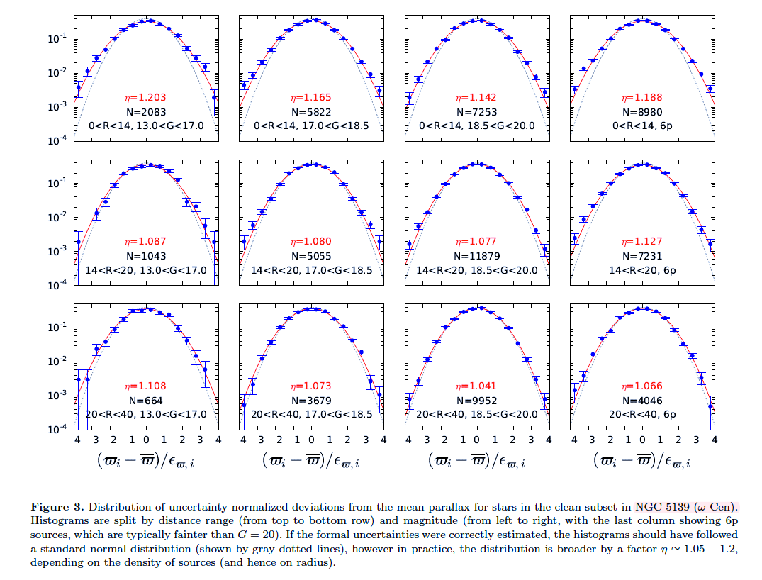
4.1 Using cluster members: Vasiliev + 2020
k5
fainter
k6
- Astrometric cluster members: 𝜛_{i}
- (𝜛_{i} - 𝜛_{c}) /𝜎_{i} follows the Gaussian (0,k)
Denser
- k₅ and k₆ are varies with
local star density and the magnitude !

Slide 7
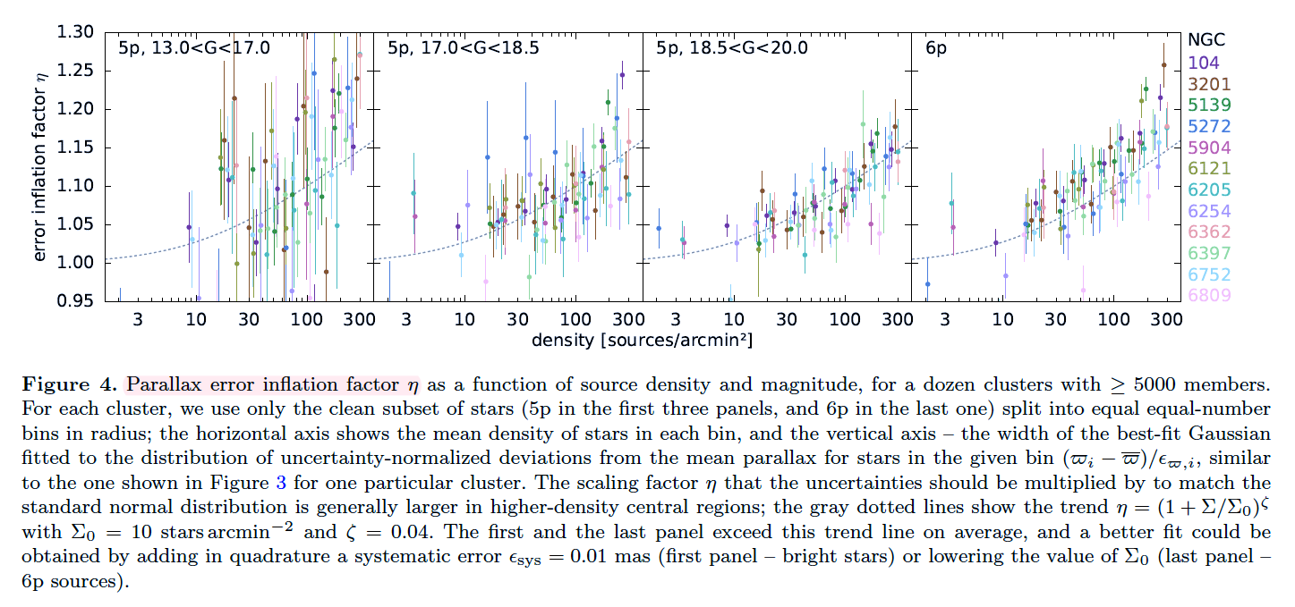
Vasiliev + 2021 (more globular clusters)
k increases with star density !
?

Slide 8
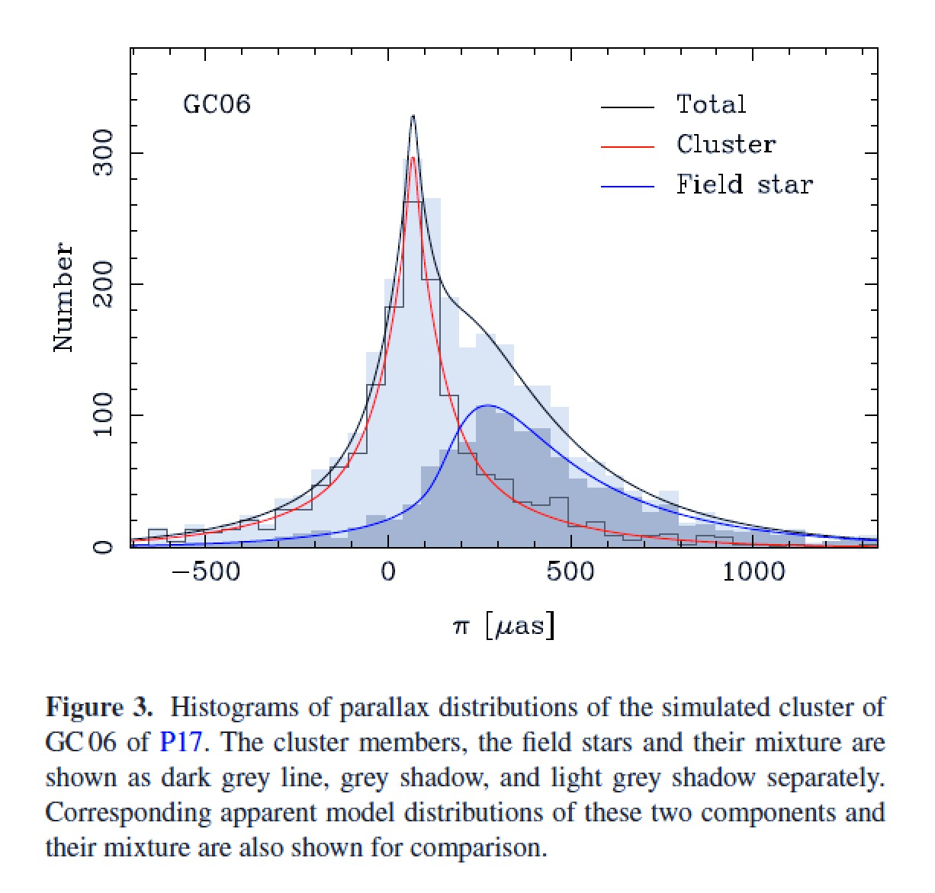
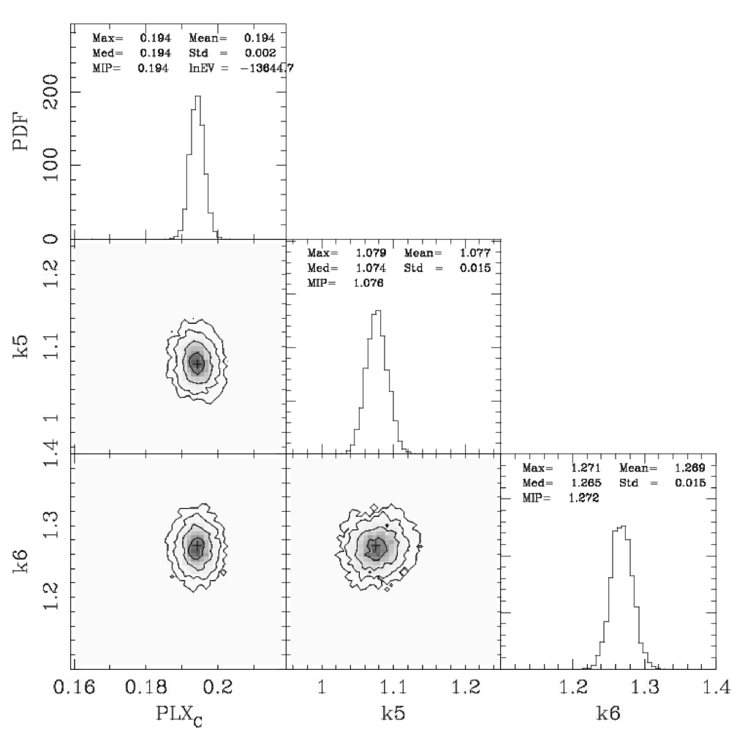
4.2 MM fitting of cluster’s parallax : Shao & Li 2019 (Gaia DR2) and 2021 in preparation (EDR3)
Field stars
Cluster members
- 𝜎_{𝜛}(ext) = k 𝜎_{𝜛}(i)
- add k₅, k₆ as fitting parameters

Slide 9
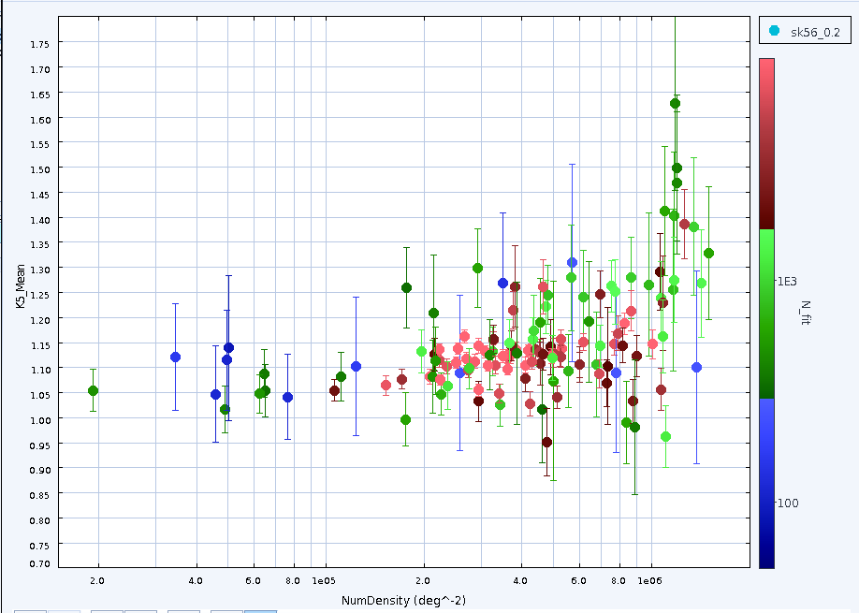
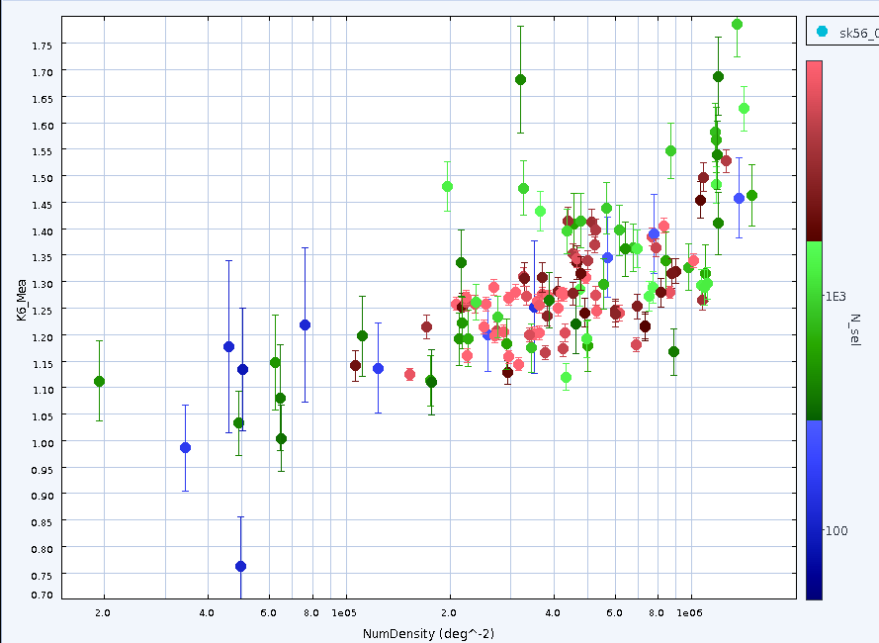
Preliminary result for ~ 130 GCs
k₅ and k₆ is generally larger than those from QSOs
In cluster, k₆ are usually larger than k₅
k increases with number density of the clusters
K5
K6
QSO
QSO
Next: local density dependence in the same cluster; luminosity dependence; open clusters …

Slide 10
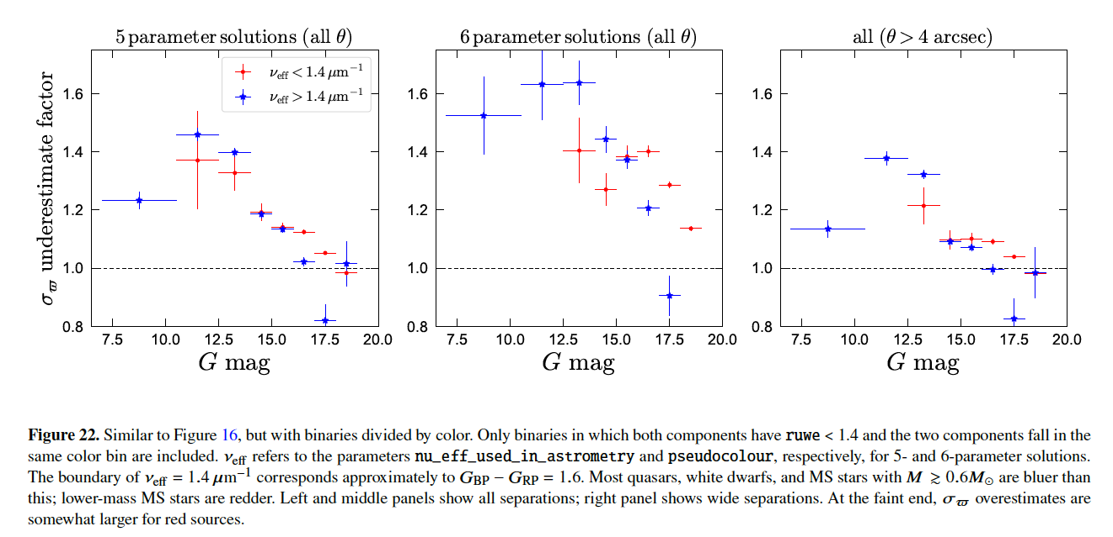
4.3 Estimating k from wide binaries : El-badry + 2021 (EDR3)

Slide 11
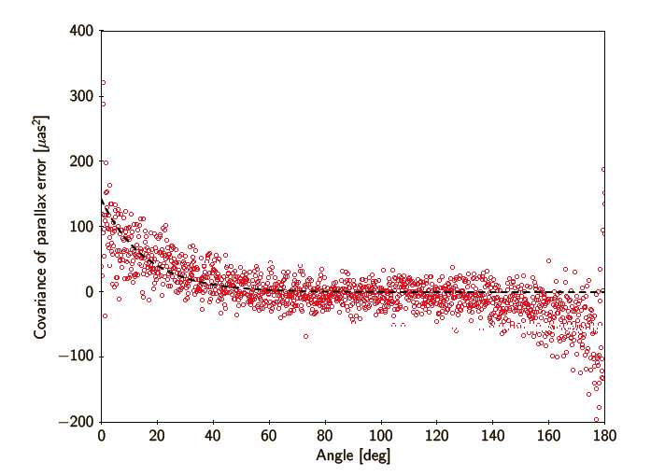
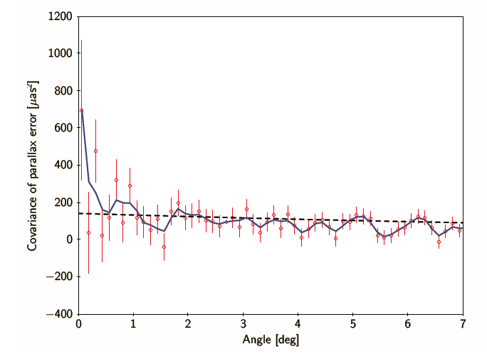
5. How to Estimate the systematic error 𝜎_{s}:
${ σ}_{ext}^{2}$ = ${ k^{2} σ}_{i}^{2}$ ${+ σ}_{s}^{2}$
The spatial covariance in parallax:
→ V_{𝜛}(0) = 𝜎_{s}²
to check if the ZP-“bias” of nearby stars are related ?
QSOs
QSOs
𝜎_{s}(0.5°) = 12 𝜇as (EDR3)
17 𝜇as (DR2)
𝜎_{s}(0°) = 27 𝜇as (EDR3)
43 𝜇as (DR2)

Slide 12
6. How to using the parallax error correctly: Lindegren + 2018
n = 1:
- remember the k factor ;
- considering the value of 𝜎_{s}~ 0.025 mas, check if it is neglectable, compare it with 𝜎_{i} and also the value of f = 𝜎_{ext}/𝜛
${ σ}_{ext}^{2}$ = ${ k^{2} σ}_{i}^{2}$ ${+ σ}_{s}^{2}$
For a group or cluster with n stars:
- the 1st term could be significantly reduced with a large n
- increase of n do not help to reduce the 2nd term; It only can be smoothed down by enlarge the angular volume, 𝜎_{s} (0.5°) ~ 0.012 mas

Slide 13
7. The limitation of accuracy of EDR3 parallax
f = 0.050
f = 0.025
𝜎_{s} ~ 0.025 mas, for single target, corresponding to 5% uncertainty (0.10 mag) at 2 kpc,
~ 0.012 mas for group of stars, 2.5% uncertainty (0.05 mag) ~ 2 kpc
Using EDR3, only nearby clusters could play as calibrate place for ‘Standard candles’
Don’t give up the photometric method of distance ( > 1 kpc)
Conditions may improves with the further data release of Gaia: 𝜎_{s} ~ 0.043 mas → 0.027 → ……

