Slide 1
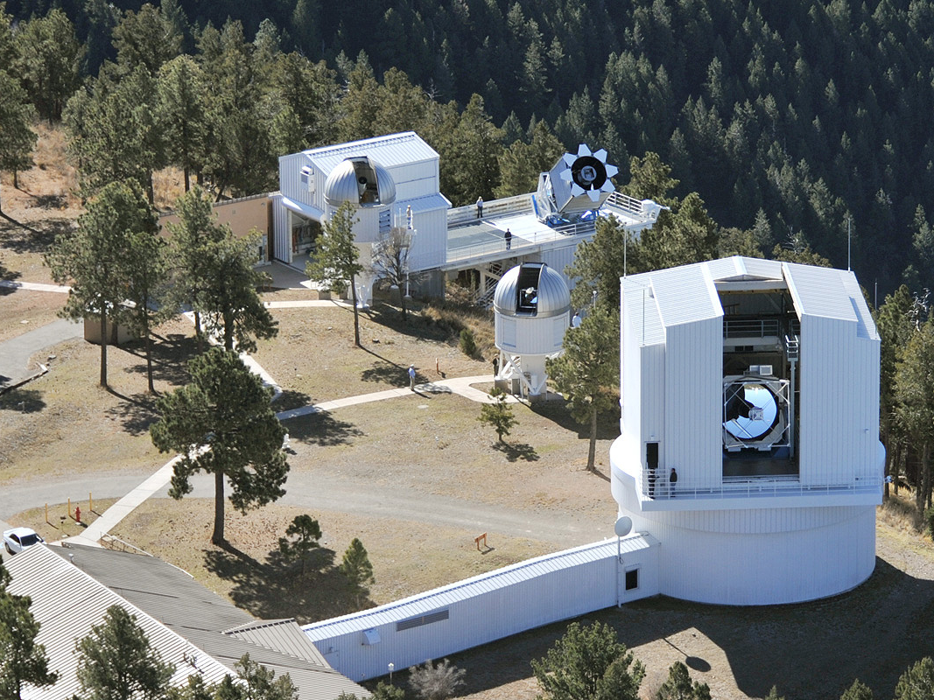
MaNGA: Mapping Nearby Galaxies at APO
袁方婷，上海天文台
2015.4.30，嘉定

Slide 2
大纲
IFS简介
MaNGA巡天综述
巡天目前状况
MaNGA Kentucky会议概要
Ancillary program: Observing close pairs using MaNGA
总结

Slide 3
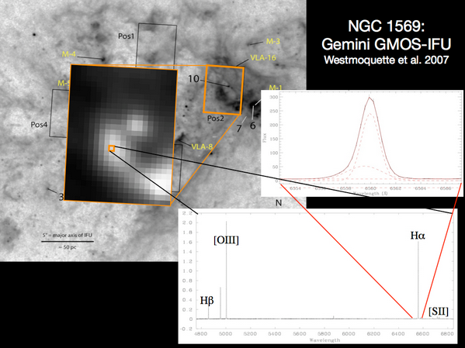
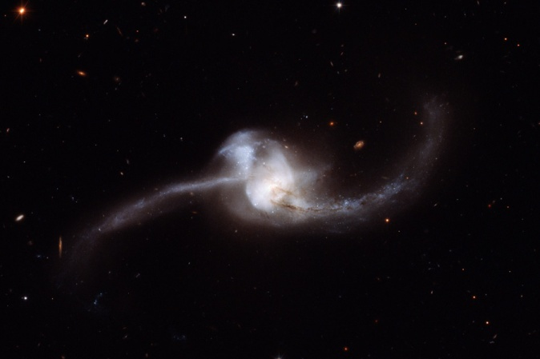
IFS简介
IFS: integral field spectroscopy
二维光谱，具有空间分辨的光谱

Slide 4
巡天综述
MaNGA科学：关键问题
The growth of galaxies
How does gas accretion drive the growth
How do mergers, stellar accretion, and instabilities build spheroidals
The death of galaxies
What quenches star formation? Its environment dependence
The birth of galaxies
How is angular momentum distributed and transferred during formation
How do various mass components assemble and influence one another

Slide 5
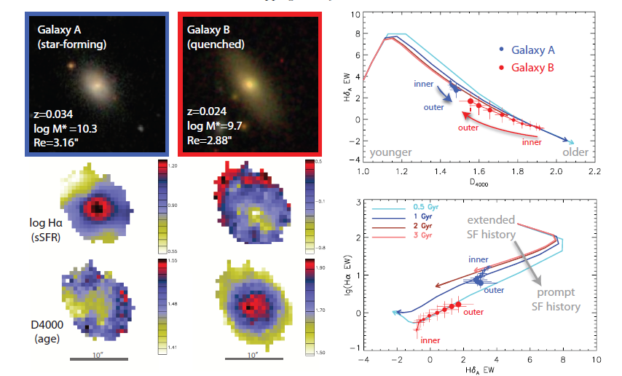

Slide 6
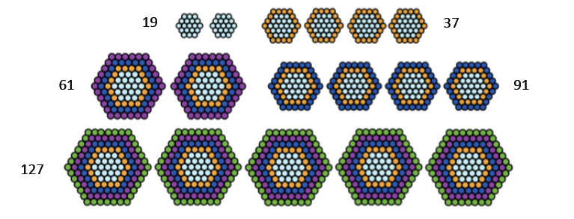
仪器
MaNGA IFU
Bundle sizes from 19 fibers to 127 fibers + minibundles (7 fibers), radius from 12’’ to 32’’
Different IFUs distributed in the plate with the ratio 2:4:4:2:5

Slide 7
仪器
光谱仪
Two SDSS/BOSS spectrographs
near-UV到near-IR覆盖
Blue side: R~1400 at 4000A to R~2100 at 6000A
Red side: R~1800 beyond 6000A, peaks at R~2600 near 9000A
Sky subtraction
Sky fibers close to the Science IFU

Slide 8
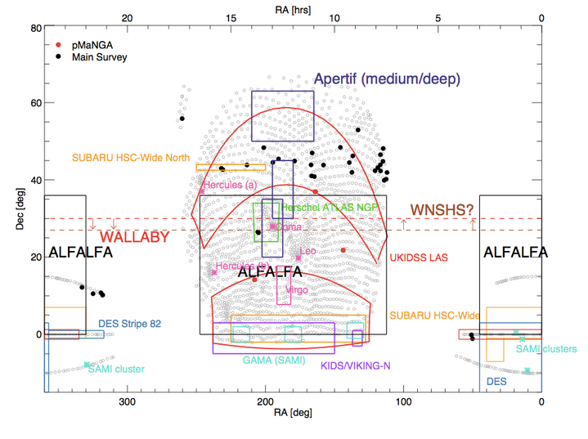
样本设计
10,000 galaxies across ~4000 deg², redshift z~0.03
Flat stellar mass distribution with M > 10⁹ Msun
Smallest galaxy diameter sampled by at least 5 spatial bins
Primary Sample: 67%, spatial coverage to 1.5 Re，Secondary Sample: 33%, spatial coverage to 2.5 Re
No size or inclination cuts
3-hour exposures with effective 9-pt dithering
Spatial sampling of 1-2 kpc
Per-fiber S/N=5-10 per angstrom at 1.5 Re

Slide 9
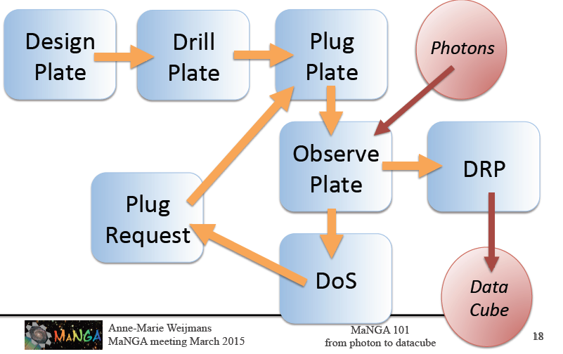
MaNGA Data Cube
Data cube contains reduced data for further analysis
How to get a data cube

Slide 10
Current state of the survey
https://trac.sdss.org/wiki/MANGA/Data/Access#MPL-3
MPL-3 has just been released:
67 plates - 720 galaxies, 407 stellar library stars. Fully reduced intermediate products, fiber row-stacked spectra (RSS), and datacubes

Slide 11
Current Science groups

Slide 12
Kentucky会议总结
自MaNGA巡天开始后第一次会议

Slide 13
State of the survey (Till April)
We are behind the schedule!!

Slide 16
数量只有预期的一半

Slide 18
We voted in the meeting, and now it is decided that the exposure time will be reduced for each observation run

Slide 19
Data Reduction Pipeline (DRP) Outline
David Law

Slide 20
DAP:
Kyle Westfall

Slide 21
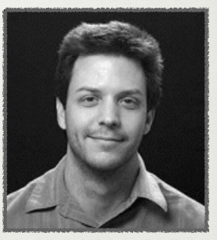
Brian Cherinka
CAS and SAS
MaNGA will develop more interactive and user friendly SAS and CAS interface
Every user can tell their requirements

Slide 24
Ancillary program: Observing galaxy close pairs using MaNGA
MaNGA main sample
Missing close pairs
Quite often, only one galaxy of a pair is included in the main sample
We proposed an ancillary program to observe a sample of galaxy pairs using MaNGA IFU

Slide 25
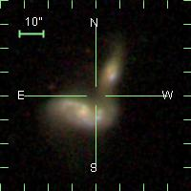
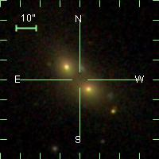
Strategy
Pairs using 1 IFU (Yuan, Shen et al.)
For pairs with small angular separation, it is possible to cover both galaxies in a pair using 1 IFU
Pairs using 2 IFUs (Lin, Keenan et al.)
For pairs with larger angular separation, 2 IFUs are necessary to cover both galaxies
377 pairs are already included in the main sample
MaNGA Target
MaNGA Target

Slide 26
Current projects on MaNGA pairs
Stellar populations and star formation history in galaxy pairs (with multiwavelength data)
Control sample from Maria’s isolated galaxies
SFR enhanced by merging process (Lin Lihwai’s group)
JCMT follow-up: plan
Gas content from CO observation
Control sample can be taken from Cheng Li and Ting Xiao’s proposal about the CO-followup of MaNGA galaxies

Slide 27
Take away
MaNGA will observe ~10,000 galaxies in 6 years, providing spatially resolved spectra of these galaxies to 1.5Re
DRP to datacube, science can started from datacube
Data access from SAS and CAS

Slide 28
Thank you for your attention!

Slide 30
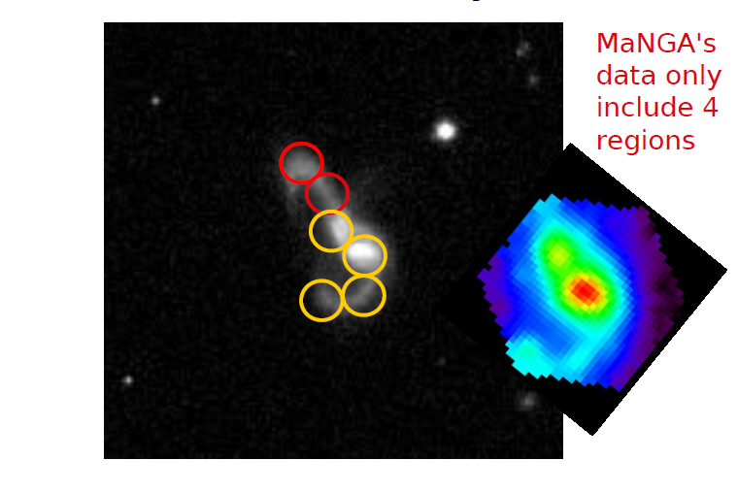
Exploratory Work on Mrk848: Multiwavelength photometry data

Slide 31
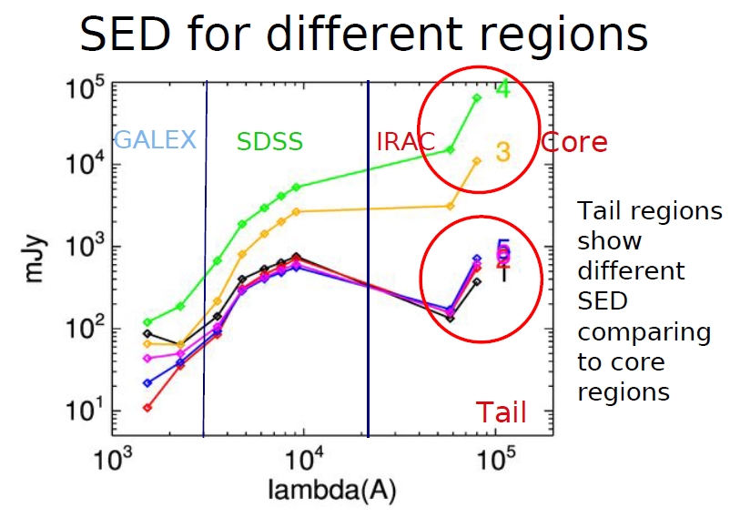

Slide 32
